Slide 1
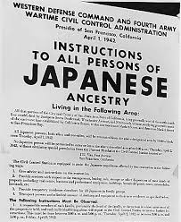
World War II
UEQ: Could World War II have been prevented?
UEQ: What kind of sacrifices does war require?

Slide 2
LEQ: What led to the United States’ involvement in World War II?
Bellwork: On a white board write down what you believe the term internment means. Where have you heard this term about?

Slide 3
https://www.youtube.com/watch?v=A61yDOCyFR8

Slide 4
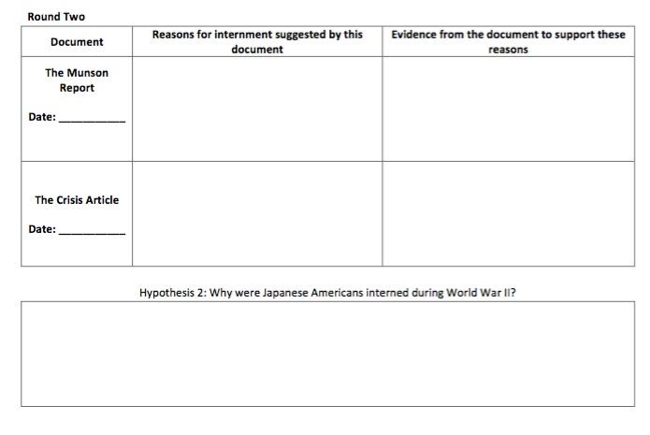

Slide 5
