Slide 1
Please find your new Seat!

Slide 2
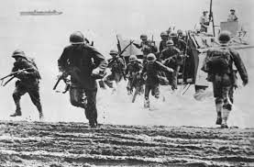
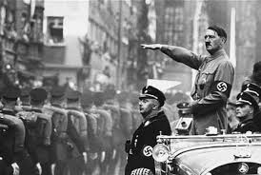
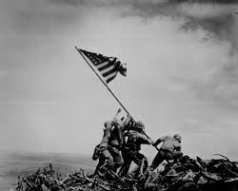
World War II
UEQ: Could World War II have been prevented?
UEQ: What kind of sacrifices does war require?

Slide 3
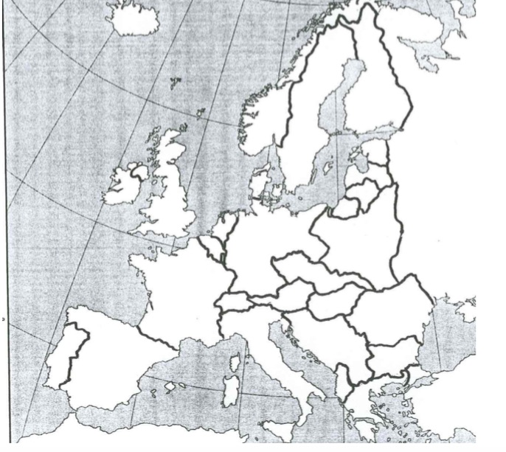
LEQ: How did European nations try to prevent war?
Label the following countries:
Germany, France, Belgium, The Netherlands, Denmark, Great Britain, Ireland, Soviet Union, Italy, Switzerland, Spain, Portugal Czechoslovakia, Austria, Hungary, Poland, Norway, Finland, Sweden, Estonia, Latvia, Lithuania, East Prussia, Yugoslavia, Romania, Bulgaria, Albania, Greece, Turkey

Slide 6
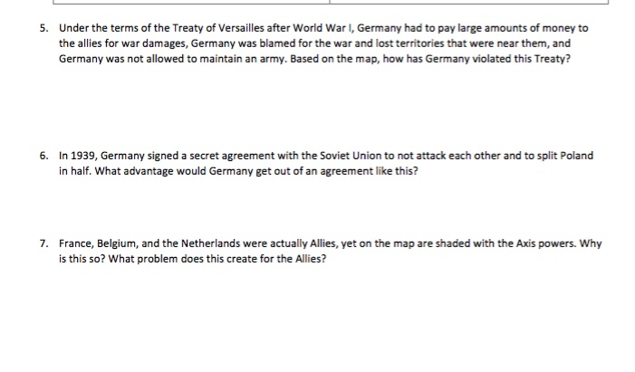

Slide 7
LEQ: What economic and political conditions following World War I encouraged dictatorship?
Find your map from yesterdays class! If you were not here you need to get a blank one and fill it in!
https://www.youtube.com/watch?v=Objoad6rG6U

Slide 8
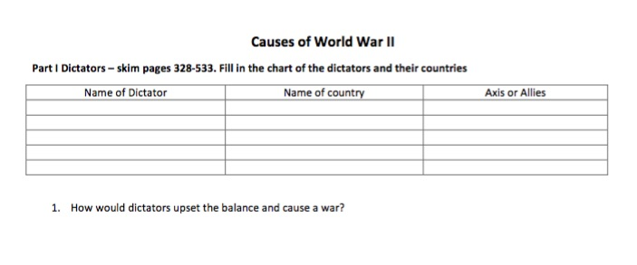

Slide 10
