Slide 1
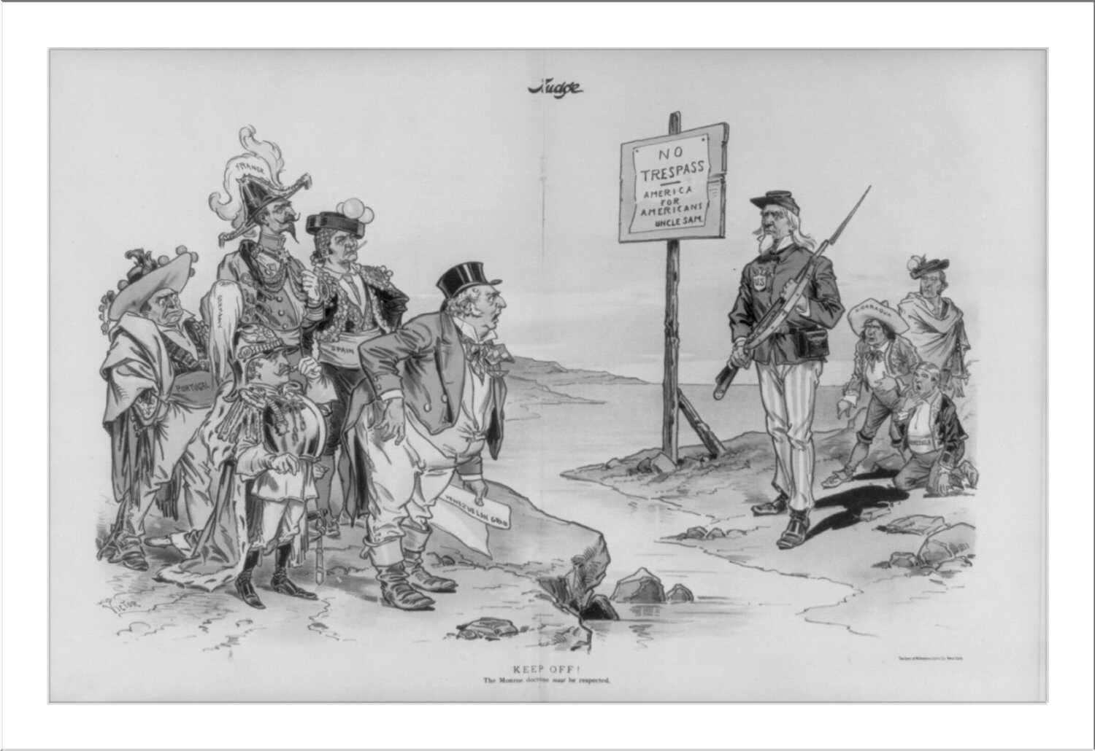
P
O
S
E
S

Slide 2
Why American Imperialism?

Slide 3
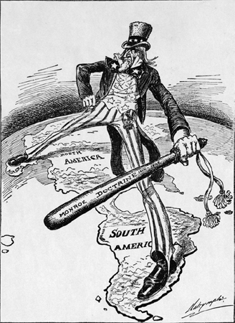
The Monroe Doctrine
In the early 1800s, Spain and Portugal's central and South American Countries were declaring their independence
President James Monroe wanted to keep Europe out of the Americas
Monroe warned the European countries to stay out of the Americas or they would have to deal with the U.S.

Slide 4
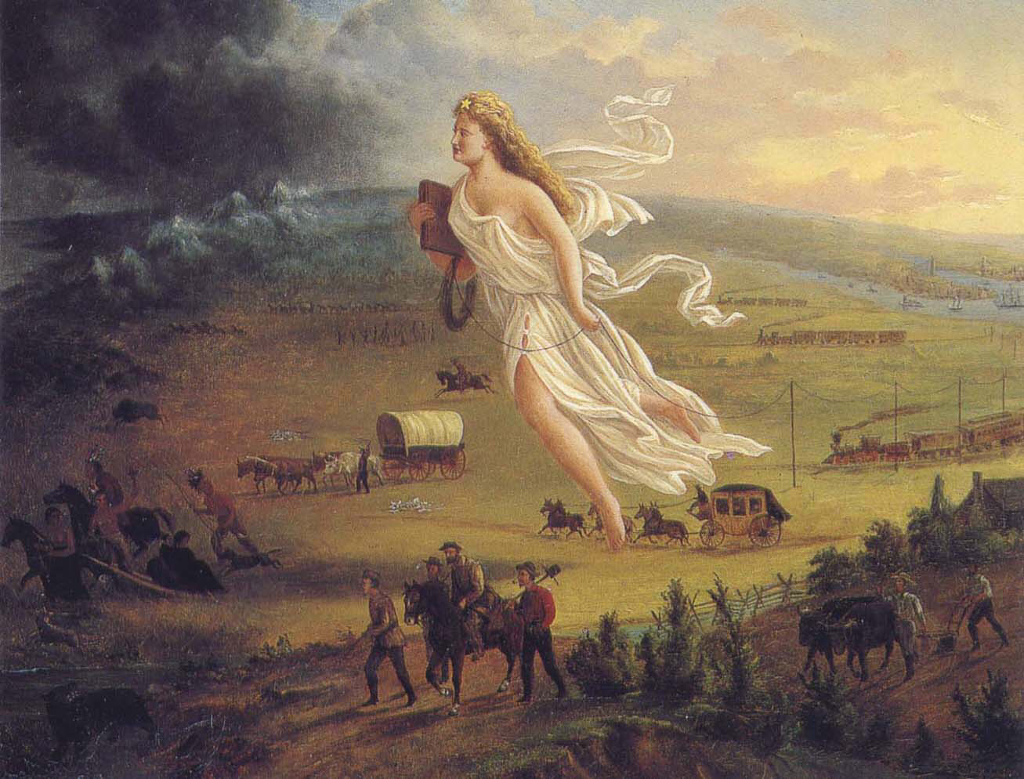
Manifest Destiny
As Americans began moving west, they began to feel this was their destiny
Some began to feel God wanted the U.S. To expand to the Pacific and beyond
This led to taking over Mexican and Native American Territory

Slide 5

Pan-Americanism
Pan-Americanism is a movement that seeks to create relationships among the countries of the Americas
This became an extention of The Monroe Doctrine to continue the U.S. Protection over the Americas
This led to various organizations to create unity amongst North and South America

Slide 6
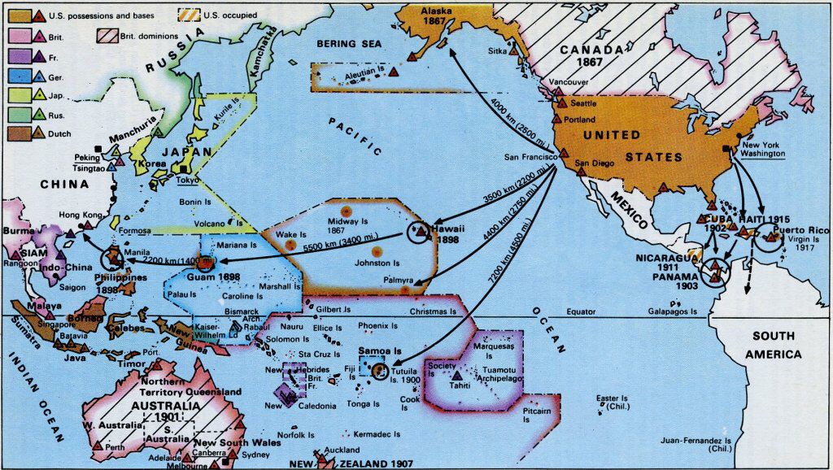
Turner Thesis
Idea that democracy was formed on the American Frontier
Settlers had to make their own way, rules, religion, society, etc…
When the frontier ran out, many looked for new frontiers overseas to continue this spread of democracy

Slide 7
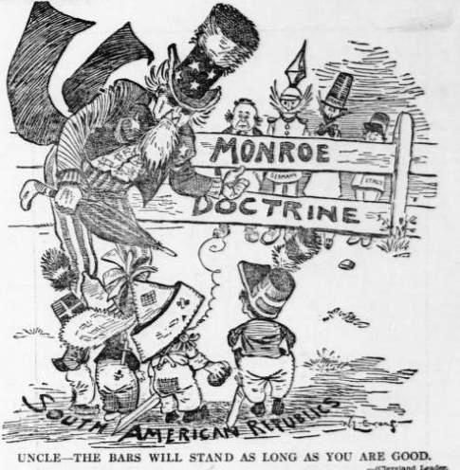
People
Objects 2-3 most important
Setting
Engagement (action)
Summary (P.O.V.)

