Slide 1
LEQ:Why did the progressives support the woman suffrage movement?
Write down your LEQ and HW
Place your Reform HW out to go over. We will take notes on all the reforms that were a choice.

Slide 2
Bell Work
Directions: Think about anything you know about this women. Who was she? What did she do?
THINK-PAIR-SHARE

Slide 3
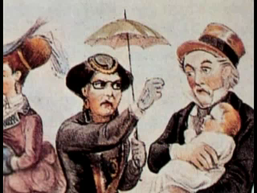

Slide 4
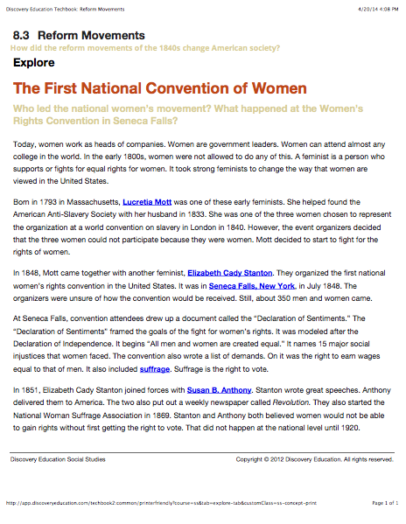
Whole group read and annotate!

Slide 5
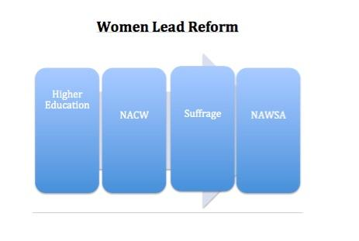
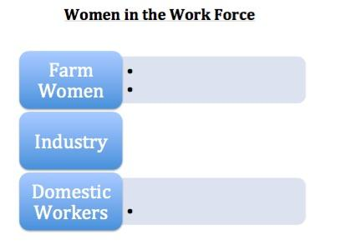
Split the class Notes
Directions: You will be given one side of notes and a reading. Either women lead reform or women in the work force. Complete your side of notes and be ready to share out using a stand-up hand-up pair-up.

Slide 8
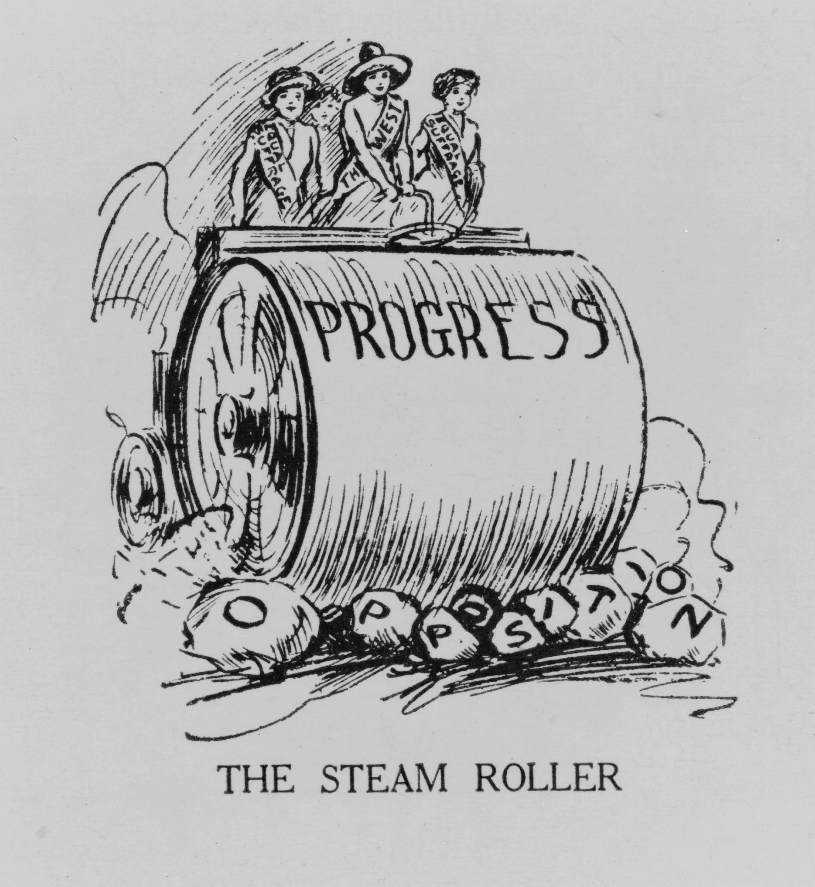
Homework
P = people
O = object
S = setting
E = Engagement
S = Summary

