Slide 1
The Vietnam War

Slide 2
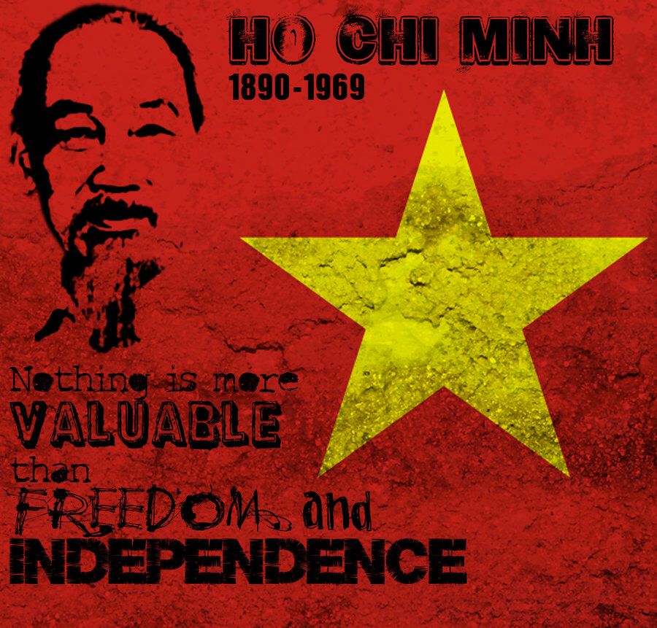
Why Vietnam?
The French controlled Vietnam through both world wars, which didn’t sit well with the leader of the nationalist party, Ho Chi Minh.
Ho Chi Minh led the defense against Japan during World War II and declared independence when Japan surrendered
France refused to recognize the independence and a Civil War erupted, with the Soviet Union and China supported the now communist Ho Chi Minh
When France lost despite U.S. helping fund the war, the Geneva Accords peace treaty split Vietnam into communist north and Imperial South

Slide 3
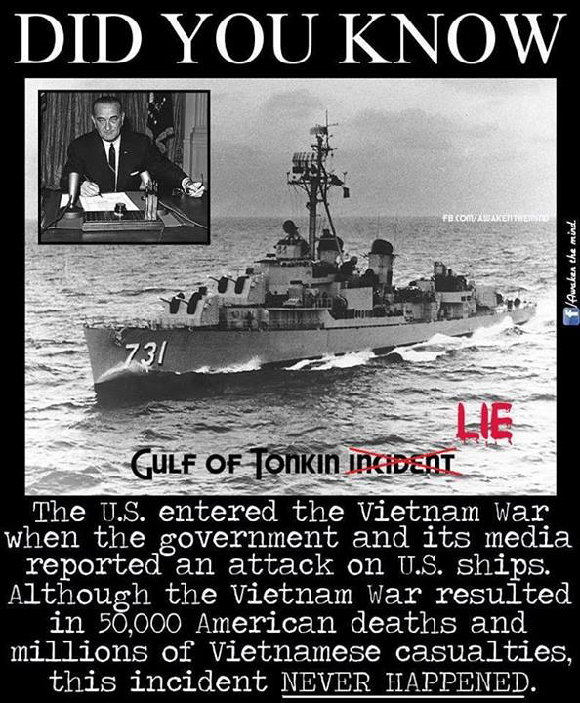
The U.S. Jumps in
The U.S. was worried communism would continue to spread, an idea that became known as the "domino theory," so the U.S. began supporting the South Vietnam Emperor
The emperor was brutal, which led to a communist revolt and guerrilla warfare. The U.S. Sent support, but the emperor was assassinated by his own generals
President Johnson then announced that a U.S. ship had been attacked, which would later turn out to be North Vietnam defending their waters
Under the Gulf of Tonkin Resolution, President Johnson was granted broad powers to deal with North Vietnam, which he used to escalate a war in Vietnam

Slide 4
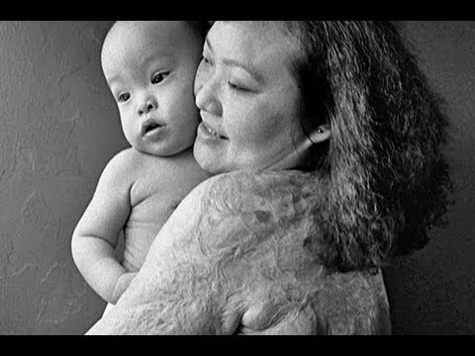
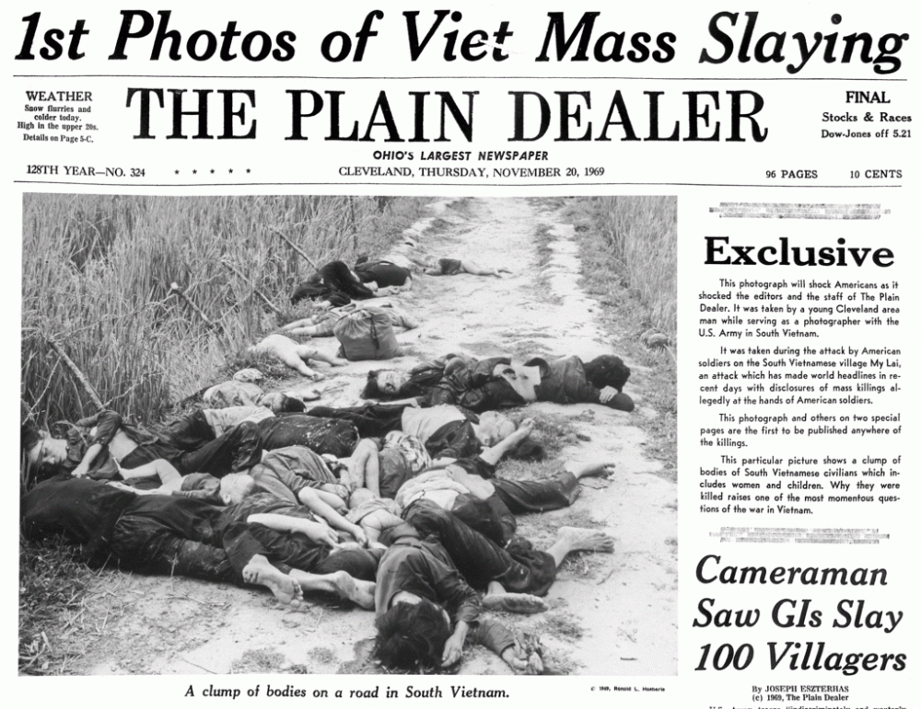
Combat in Vietnam
The U.S. used intense bombing runs using napalm, which stuck to the skin, and cluster bombs to do horrific damage
To take out the thick jungle, a herbicide called Agent Orange was created, killing the jungle, but also harming American soldiers who were exposed to the harmful chemicals
Despite these tactics, the soldiers were often under attack from secret tunnels, vietnamese citizens working for the Vietcong, and a brutal climate
This led soldiers to attack villages and kill unarmed men, women, and children such as the My Lai massacre

Slide 5
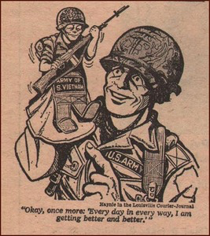
The U.S. Loses the War
The Vietcong did a surprise attack called the Tet Offensive on the Vietnamese New Year which led to major victories for The Vietcong
New President Nixon continued the war but turned the fighting over to the South Vietnamese under the new policy called Vietnamization
A cease fire was negotiated in 1973, yet fighting continued until North Vietnam defeated the south and united under Ho Chi Minh's rule
This would lead congress to pass the War Powers Act to limit the President's ability to commit troops in overseas fighting without approval

Slide 6
People:
Objects:
Setting:
Engagement:
Summary:

