Slide 1
Warm up
Directions: On a whiteboard explain, If a country says they are staying neutral in a war, what does that mean? Give an example if possible.
Video Clip: https://app.discoveryeducation.com/techbook2:concept/view/guidConceptId/7897CB27-DAB6-40E7-ADFD-462246ADA91C/guidUnitId/629EF8D5-9668-403D-B4BE-3A46A62DA651#/tab=explore-tab&page=7&subTab=explore-main-tab

Slide 2
The United States enters the War
LEQ: What led to the United States’ involvement in World War II?

Slide 3
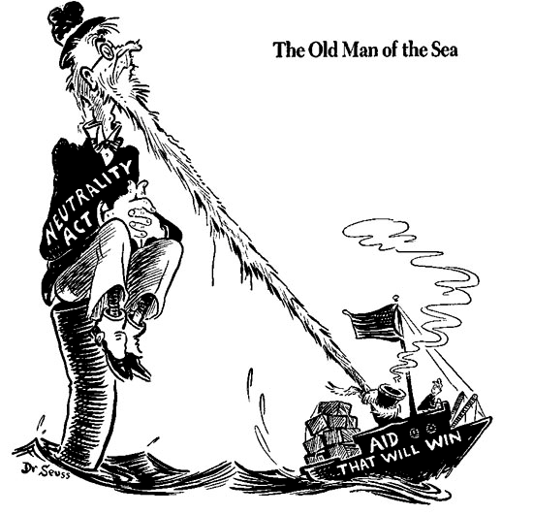
America stays Neutral
After World War I, the United States returned to isolationism to stay out of Europe’s problems
Because of the Great Depression, the United States was unable to get involved in world affairs (no $$)
Congress passed a series of neutrality acts in hopes of avoiding being dragged into the war
The Neutrality Act stopped the sale of weapons to countries at war, loans to nations at war, and Americans traveling on the ships of nations at war

Slide 4
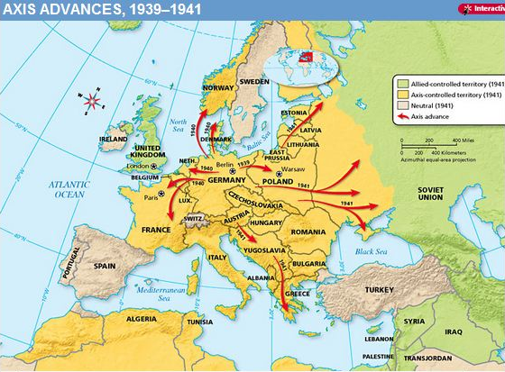
The U.S. Becomes less Neutral
As Japan and Germany started invading other countries, Roosevelt wanted to do more to help
The U.S. began a program called Cash-and-Carry where countries could pay cash and transport U.S. goods themselves
Next the U.S. began a program called Lend-Lease in which the U.S. would loan war goods to countries who were vital to U.S. Defense
Cash-and-Carry and Lend-Lease were designed to help the Allied countries without actually getting into the war

Slide 5
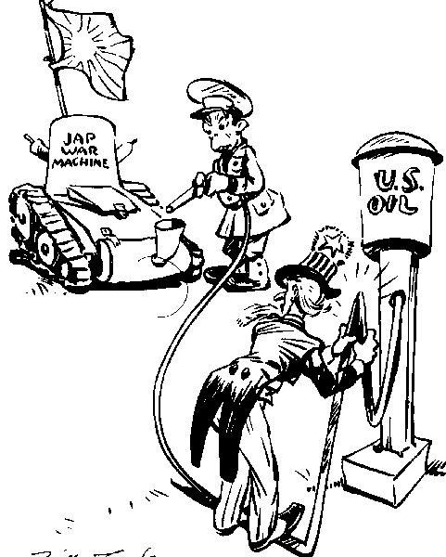
U.S. – Japanese Tensions
Despite Japan invading China, the U.S. continued to trade with them, including oil that Japan desperately needed
When Japan continued to invade southern Asia, the U.S. stopped trade unless Japan withdrew
Japan refused and invaded oil fields so they would have their own oil supply
To keep the U.S. out of the war Japan began planning a surprise attack to destroy the U.S. navy in the Pacific

Slide 6
The Days leading up to Pearl Harbor
https://app.discoveryeducation.com/techbook2:concept/view/guidConceptId/7897CB27-DAB6-40E7-ADFD-462246ADA91C/guidUnitId/629EF8D5-9668-403D-B4BE-3A46A62DA651#/tab=explore-tab&page=9&subTab=explore-main-tab

Slide 7
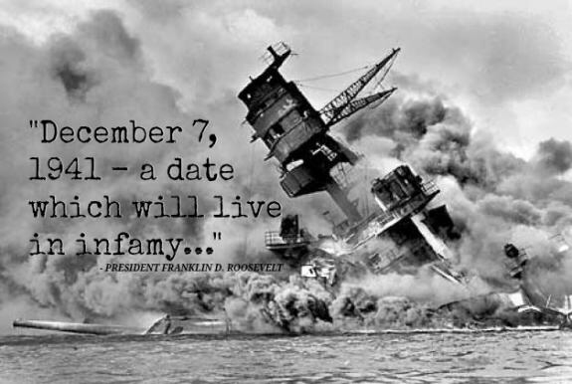
Japan attacks Pearl Harbor
Japanese leaders believed an attack on Pearl Harbor would knock out the U.S. for a short time
The attack destroyed ships and aircraft and killed over 2,000 men
https://app.discoveryeducation.com/techbook2:concept/view/guidConceptId/7897CB27-DAB6-40E7-ADFD-462246ADA91C/guidUnitId/629EF8D5-9668-403D-B4BE-3A46A62DA651#/tab=explore-tab&page=8&subTab=explore-main-tab
However, they did not destroy the repair yards, refueling stations, or aircraft carriers.
Roosevelt asked for and received a declaration of war on Japan the next day

Slide 8
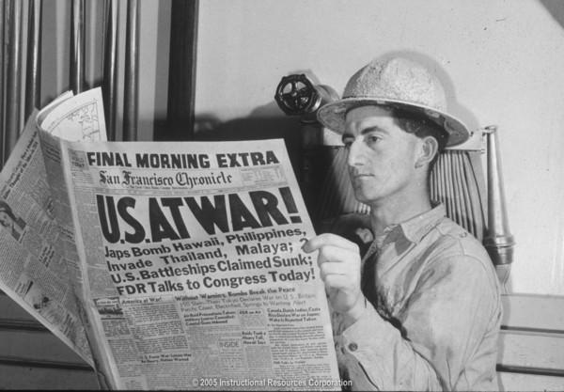
Summary
Do you think the United States did the right thing in trying to stay out of the war? Give two reasons, from your notes, to support your answer.

