Slide 1
The Pacific Theater
The War Against Japan

Slide 2
Japan takes the Pacific
After Pearl Harbor, Japan took over several nations in the Pacific, including Hong Kong, Burma, the Solomon Islands, and Singapore
The biggest victory was in the Philippines, where Japanese soldiers forced the surrender of American Forces at Bataan in 1942
These soldier were forced to undertake an 80 mile “Bataan Death March” in the heat
The soldiers were given no food and little water while being beaten and bayoneted. This caused the death of several thousand troops

Slide 3
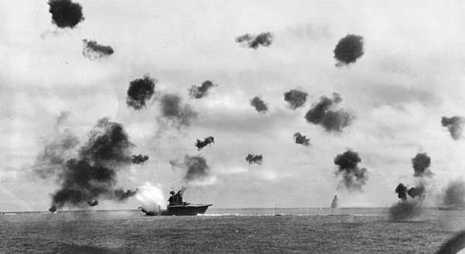
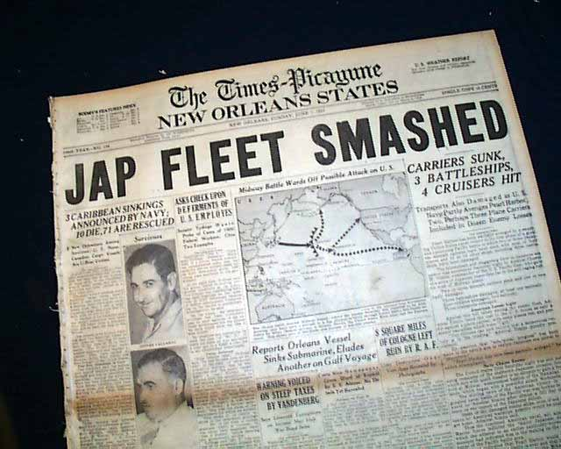
America fights back
In April of 1942, James Doolittle led a daring raid on Tokyo leading 16 bombers to attack the city, later known as Doolittle’s Raid
Next the Americans helped the Australians stop the Japanese advance towards Australia in the Battle of the Coral Sea
America then broke Japanese codes and discovered the next attack would be at Midway Island, northwest of Hawaii
The Americans caught the Japanese off guard and destroyed their planes before they could take off. This caused massive destruction to the Japanese fleet

Slide 4
The Allies go on the Offensive
The Battle of Midway was a turning point in the war, allowing the Allies to begin “Island Hopping,” a tactic where you go island by island taking back territory.
Next the allies attacked Guadalcanal, a gruesome 6 month fight their soldiers referred to as the Island of Death
After successful Island hopping campaigns the Allies landed on the Philippines for the Battle of Leyte Gulf
The Japanese through their entire fleet at the Allies. Despite using Kamikaze attacks, the Japanese were decimated at Leyte Gulf and their fleet was destroyed

Slide 5
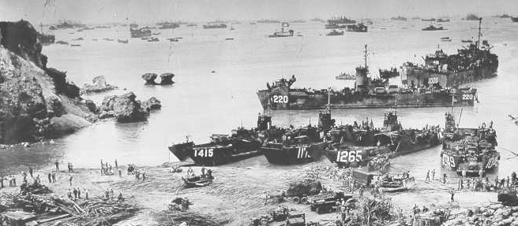
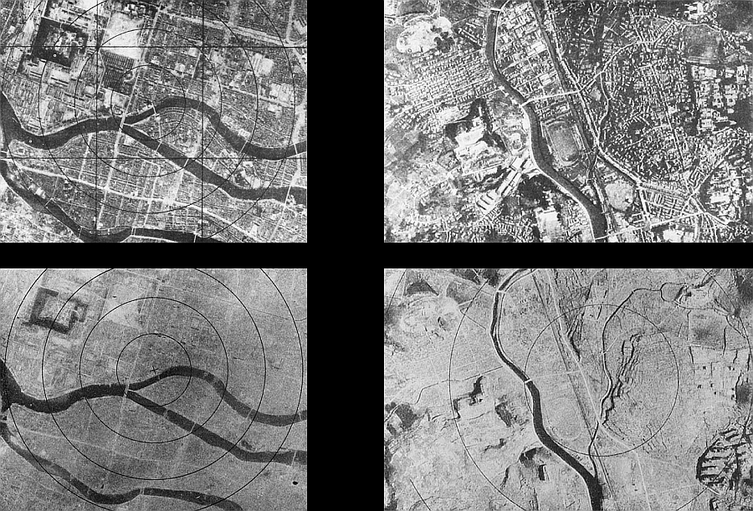
The Final Push
Next was taking the island of Iwo Jima, the most heavily defended spot on earth. Of the 20,700 Japanese troops stationed, only 200 would survive
Next was Okinawa. The Japanese Kamikaze attacks sunk over 30 ships and killing over 5,000 sailors. When the fighting on land was over 7,600 Americans had died,
However, 110,000 Japanese had died defended the island. Many feared an attack on the Japanese mainland would lead to millions of deaths.
The U.S. demanded unconditional surrender. When Japan refused, the U.S. dropped the Atomic Bomb causing Japan to surrender

Slide 6
Back in Europe
The Allies put Nazi leaders on trial for war crimes, using the camps as evidence at the Nuremberg Trials
The Nazis tried to defend themselves by saying their were following orders
They were, however, found guilty and either put to death or given life in prison

Slide 7
Summary
People:
Objects:
Setting:
Engagement:
Summary:

