Slide 1
Social issues at the end of the 20th century

Slide 2
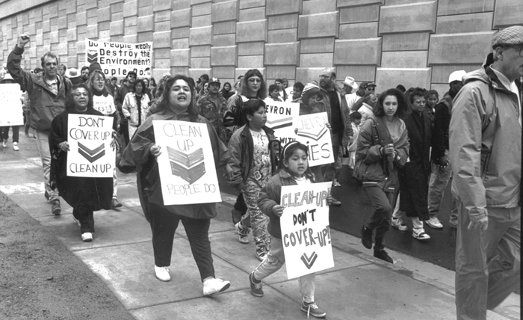
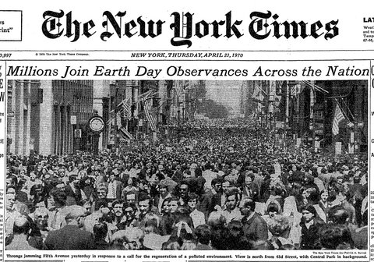
Environmentalism
In the 1960s concern over pollution and overusing the land caused an increase in environmental activism
On April 22, 1970, the U.S. celebrated Earth Day to bring awareness to the problems of pollution, toxic waste, and dwindling resources.
This led to the creation of the Environmental Protection Agency (EPA), the Clean Water Act, and the Clean Air Act
New debates have started over nuclear energy, causes of global warming, and the balance between conservation and business interests.

Slide 3
Summary 1
What role should the government play in protecting the environment?

Slide 4
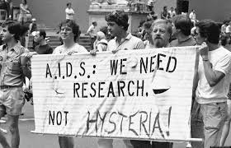
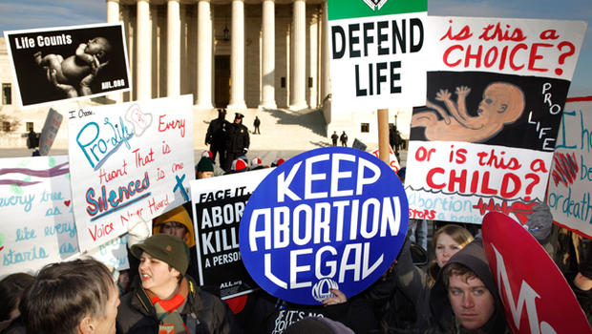
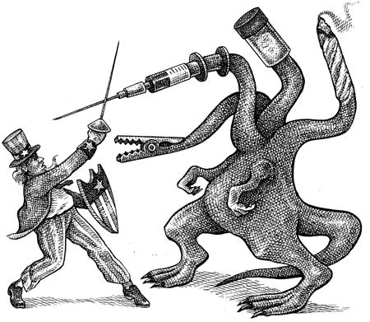
Health concerns
The biggest health concern of the period was AIDS, a virus that destroys the immune system causing infections and rare cancers
Aids spread rapidly without a cure in sight, causing panic over prevention, and fear over how it is transmitted
Concerns over the legalization of abortion led states to fight for and win the ability to restrict abortions within their state.
While politicians waged a War on drugs, others continue to argue for there legalization to help reduce the power of gangs

Slide 5
Summary 2
What role should the government play in a persons personal decision about their own health?

Slide 6
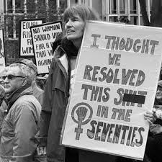
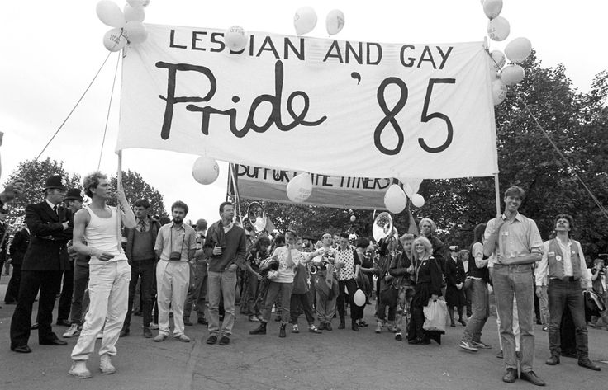
The Fight for Rights
Despite women getting jobs in public office and seeing an overall increase in work, they are still underrepresented and underpaid compared to men.
African Americans also made gains in jobs and public office, but as with women they are underrepresented and underpaid compared to whites
Latinos have become the fastest growing minority group, who have fought for bilingual programs and immigration reform
The gay rights movement struggled to battle the stigma of AIDS and religious backlash to earn more and more protections under state and national laws

Slide 7
Summary 3
What role should the government play in the treatment of minority groups?

Slide 8
Final summary
A fourth social issue is education. How might improvements in the educational system help solve some of these other social problems? Choose at least two social issues to help explain your answer.

