Slide 1
How did the United States become an industrialized society after the Civil War?
Unit #2

Slide 2
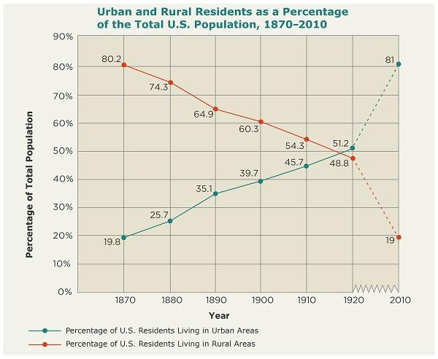
LEQ: · What types of problems developed due to the rapid growth of urban areas?
Directions: On a whiteboard answer the three questions using the graph.
1.)What year shows more people living in cities than on farms?
2.) What percent of people lived in the cities in 1870?
3.) What percent of people lived in the cities in 2010?

Slide 3
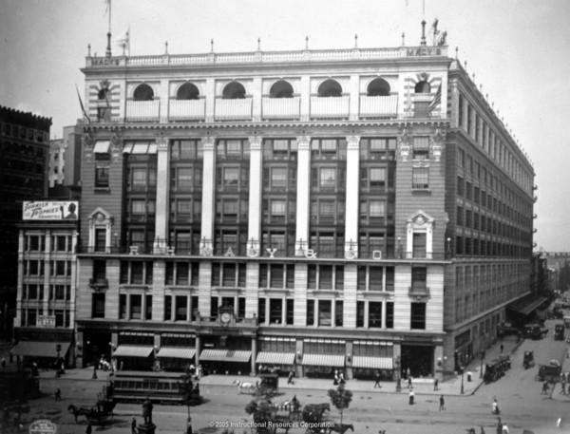
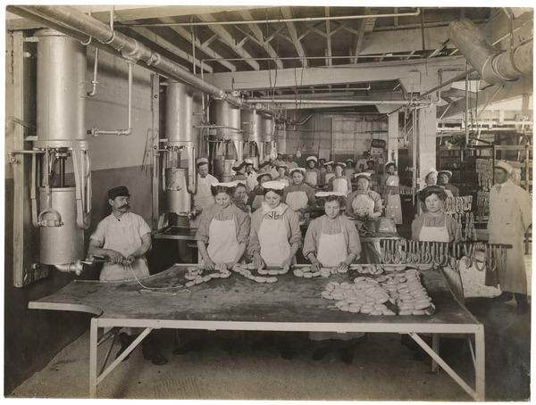

Slide 4
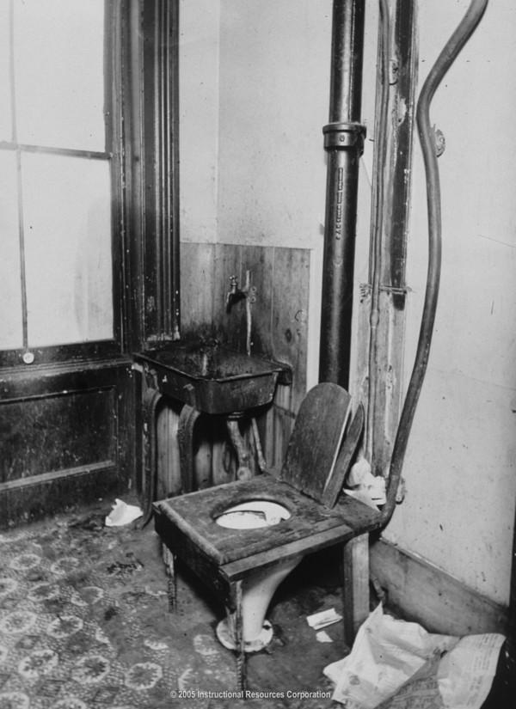
#1 Tenements | #2 Disease
#3 Crime | #4 Jacob Riis

Slide 5
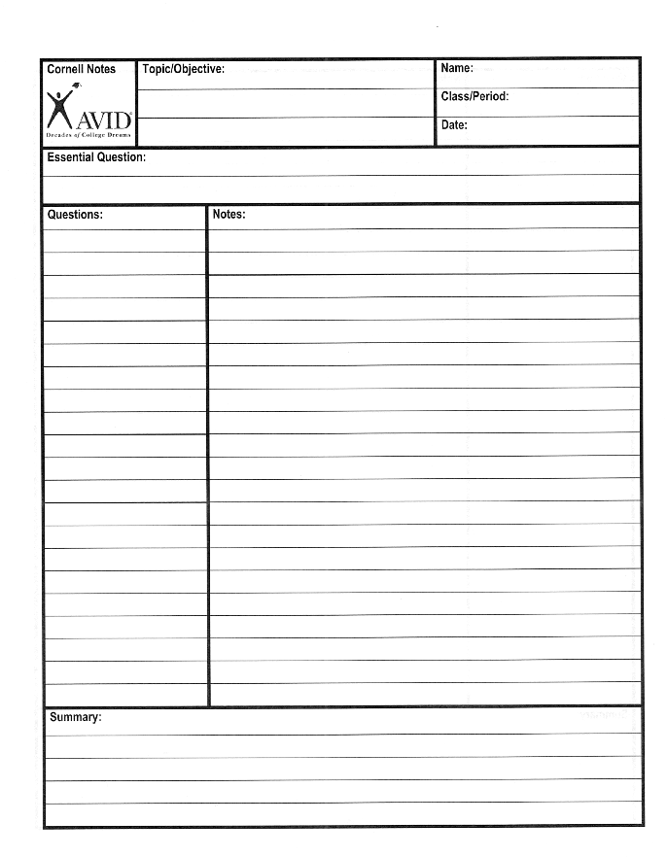
Powerpoint Lecture and Notes

Slide 6
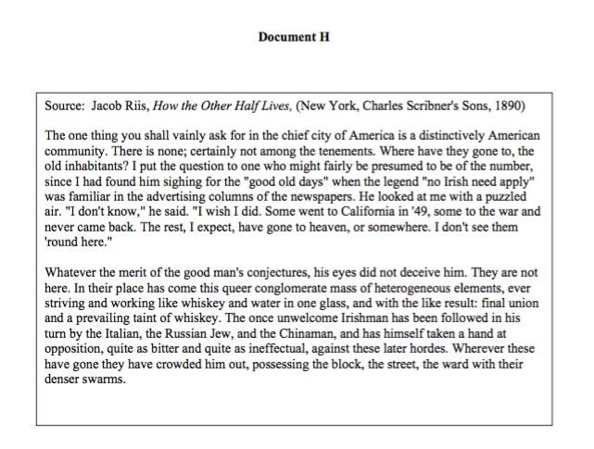
Homework - DBQ - How were Immigrants Viewed?

Slide 7
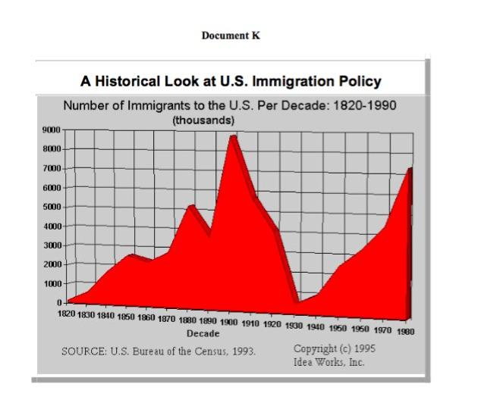
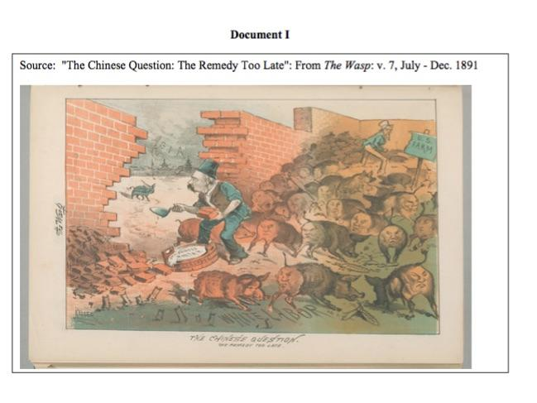
Homework - DBQ - How were Immigrants Viewed?
Directions -
Use Documents I, and K to add if immigrants were viewed as positive or negative as they came to America. You are looking for evidence from the documents.

