Slide 1
How did the United States become an industrialized society after the Civil War?
Unit #2

Slide 2
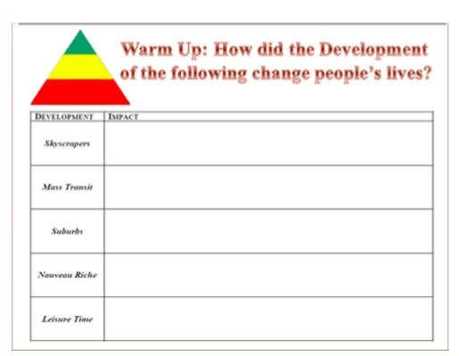
LEQ: · How do you think life in big cities was different from life on farms and in small towns?
Why did nativists oppose immigration?
I am not collecting your DBQ! You need it for tonight's HW!
Directions: Try your best to complete the graphic organizer. How did people’s lives change as they moved into cities?

Slide 3
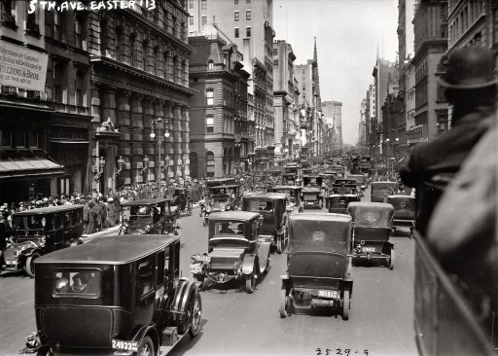
City Video
https://app.discoveryeducation.com/player/view/assetGuid/c1e3d50d-fdd7-434d-9531-6f408f4d3e9b

Slide 4
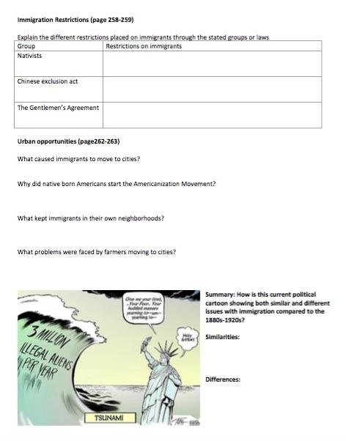
Graphic Organizer and Reading

