Slide 1
How did the United States become an industrialized society after the Civil War?
Unit #2

Slide 2
LEQ: ·How did European immigrants of the late 1800s change American society?
· How were the experiences of Asian immigrants different from those of Europeans immigrants?
Bellwork:
Write down your LEQ and HW
Read the letter you received when you walked in the door.
Mark up the letter and determine if the person migrated for “push” reasons or “pull” reasons.

Slide 3
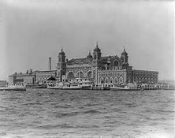
Video
https://app.discoveryeducation.com/player/view/assetGuid/215c7eb3-06ba-4d9e-b57c-3e7f2196b1e7

Slide 4
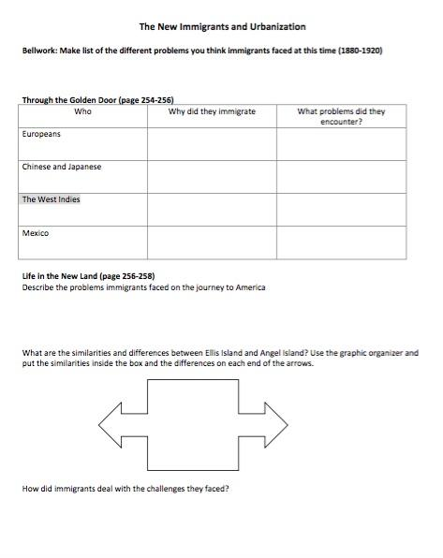
Graphic Organizer and Reading

Slide 5
