Slide 1
How did the United States become an industrialized society after the Civil War?
Unit #2

Slide 2
LEQ:·· Why did workers try to form unions in the late 1800s?
How did outside sources effect the success and failures of the unions?
Bellwork:
Write down your LEQ and HW
Have your Rockefeller HW out to hand in!
Think of a time when you really hated your job or a job you had to do. On a whiteboard explain why you hated the job and what you did about it.

Slide 3
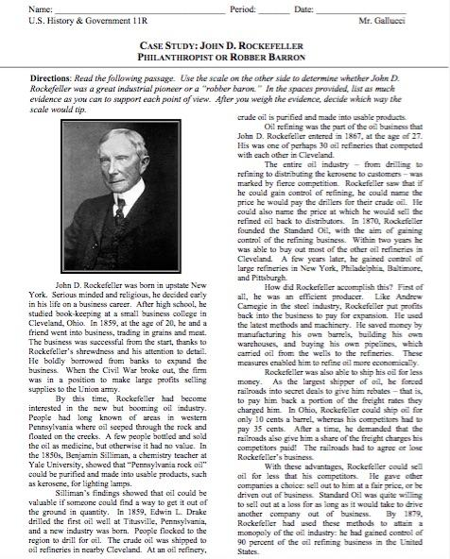
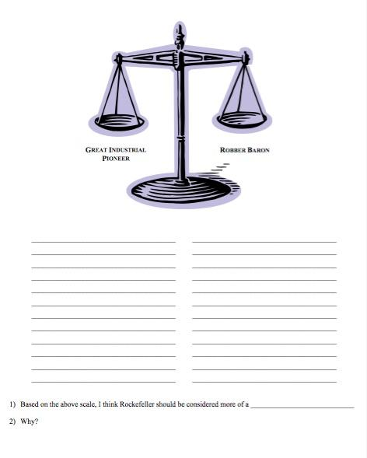
Homework Hand In

Slide 4
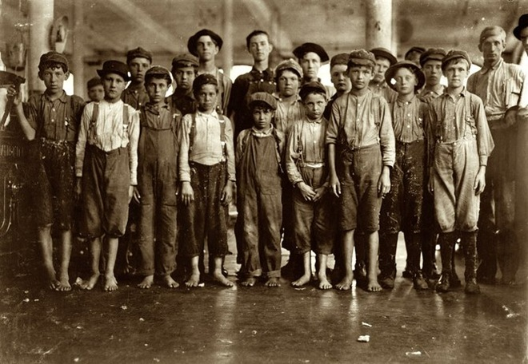
Repetitive Tasks
Simple jobs and tasks over and over again
Less skilled work
Low Wages
Many could not afford food. Women and children were paid less than men and immigrants were paid even less.
Long Hours
6-7 days a week
10-15 hours a day
Workers face many problems!
Child Labor
Paid Less
1:5 children worked, no school
As young as 8 years old.
Living Conditions
Crowded, slums
Many bosses controlled town officials and the rent prices.
Unemployment
If you were injured you would become unemployed. No health insurance or pension

Slide 5
Unions =
Knights of Labor
Terrence Powderly
Skilled and unskilled
Women welcomed
Minorities welcomed
Does not last long, collapses after a riot
American Federation of Labor
Made up of different unions; carpenters, shoemakers, etc.
Samuel Gomper
Improving conditions and wages
Hostile to immigrants
Did not welcome women or african americans

Slide 6
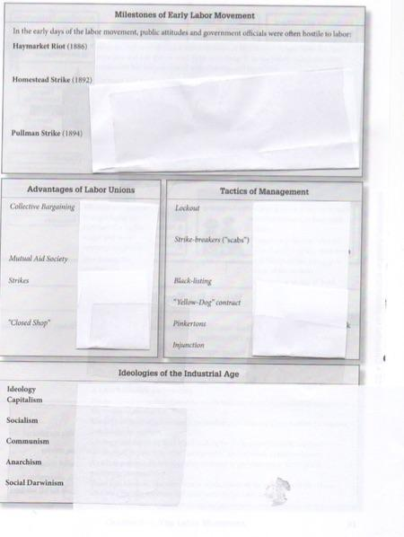
Chapter 5 - The Labor Movement
Directions:
Use chapter 5 in the “Gateway to US History” textbook to complete the graphic organizer. The main ideas are given, you are looking for the details.

Slide 7
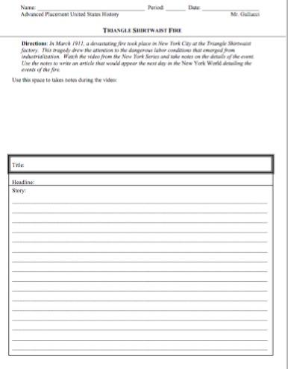
Find this sheet!

Slide 8
https://www.youtube.com/watch?v=-Ur1iVAmlYY

Slide 9
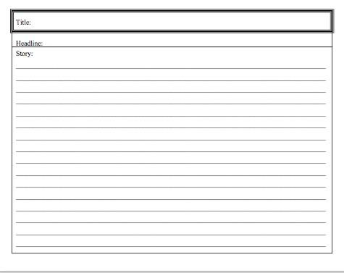
Homework
Directions:
Use your notes from class, the video, and any internet resources, to create a newspaper headline that might have appeared the day after the day after the factory fire. Be Historically accurate!

