Slide 1
How did the United States become an industrialized society after the Civil War?
Unit #2

Slide 2
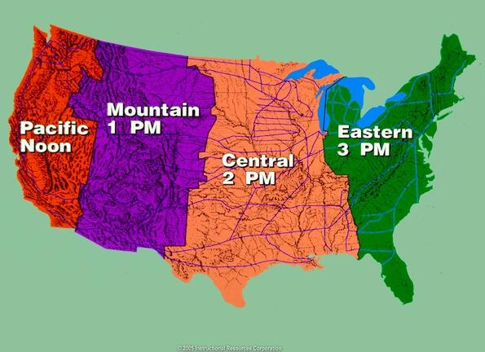
LEQ:· How did the transcontinental railroad transform the West?
How did government grants to build railroads result in large-scale corruption?
Bellwork:
Write down your LEQ and HW
Take out your multiple choice HW
Complete the timezone map using the blank map and crayons. Draw in the transcontinental Railroad too!

Slide 3
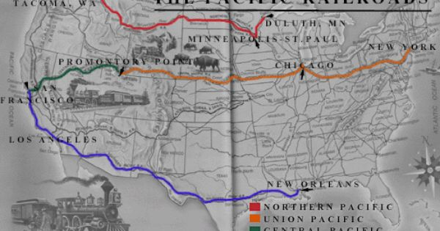
https://www.youtube.com/watch?v=Spgdy3HkcSs
Start at 9:00 Minutes!

Slide 4
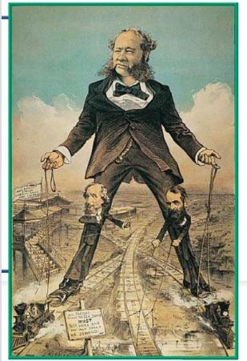

Slide 5
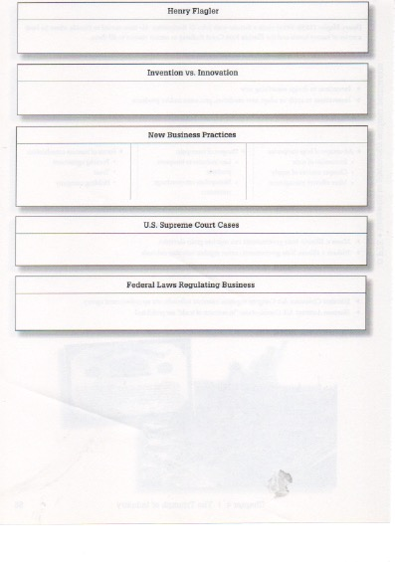
Page 72 - 74

Slide 6
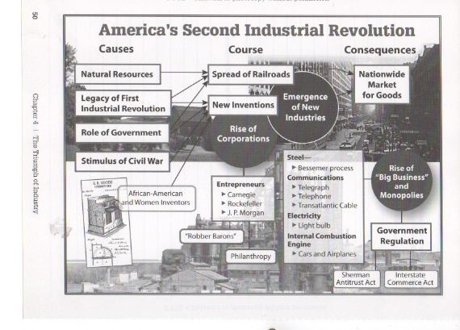

Slide 7
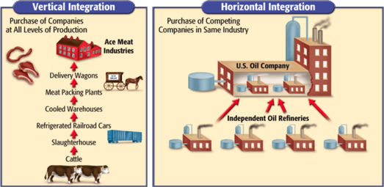

Slide 8
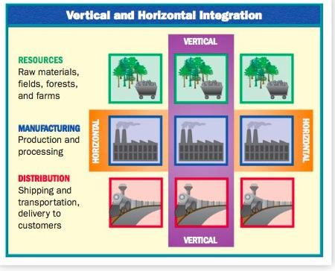
Summary
Using the notes provided, and the graph, write a paragraph explaining the difference between vertical integration and horizontal (monopoly) integration. What type of business model is better? How would you make more money?

Slide 9
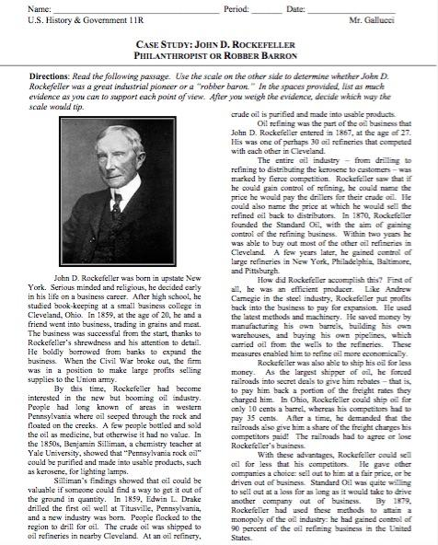
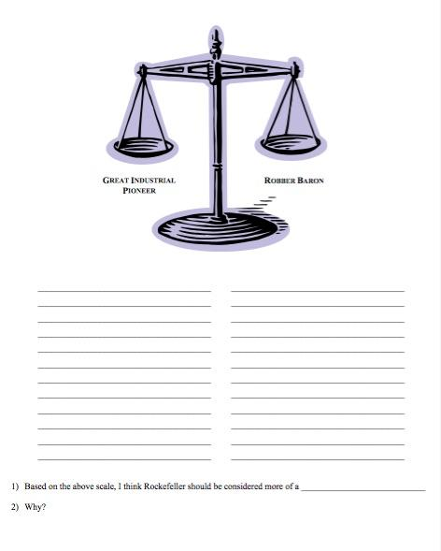
Homework

