Slide 1
How did the United States become an industrialized society after the Civil War?
Unit #2

Slide 2
LEQ: Why was the United States successful at industrialization?
Who were the significant inventors of the Industrial Revolution?

Slide 3
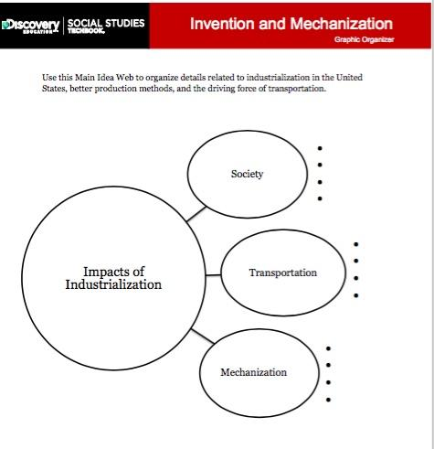
Directions: With a partner you are looking for how Industrialization impacted society, transportation, and mechanization. You are looking for three examples for each.
What is Industrialization?
Mrs. Nyiel will model Society!

Slide 4
Assembly Line

Slide 5
Inventors Notes!

Slide 6
LEQ:· How did laissez-faire economics promote industrialization?
Compare and Contrast the First and Second Industrial Revolutions.
On a white board, look up the term “Laissez-faire” and draw an image to represent what it means.

Slide 7
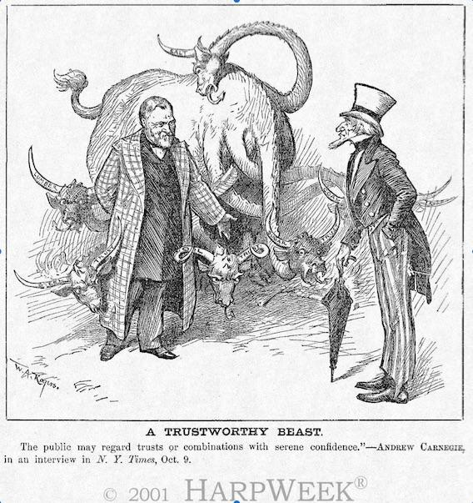

Slide 8
Second Industrial Revolution Teacher Notes

Slide 9
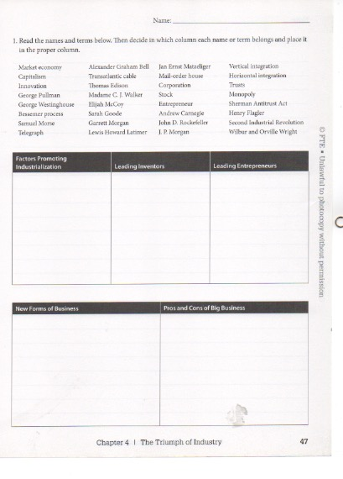
Find this sheet!

Slide 10
Gateway to United States History
Chapter 4 - The Triumph of Industry
Directions: With your shoulder partner, or small group, read over chapter 4 starting on page 61. As you get to a term in bold determine if it goes in factors, inventors, entrepreneurs, new forms of business, or pros and cons.
Factors = Caused Industrialization / made it happen
Inventors = Created things
Entrepreneurs = invested / ideas / donated
New Business = new ways to earn money
Pros and cons = positives and negatives

Slide 11
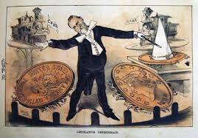
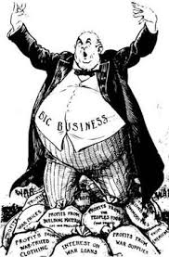
All of this leads to the...
GILDED AGE

Slide 12
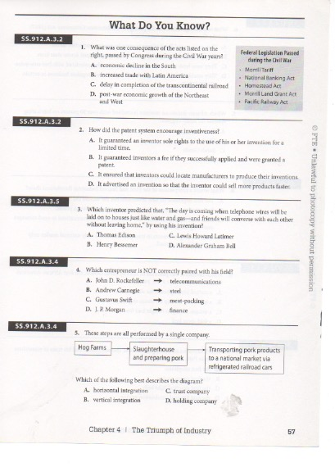
Homework

