Slide 1
How did the United States become an industrialized society after the Civil War?
Unit #2

Slide 2
LEQ: What were the costs and benefits of settling on the Great Plains?

Slide 3
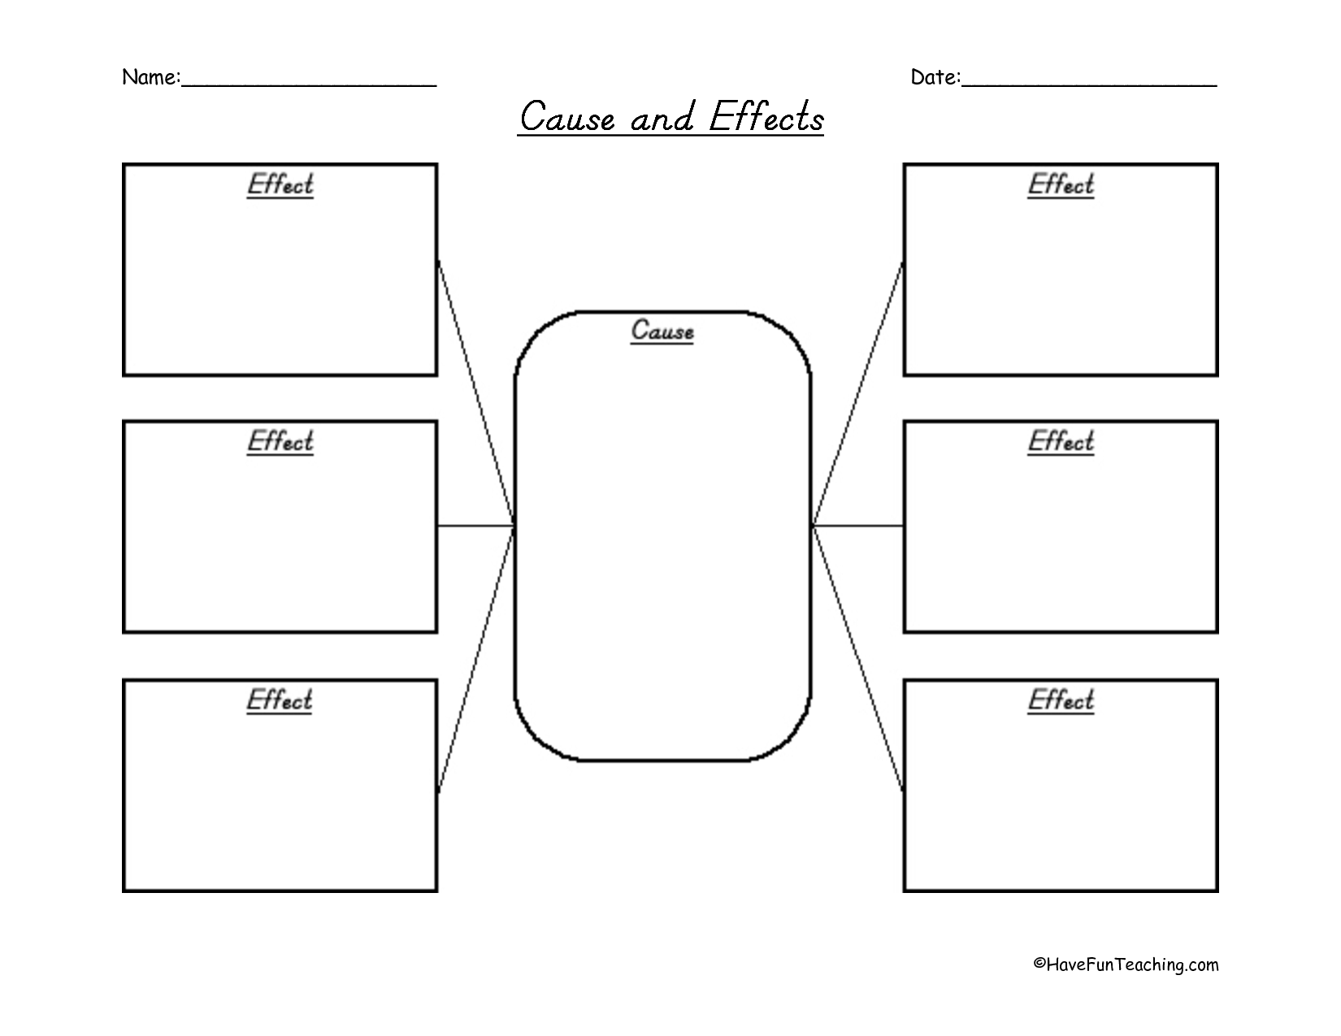

Slide 4
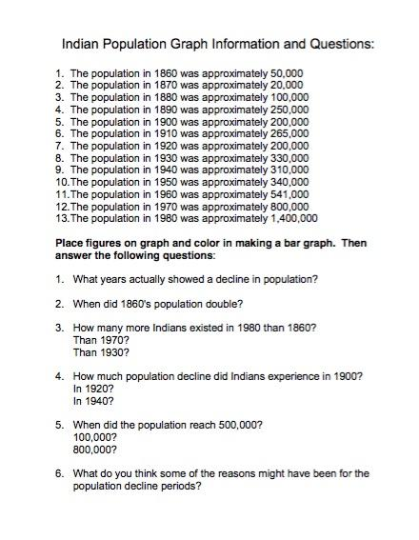
Native American Population Graph

Slide 5
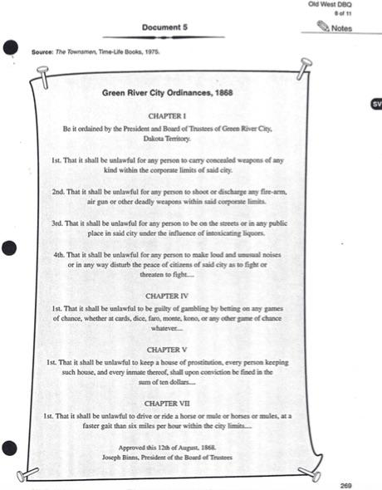
Homework
Directions: Complete box #3 in your graphic organizer. Use documents #4 and #5 to look for two pieces of evidence that the West was violent.

