Slide 1
How did the United States become an industrialized society after the Civil War?
Unit #2

Slide 2
DBW Homework Review – Background
Directions: Use the background reading “How violent was the West”. Write down two pieces of evidence in your box #1 graphic organizer.

Slide 3
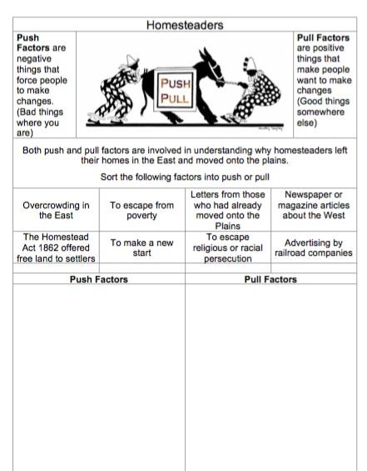
LEQ: What encouraged settlers to move west to the Great Plains?
Bellwork:
Write down your LEQ and HW.
Have your Test Corrections and West Graphic Organizer out to turn in.
Complete the push and pull Bellwork in the sleeve! Why did people migrate to the West?

Slide 4
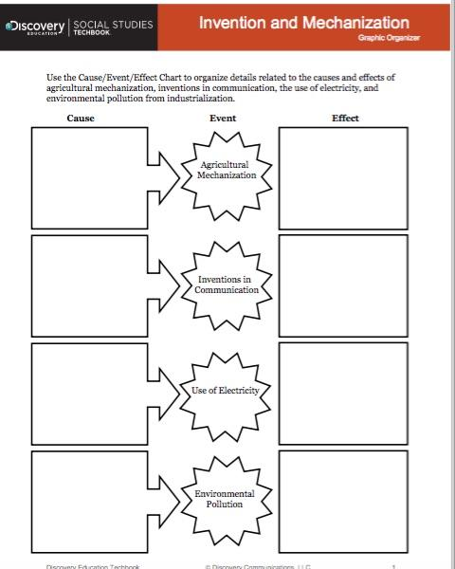
Cause and Effect
Directions: Watch a five minute video clip about agriculture. You are looking for the cause, or why farmers needed new equipment. You are also looking for the effect, or what happened after with the new equipment.
https://app.discoveryeducation.com/techbook2:concept/view/guidConceptId/0B1144A7-B5BF-495B-AA3D-02BF050B5080/guidUnitId/CE59790A-DCE5-4E96-8AE2-AAF5281ABAFE#/tab=explore-tab&page=7&subTab=explore-main-tab

Slide 5
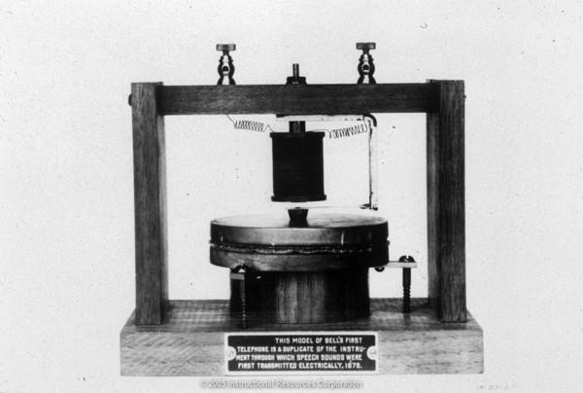
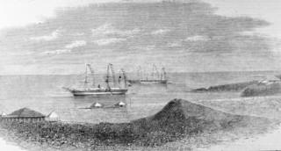
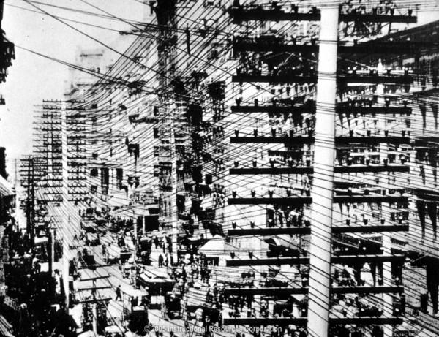
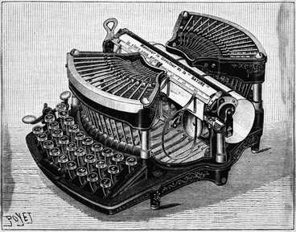
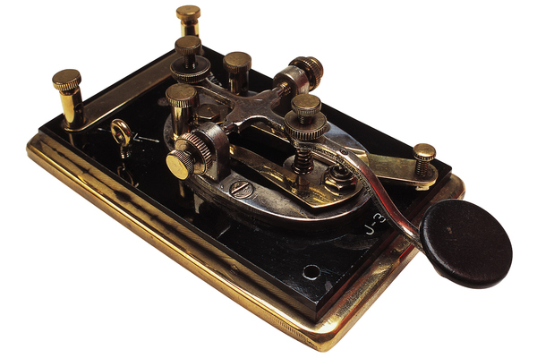
Communication
https://app.discoveryeducation.com/techbook2:concept/view/guidConceptId/0B1144A7-B5BF-495B-AA3D-02BF050B5080/guidUnitId/CE59790A-DCE5-4E96-8AE2-AAF5281ABAFE#/tab=explore-tab&page=8&subTab=explore-main-tab

Slide 6
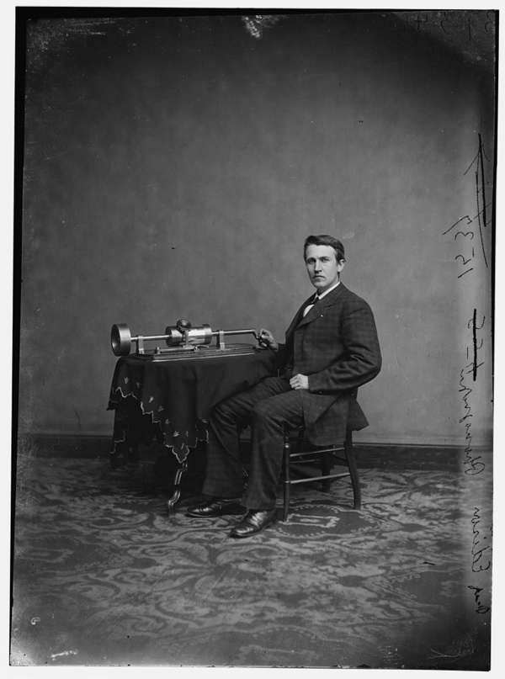
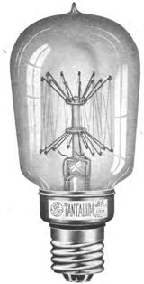
Electricity

Slide 7
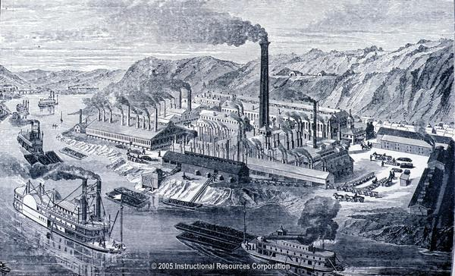
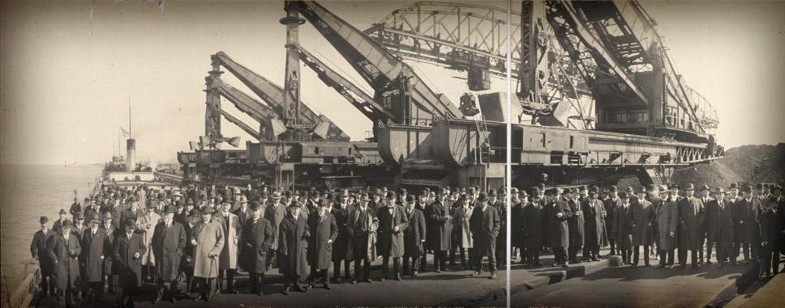
Industrialization
https://app.discoveryeducation.com/techbook2:concept/view/guidConceptId/0B1144A7-B5BF-495B-AA3D-02BF050B5080/guidUnitId/CE59790A-DCE5-4E96-8AE2-AAF5281ABAFE#/tab=explore-tab&page=10&subTab=explore-main-tab

Slide 8
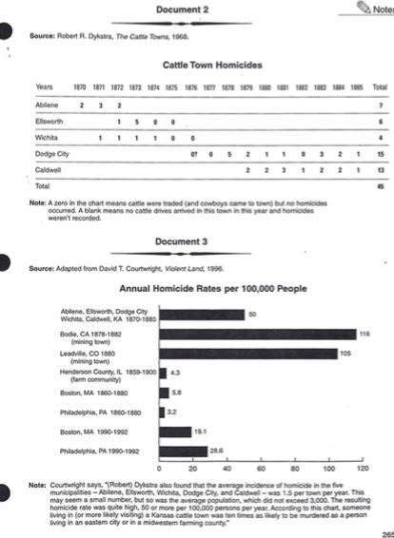
Homework
Directions: Use documents #1, #2, and #3 to look for evidence that the West was violent. Write down two pieces of evidence in your box #2 graphic organizer.

