Slide 1
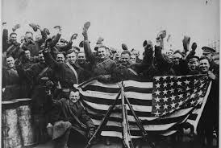
Post WWI and Roaring 20’s
Review Day

Slide 2
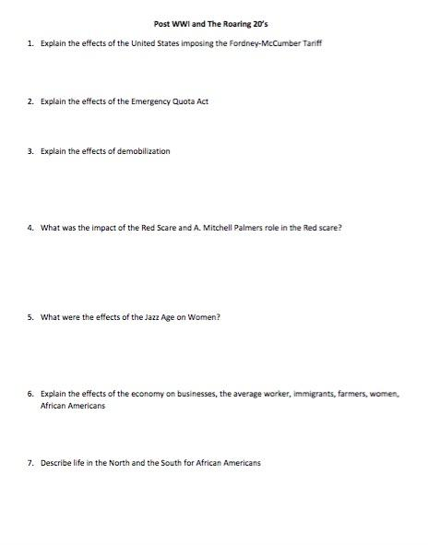
Review Agenda
Alone for 5 Minutes with no resources.
Alone for 5 Minutes with resources.
With a partner for 8 minutes.
With Mrs. Nykiel for 5 minutes.

Slide 3
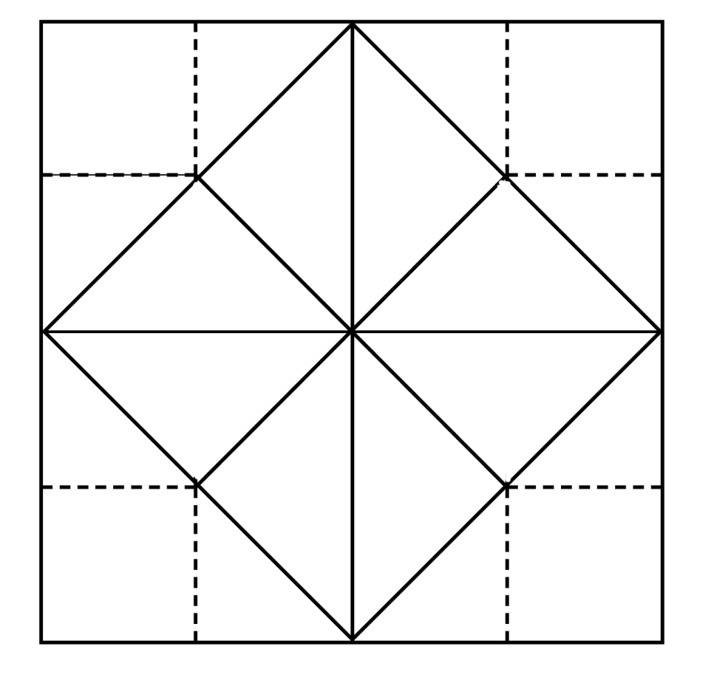
Review Square
Directions:
Choose any four questions and create a review square. This is a game that can be used to ask a question, then review the answer. Choose any four questions to write, and then answer.
Worth 5 Bonus Points on tomorrow's test!

Slide 4
