Slide 1
Progressivism
Unit #3
UEQ: How did social movements shape politics and reform in the late 19th and early 20th centuries?

Slide 2
LEQ: What problems did social-welfare progressives attempt to reform?
Write down your LEQ and HW
Place your HW out to be collected.
On a whiteboard remind yourself of the word progressivism, and what it was all about!

Slide 3
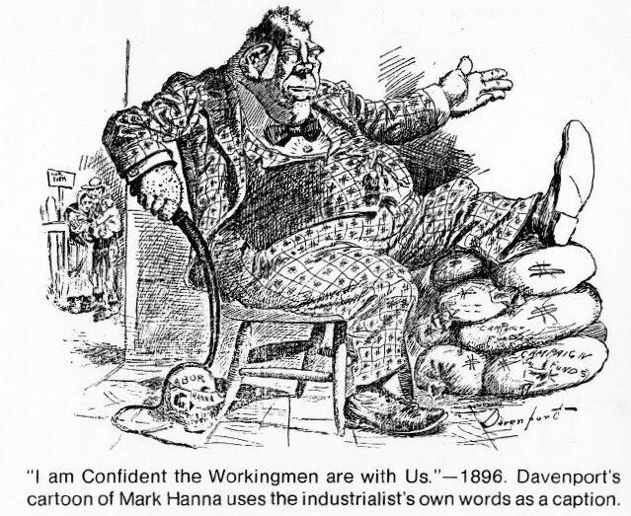
POSES
People
Objects
Setting
Engagement
Summary

Slide 4
