Slide 1
Progressivism
Unit #3
UEQ: How did social movements shape politics and reform in the late 19th and early 20th centuries?

Slide 2
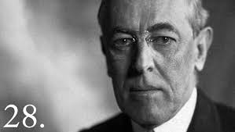
LEQ: How did Wilson earn the respect of progressives?
Write down your LEQ and HW
Place your Venn diagram HW out to be collected.
On a white board write down two things that Wilson did as president.
https://app.discoveryeducation.com/techbook2:concept/view/guidConceptId/6EB5A523-7494-4A97-A0FB-0AD6306AC5C1/guidUnitId/CCA7E5C4-C735-451C-856E-10CEA889214E#/tab=explore-tab&page=4&subTab=explore-main-tab

Slide 3
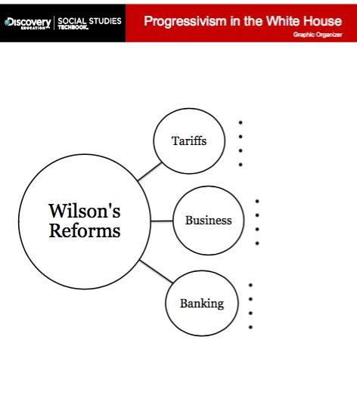
Find this Sheet
What is Progressivism again?

Slide 4
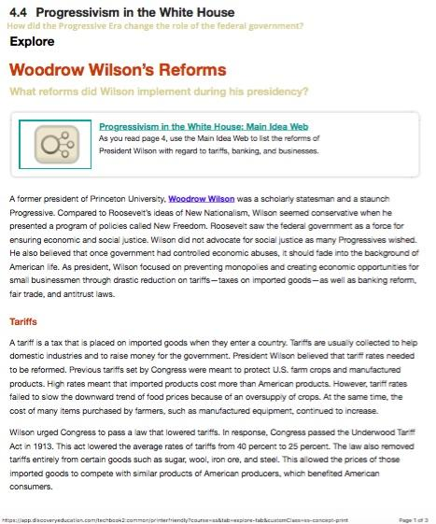
Reading and Questions
Directions:
Use the reading to find what Wilson did as President. How did he change tariffs, banks, and businesses for the better?

Slide 5
“Progressive” Amendments to the Constitution
16th Empowered Congress to impose a federal income tax. Eliminated a need to rely on tariffs to raise money. Money for the construction and maintenance of roads, bridges, and schools. | 17th The amendment establishes that two U.S. senators will represent each state, and the voters of each state will directly elect these senators. Tries to end corruption.
18th Gone Dry! imposed the national prohibition of alcohol Reformers believed that establishing prohibition would significantly lessen problems such as family abuse, crime, and absenteeism. | 19th In 1919, Congress passed the Nineteenth Amendment to guarantee women the vote. The amendment then went to the states for ratification. In a little more than 12 months, enough states voted to ratify this amendment.

Slide 6
Homework

