Slide 1
Progressivism
Unit #3
UEQ: How did social movements shape politics and reform in the late 19th and early 20th centuries?

Slide 2
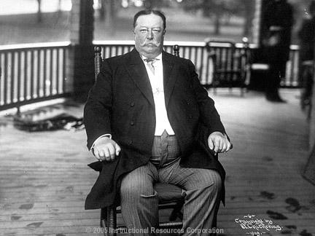
LEQ: How did President Taft’s beliefs differ from the progressives’ beliefs?
Write down your LEQ and HW
Place your Muckracker HW out to be collected.
https://app.discoveryeducation.com/player/view/assetGuid/70a995c2-8fd9-47d3-b83a-677381f0ba5c

Slide 4
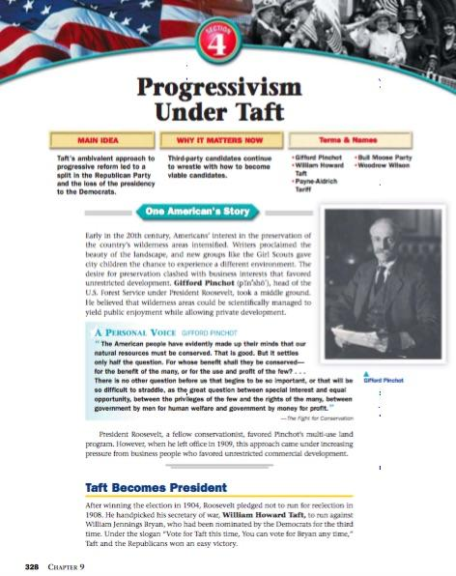
Graphic Organizer
Directions: Use the corners reading to complete the graphic organizer. What problems did Taft face as he was president.

Slide 6
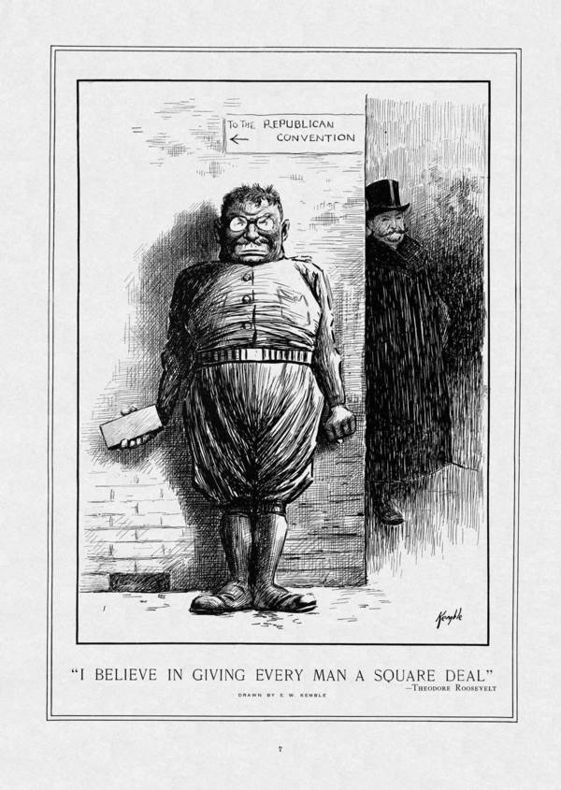
Roosevelt Vs. Taft
Directions:
On a piece of lined paper answer POSES for this political cartoon. Quiz grade!
P= People
O = Objects
S = Setting
E = Engagement
S = Summary

Slide 8
Homework
Taft Roosevelt

