Slide 1
Progressivism
Unit #3
UEQ: How did social movements shape politics and reform in the late 19th and early 20th centuries?

Slide 2
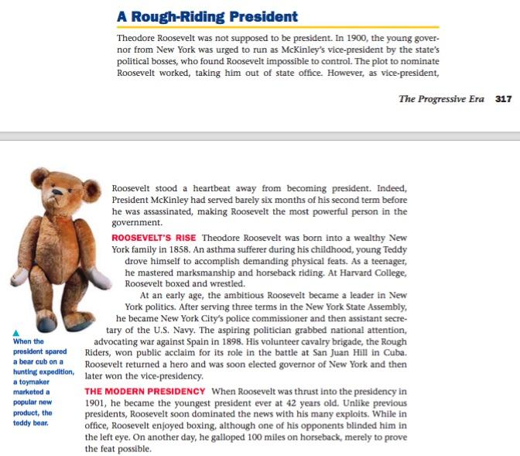
LEQ: Why did President Roosevelt support conservation?
Write down your LEQ and HW
Place your HW out to be collected.
Read the short summary about Theodore Roosevelt. How did he become the 26th president? Annotate the sleeve with the expo marker.

Slide 3
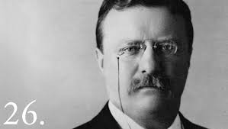
Video
http://www.biography.com/people/theodore-roosevelt-9463424#synopsis

Slide 4
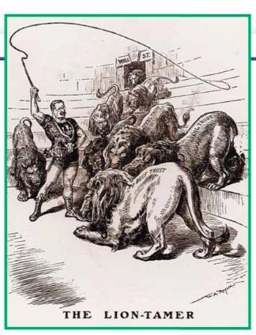
POSES
People -
Objects -
Setting -
Engagement -
Summary -

Slide 5
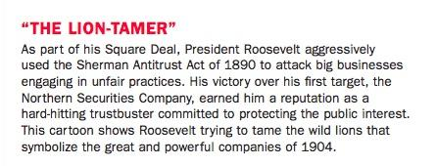
Summary

Slide 6
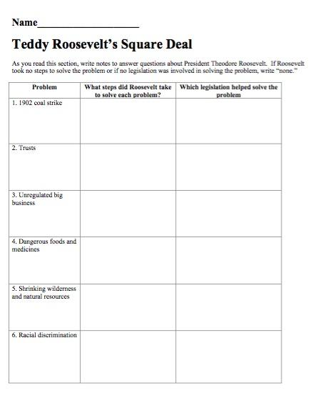
Find this sheet!

Slide 7
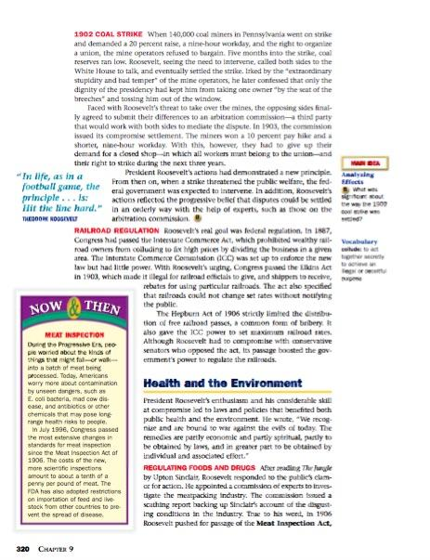
Roosevelt’s Square Deal
Directions: Use the reading to complete the graphic organizer. Write what Roosevelt did to solve the problem. Write what the government did to solve the problem, if anything.
Mrs. Nykiel will model the 1902 Coal Strike!

Slide 8
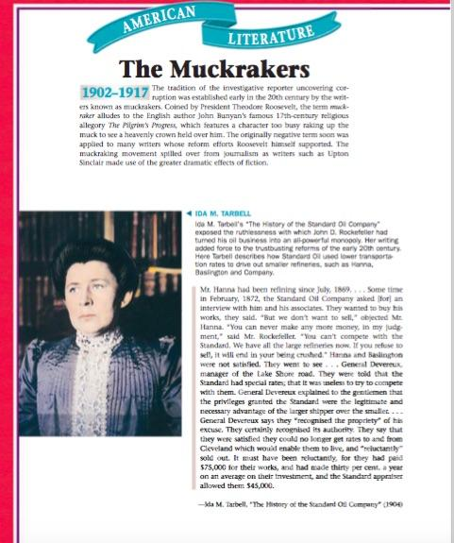
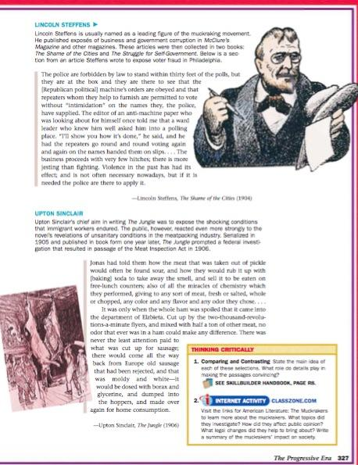
What is a Muckraker?
On a piece of lined paper write 1 paragraph.
Answer the following:
What is a muckraker?
Who is one famous muckraker?
What where they know for?

