Slide 1
Other minority social movements
LEQ: How were Latinos, Native Americans, and Women impacted during the Civil Rights Movement?

Slide 2
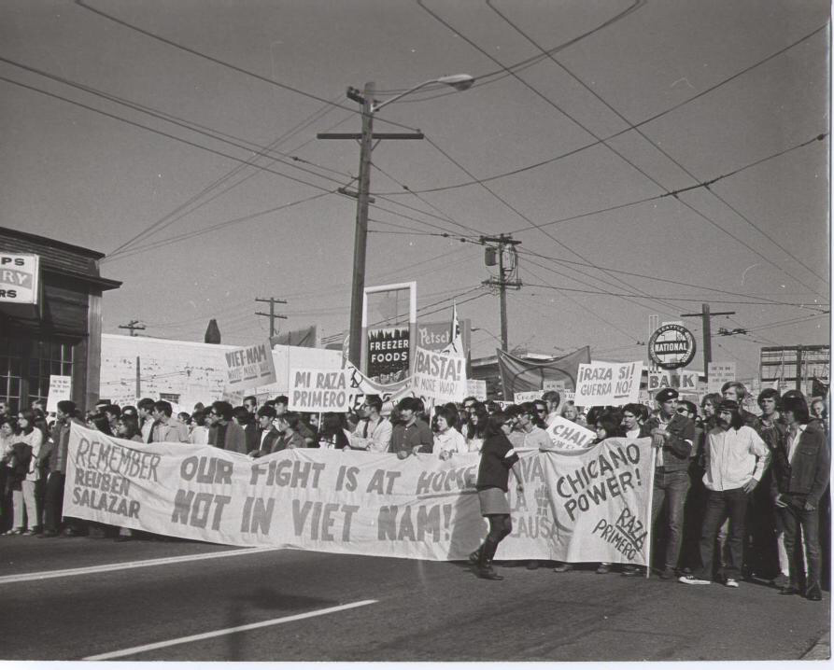
Latinos
During the 1960s, the latino population tripled from 3 million to 9 million coming from a variety of countries and settling along the borders and coastlines of the U.S.
Cesar Chavez began the United Farm Workers Union and fought for better pay, treatment, and hours by convincing supermarkets to boycott goods until the growers gave in to their demands
The "Brown Movement" began demanding better education, including language classes, as well as increased respect for latino culture
Latino political movements also were successful in getting more political representation, winning both house and senate seats as well mayors, school boards, and city councils.

Slide 3
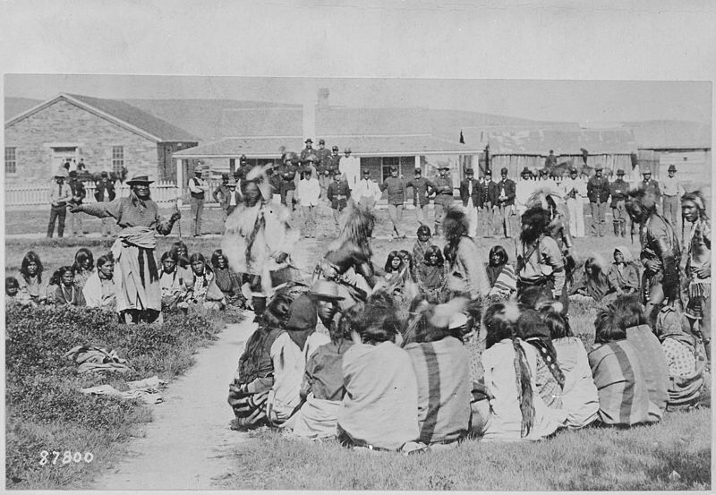
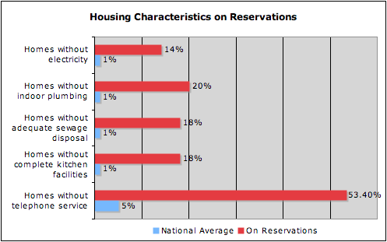
Native Americans
Native Americans wanted to be able to choose their own way of life rather than have the United States force a life on them, which President Johnson signed into a bill in 1968
Some young Indians started the American Indian Movement (AIM) to combat police brutality but branched out to protect large Native populations.
Later AIM, as well as other groups, began protesting, sometimes violently, against the U.S. Government and their treaty violations throughout history
Congress and the federal courts did make reforms including giving land back that had been taken through treaty violations, passing education reforms, and granting more self-determination for native groups

Slide 4
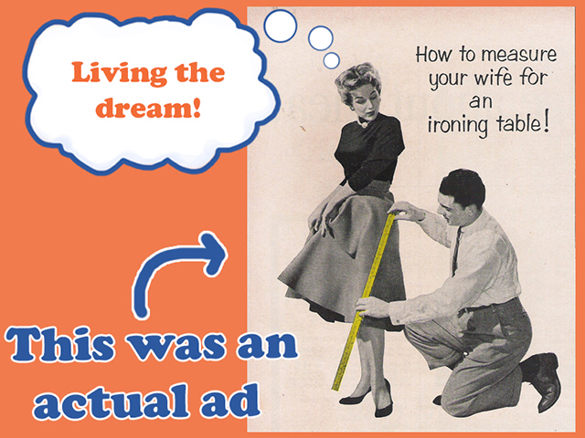
A New Women's Movement
In the 1960s, feminism rose up behind the belief women should have economic, political, and social equality with men.
Women were often not allowed to work certain jobs, or were paid less than their male coworkers even though the did the same job, causing women to organize groups to combat this treatment
Betty Friedan wrote a book called the Feminine Mystique where she outlined that the role of women as housewife left many women unfulfilled and asking "is this all?"
Early on The Civil Rights Act of 1964 and the Equal Employment Opportunity Commission (EEOC) seemed to solve these problems only to fall short of true equality.

Slide 5
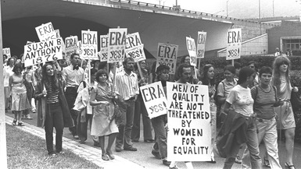
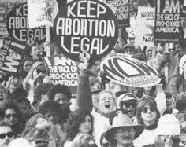
Women organize
Women first created the National Organization for Women (NOW) to fight for childcare facilities so more women could work as well as pressure the EEOC to better enforce equality rules
These led to a variety of other women's' groups and even led Gloria Steinem to create the National Women's Political caucus to seek political office as well the women's magazine Ms to treat issues from a feminist point of view
This led to political fights like Roe v. Wade over abortion and the Equal Rights Amendment. This caused a backlash against the feminist movement.
Overall the movement led to more job opportunities, more women in politics, more women graduating from college, but struggled to get women into top positions.

Slide 6
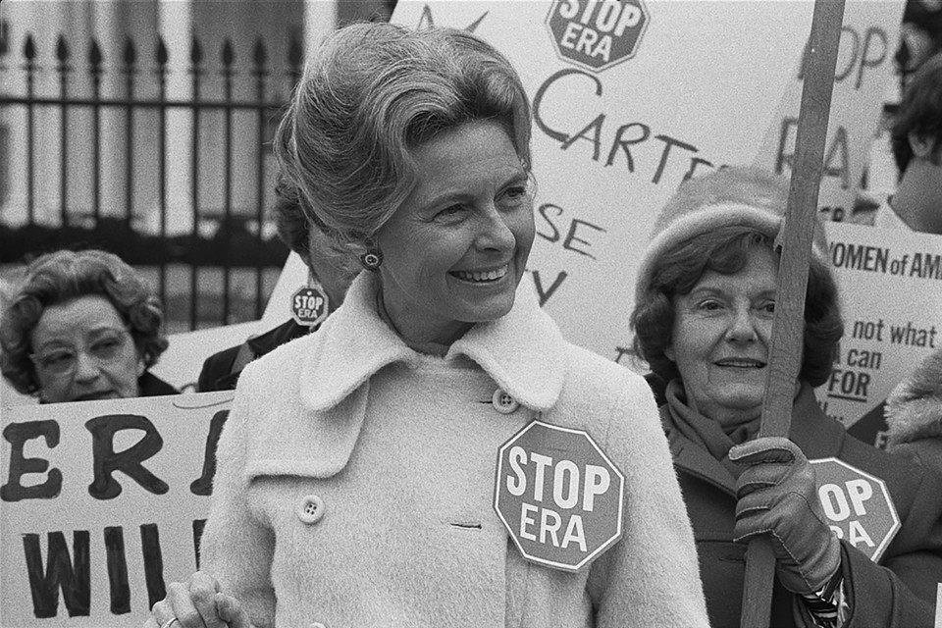
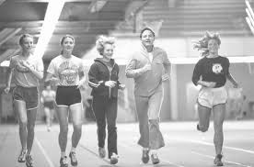
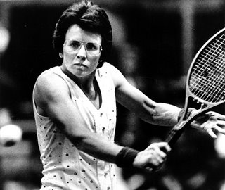
Continuing the Battle for Equality
Many people opposed equal rights for women. Phyllis Schlafly, along with conservative religious groups, felt that the Equal Rights Amendment would end the husband's responsibility to provide for his family.
Title IX of the Education Amendments Act of 1972 is a federal law that states: "No person in the United States shall, on the basis of sex, be excluded from participation in, be denied the benefits of, or be subjected to discrimination under any education program or activity receiving Federal financial assistance."
A year after Title IX, the number one women's tennis player in the world was challenged to a "Battle of the Sexes". Billy Jean King was to play former men's champion, 55 year-old Bobby Riggs. The match helped to gain respect for women's athletics.

Slide 7
Summary
Consider the organizations created by Latinos, Native Americans, and Women. Which do you think was the most influential? Explain why using complete sentences and details from your notes and class discussion.

