Slide 1
JOHN F. KENNEDY AND THE NEW FRONTIER
LEQ: What were some domestic policies initiated when Kennedy took office?

Slide 2
WARM UP
On a white board, list the things you know about John F. Kennedy

Slide 3
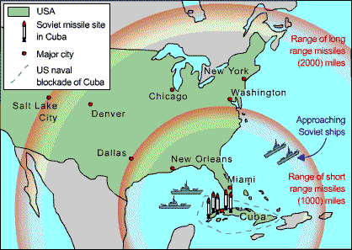
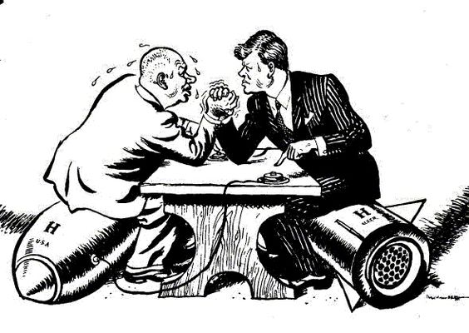
JFK and the Cuban Missile Crisis Review

Slide 4
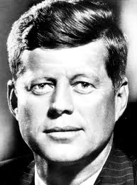
Presidential Election
Rights For the Disabled
Rights for Women
The Space Race
Stalled Domestic Programs
Page 341

Slide 5
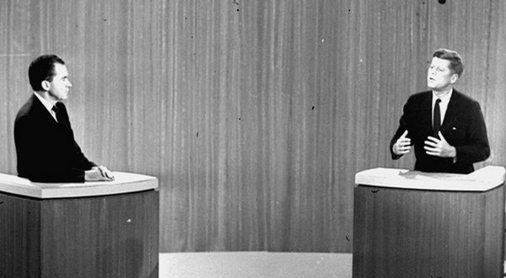
THE ELECTION OF 1960
As the election of 1960 approached, Americans were worried about the direction of their country.
With an economy in recession, the launch of Sputnik, the U-2 incident, and Cuba's switch to communism, Americans felt the U.S. was falling behind
John F. Kennedy promised a New Frontier, a symbol of his youthful vigor rather than the inaction of the Eisenhower years
Kennedy was elected and he immediately created a team of highly educated individuals to tackle America's problems

Slide 6
KENNEDY'S STRUGGLES WITH CONGRESS
Kennedy called for Americans to return to American idealism and challenged Americans to be pioneers and explorers.
Kennedy had difficulty getting congress to go along with his idealism and he often was unable to get enough votes
Kennedy proposed new tax cuts for the economy, Medicare for the elderly, a civil rights bill, and several other reforms
Republicans and Southern Democrats opposed these ideas and voted all of them down threatening to further dishearten the country.

Slide 7
THE SPACE RACE
The Soviet Union space program continued to surpass the U.S. when in 1961 Yuri Gagarin became the first human in space
Kennedy announced the U.S. would be the first to reach the moon, and America would do it by the end of the decade, a very bold declaration
In under a month, the U.S. had sent Alan Shepard to space and John Glenn to fully orbit the Earth. NASA began constructing new facilities around the country
One of these new facilities was in Cape Canaveral, FL and in 1963 would buy the land that became Kennedy Space Center, turning Central Florida into the "Space Coast."

Slide 8
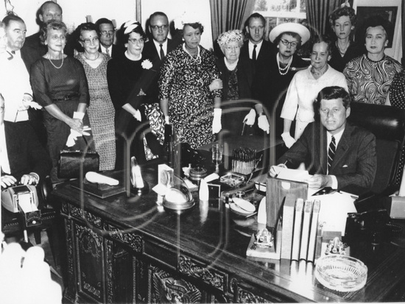
KENNEDY AND MINORITIES
Kennedy brought new attention to disabled Americans with the President's Council on Mental Retardation and the beginning of the Special Olympics
Kennedy set up a federal commission to report on the status of women and he signed the Equal Pay Act in 1963
In 1963, Kennedy ordered the Justice Department to investigate racial injustices in the South and presented a sweeping Civil Rights bill to Congress
However, Kennedy's popularity was dropping and during a visit to Texas, Kennedy was assassinated leading to former Texas Senator and Kennedy's Vice President Lyndon Johnson to take over the Presidency.

Slide 9
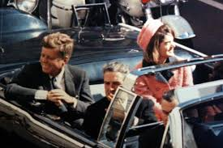
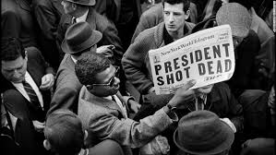
The Kennedy Assassination
https://app.discoveryeducation.com/player/view/assetGuid/e3129e12-0372-4df1-b58d-945894b1aed9

Slide 10
SUMMARY
Do you think President Kennedy was a successful leader? Use 2 facts to back up your answer.

