Slide 1
Lyndon B. Johnson and
the great society
LEQ: How did President Johnson’s experience in Congress help him get legislation passed?

Slide 2
Johnson's first days in office
Johnson took over for Kennedy and immediately asked congress to pass the civil rights and economic bills Kennedy was trying to pass
Johnson then got the economy going by getting Kennedy's income tax reduction plan passed
Next he declared a "War on Poverty," where he created the economic opportunity act to create programs to help the poor.
This created programs like Job Corps to train underprivileged youth, community action programs, Volunteers in Service to America

Slide 3
The Great Society
Johnson won re-election in a landslide which also saw the democrats take both houses of congress
Johnson could now go even further in his social reforms which he called The Great Society
The Great Society became an extension of the New Deal passed by Johnson's mentor Franklin Roosevelt during the Great Depression
These reforms covered poverty, health, civil rights, education, housing and many others topics

Slide 4
POSES
People
Objects
Setting
Engagement
Summary

Slide 5
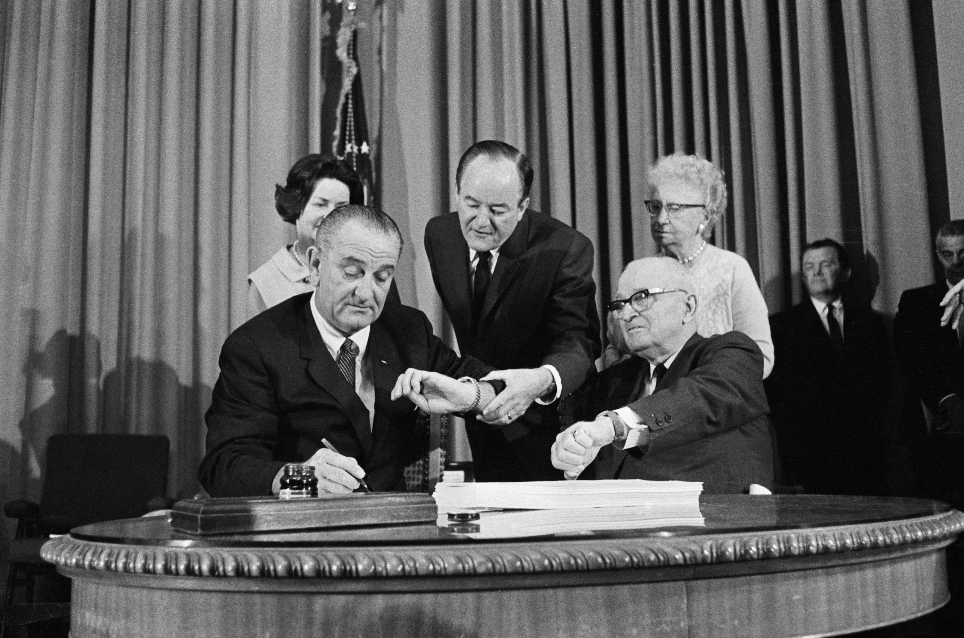
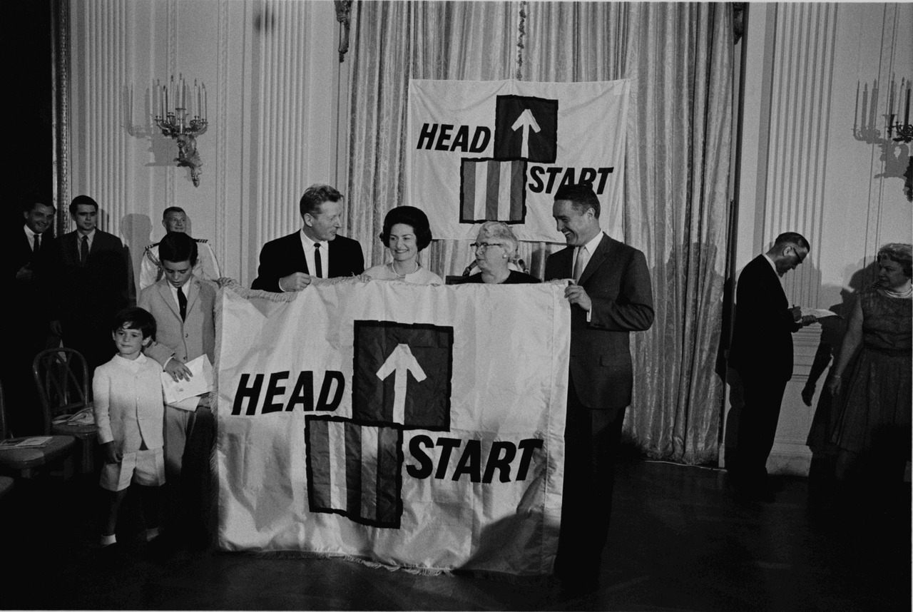
Johnson's social reforms
Medicare and medicaid are the most enduring of these social reforms
Medicare provides cheap insurance to the elderly while medicaid provides health benefits to certain people with low income
He also started the Head Start Program to help underprivileged children between the ages of 3-5 get ready for school.
The Housing and Urban Development Act (HUD) helped with urban planning, slum clearance, rental subsidies, and reconstruction of rundown buildings

Slide 6
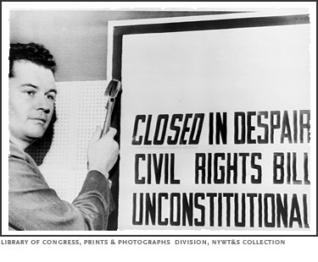
The Civil Rights Act of 1964
Johnson's greatest achievement however, is getting Kennedy's Civil Rights Act passed, the most significant since Reconstruction
It prohibited discrimination in any place of business based on race, color, religion, ethnic origin, or sex
It cut off all funding to schools who hadn't desegregated, increased voting registration, and set up the Equal Employment Opportunity Commission
The new laws were upheld by the Supreme Court and protected women, AfricanAmericans, and other minority groups

