Slide 1
Bellwork
What are the negatives of America’s involvement in other countries?

Slide 2
Effects of the Spanish American War

Slide 3
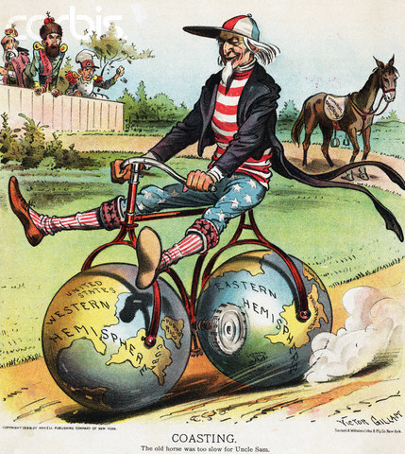
Treaty of Paris
Spain freed Cuba, gave Guam and Puerto Rico, and sold the Philippines to the U.S.
Some felt taking the Philippines was against the Declaration of Independence
Others wanted race relations at home to be fixed before we took on other country’s problems
Still others were concerned this would lead to Filipino immigrants taking American jobs

Slide 4
Think Pair Share Question
Some people say the United States was being hypocritical in the Treaty of Paris. What evidence suggests they were right?

Slide 5
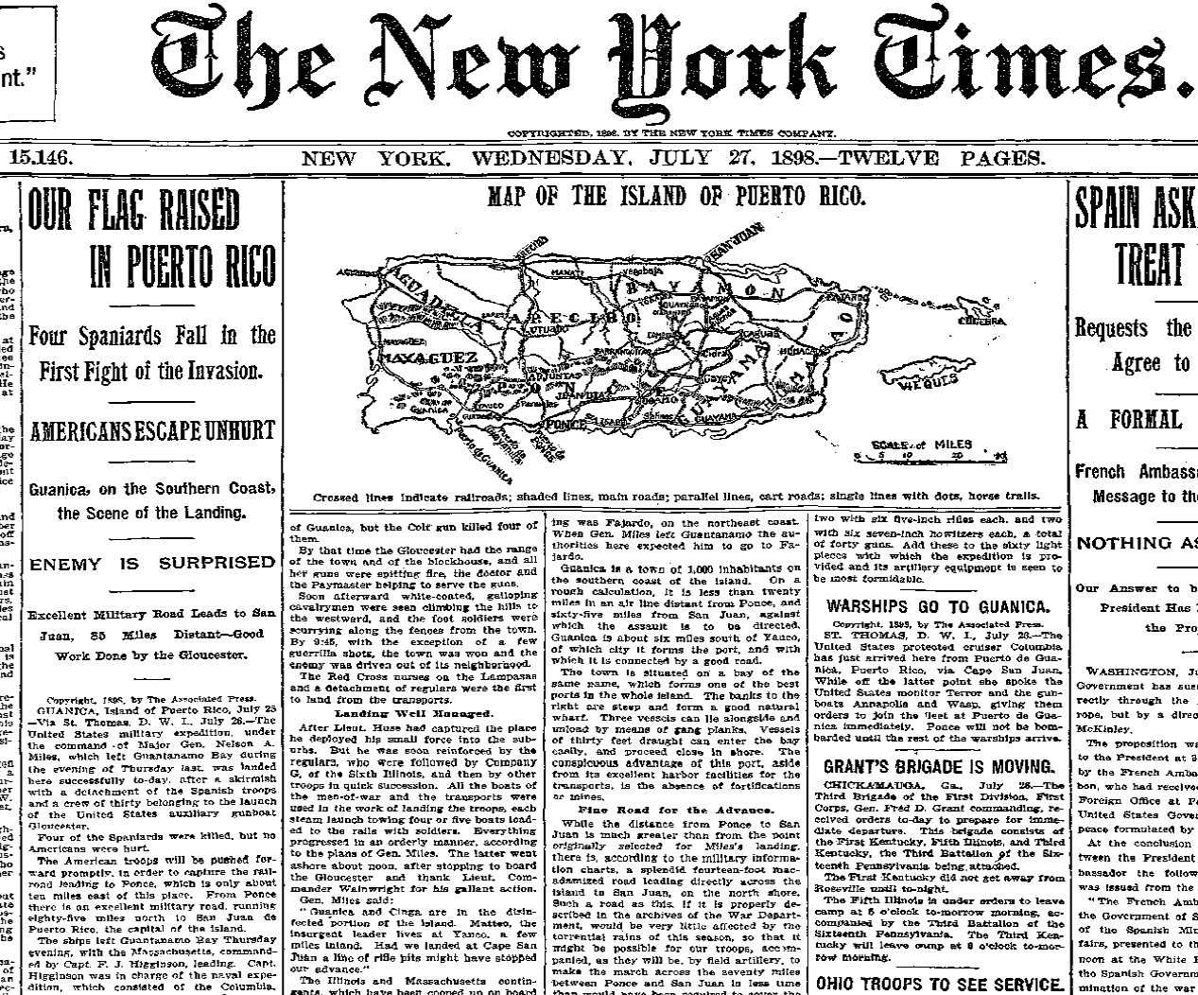
Puerto Rico
Many Puerto Ricans were worried the U.S. would not give them self rule that they had under Spain
Other Puerto Ricans, however, wanted to become a State or to remain a U.S. territory
The U.S. first controlled Puerto Rico with the military during and then after the war
Later, the U.S. gave some powers of self government back to the people, but still maintained overall control as a territory

Slide 6
Think Pair Share
Do you think Puerto Rico should become a new State?

Slide 7
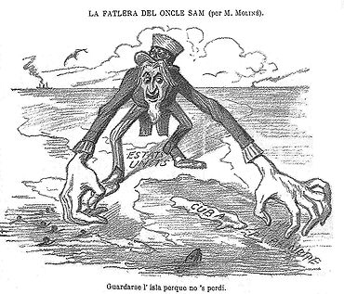
Cuba
During the War, the U.S. passed the Teller Amendment which promised not to annex Cuba even if it won the war
However, After the war, the U.S. kept its military there and they kept the same officials that were there under Spain
While the U.S. military did provide things like food, medicine, clothes, and schools, many Cubans resented and protested the against the military
Cuba was then forced to sign the Platt Amendment which allowed the U.S. to intervene at anytime and set up a naval base, later known as Guantanamo Bay.

Slide 8
Think Pair Share question
Why would the United States want to keep control over Puerto Rico and Cuba?

Slide 9
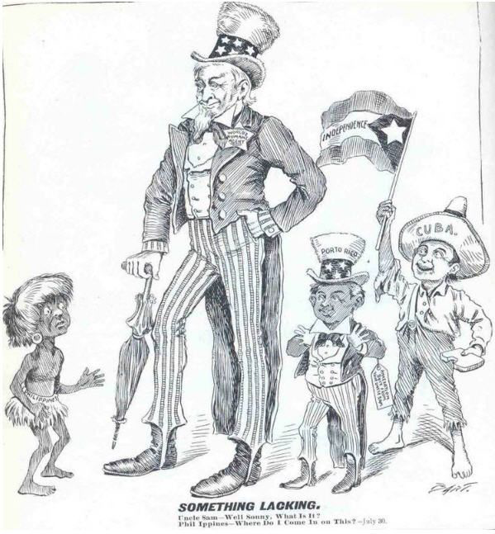
The Philippines
The Filipinos were outraged the U.S. had annexed them after promising they would be given independence
While the Filipinos rebelled against U.S. control the U.S. had forced filipinos into camps where poor sanitation, starvation, and disease killed thousands
American soldiers looked at the Filipinos as inferior humans which spread racial prejudice
Ultimately the U.S. would control the government of the Philippines as a territory until their independence in 1946

Slide 10
