Slide 1
How did the United States become an industrialized society after the Civil War?
Unit #2

Slide 2
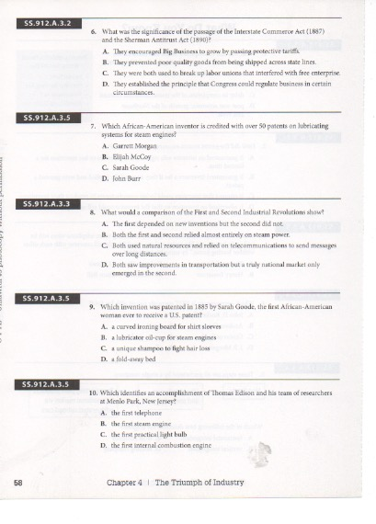
LEQ:· What advantages do large corporations have over small businesses?
What new business strategies allowed businesses to weaken or eliminate competition?
Bellwork:
Write down your LEQ and HW
Have your multiple choice HW out to go over!
Review your answers with your shoulder partner and discuss the results!

Slide 4
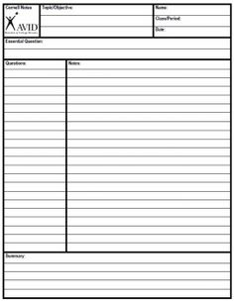
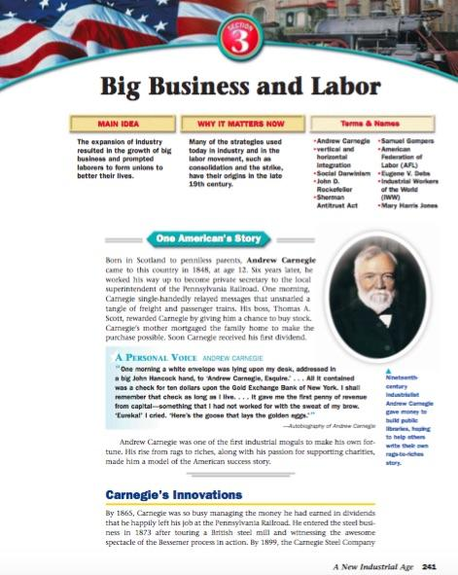
Cornell Note Taking

Slide 5
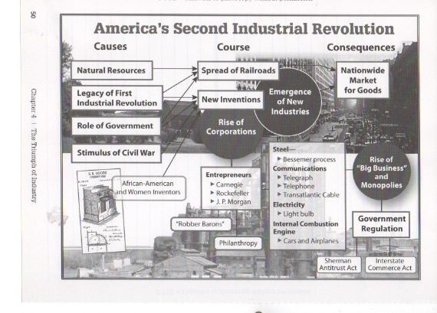

Slide 6
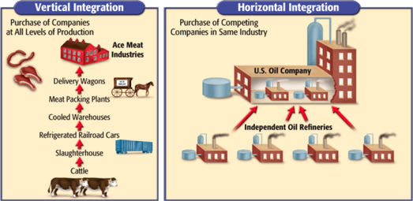

Slide 7
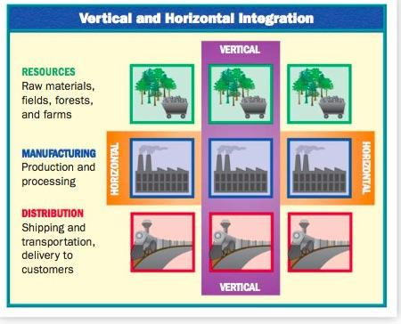
Summary
Using the notes provided, and the graph, write a paragraph explaining the difference between vertical integration and horizontal (monopoly) integration. What type of business model is better? How would you make more money?

Slide 8
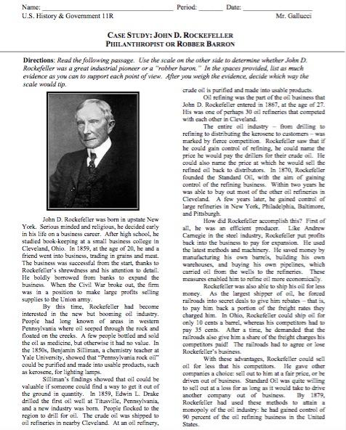
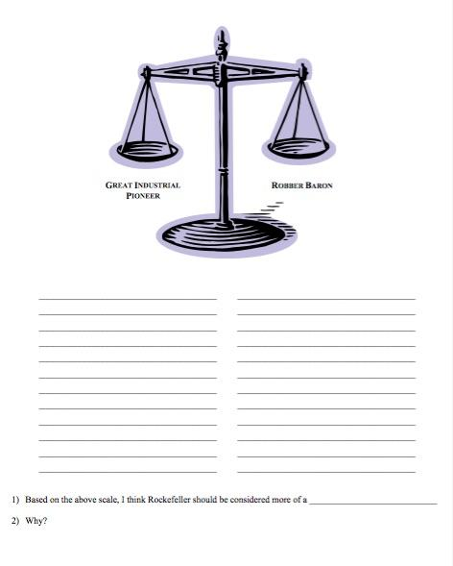
Homework

