Slide 1
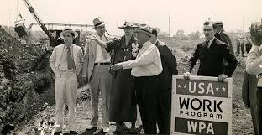
The Great Depression
UEQ: How did the New Deal lessen the effects of the Great Depression on the American people and simultaneously forever change the role of government?

Slide 2
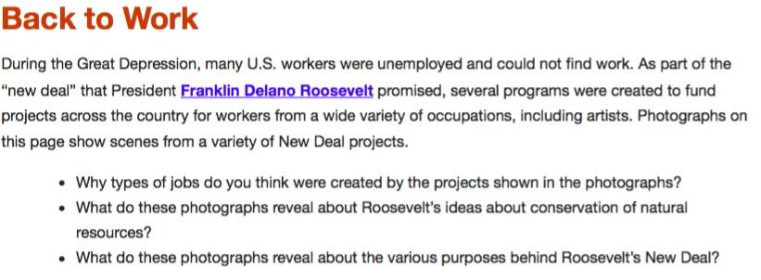
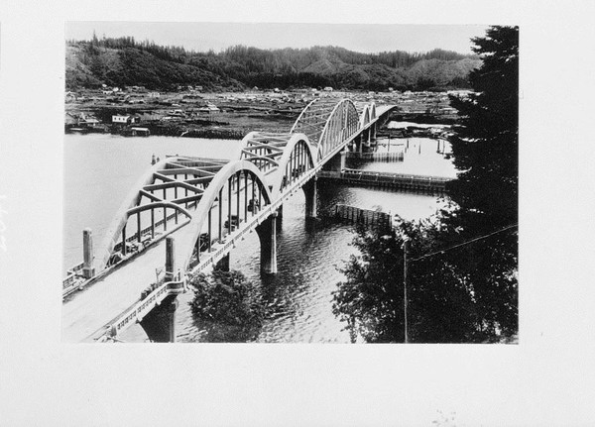
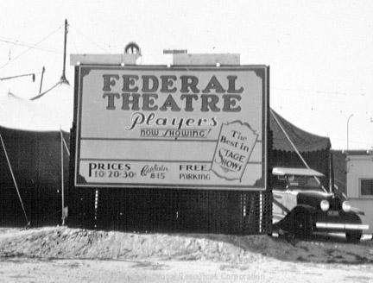
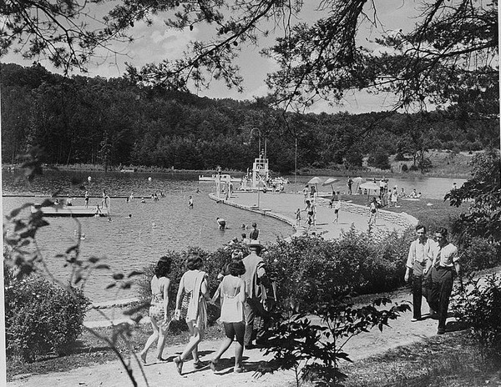
LEQ: How did New Deal legislation try to stabilize agriculture and industry?

Slide 3
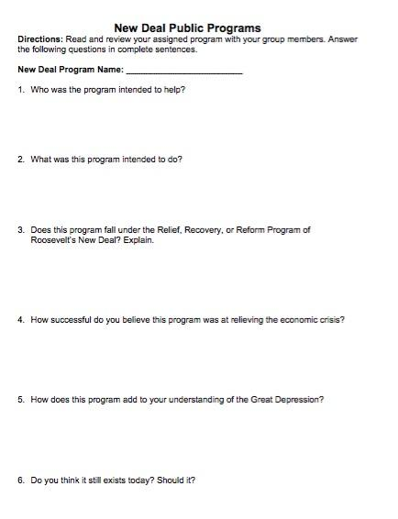
New Deal Public Programs
Directions: We will complete one public program together as a class. This was how Roosevelt wanted to stabilize the economy. We will fill out the graphic organizer.

Slide 4
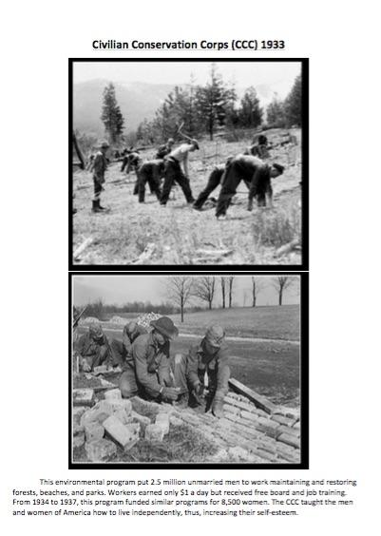

Slide 5
3 Stations Today
Directions:
Your table will receive a public works program. Work together for ten minutes to read the document and answer the graphic organizer. You will then rotate to the next public work station. There are six total!
DO NOT ROTATE UNTIL THE TIMER!

