Slide 1
LEQ: WHAT TYPES Of GOVERNMENT EXISTED AT THE START OF wwii?

Slide 2
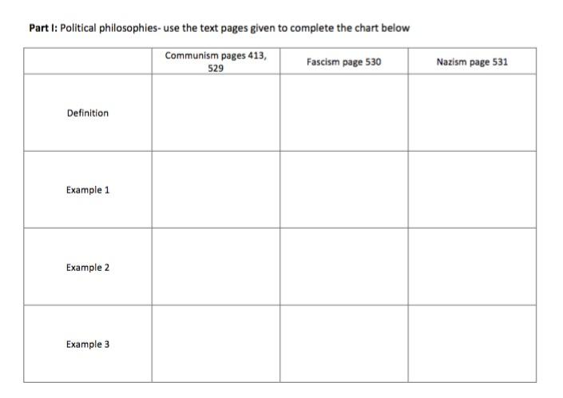

Slide 4
