Slide 1
Civil War Unit #1
Unit Question:
How did the Civil War and failure of reconstruction change the course of the United States?

Slide 2
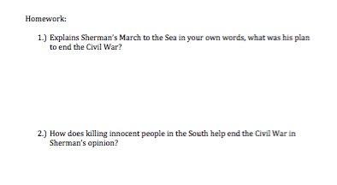
Homework to hand in…

Slide 3
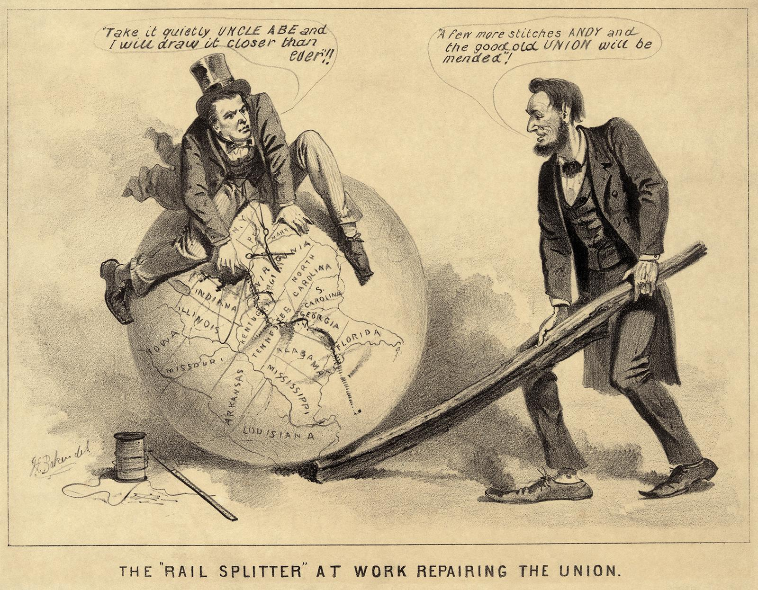
Reconstruction - Background Video
https://www.youtube.com/watch?v=nowsS7pMApI
Directions: Use a white board and marker. As the video plays you are listening for the definition of Reconstruction.

Slide 4
LEQ: What were the successes and failures of Reconstruction?
Period of time following the Civil War from 1865 - 1877. The plan was to rebuild the United States and help African Americans assimilate.

Slide 5
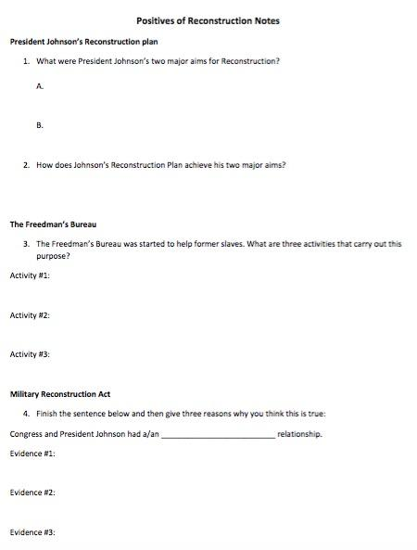
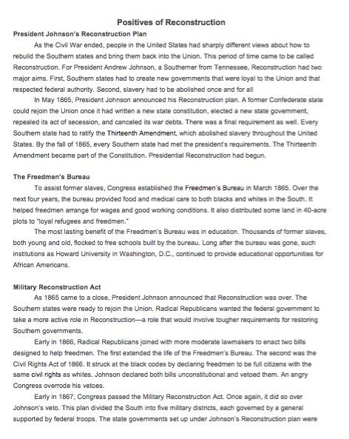
Positives

Slide 6
LEQ: What were the successes and failures of Reconstruction?
Bellwork: Write down three positives of Reconstruction from yesterday’s lesson on a whiteboard.
Period of time following the Civil War from 1865 - 1877. The plan was to rebuild the United States and help African Americans assimilate.

Slide 7
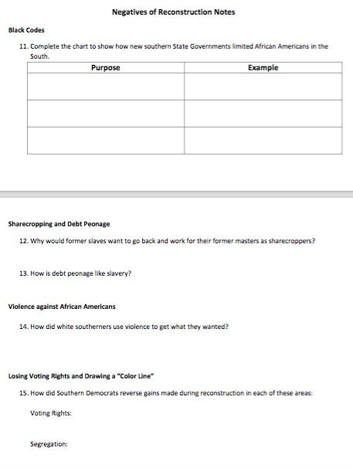
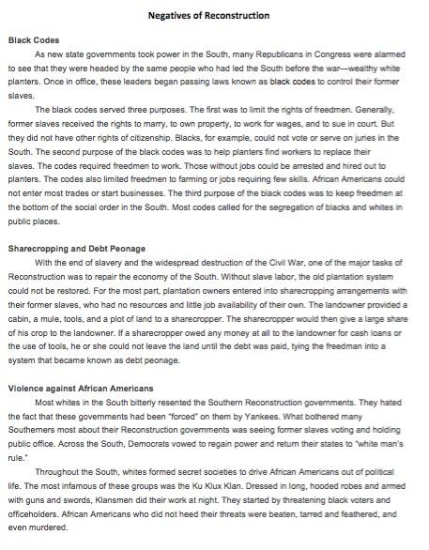
Negatives

