Slide 1
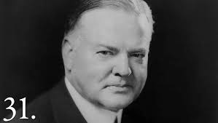
The Great Depression
UEQ: How did the New Deal lessen the effects of the Great Depression on the American people and simultaneously forever change the role of government?

Slide 2
LEQ: How did President Hoover’s governing philosophy influence his efforts to combat the Great Depression?
https://app.discoveryeducation.com/player/view/assetGuid/690b0785-7582-4b64-abd2-d8ddffb7e9b5

Slide 3
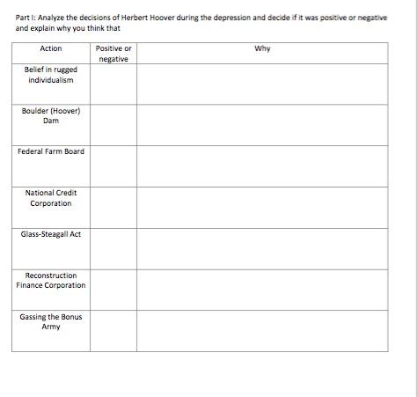
Directions:
Using the textbook pages 478-483 complete the assigned section. We will divide the class into seven groups.

Slide 4
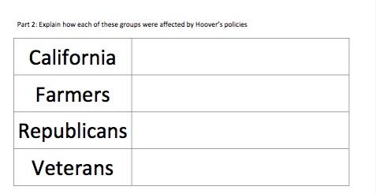
Partner Work!

Slide 5
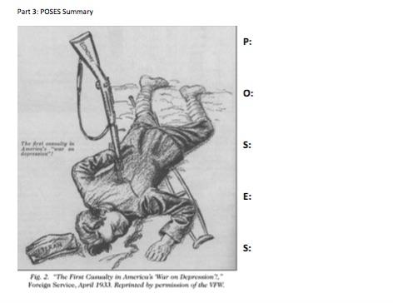
Sheet will be collected at the end of class!

