Slide 1
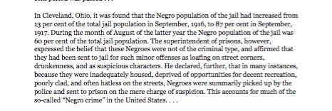
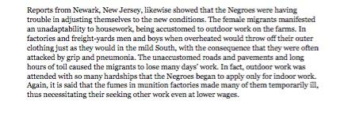
LEQ: What does the Harlem Renaissance reveal about African American culture in the 1920s?
Bellwork:
You were given a short summary to read. Annotate the summary and determine how were African Americans treated when they migrated north during the Great Migration?
Music Clip - Rhapsody in Blue https://www.youtube.com/watch?v=eFHdRkeEnpM

Slide 2
Predicting!

Slide 3
Harlem Renaissance Video
http://www.history.com/topics/roaring-twenties/videos/the-harlem-renaissance
Directions: Using the background video complete the sections of your graphic organizer
What is the Harlem Renaissance?
What was the Great Migration?

Slide 4
What was the Renaissance?
What was the Great Migration?

Slide 5
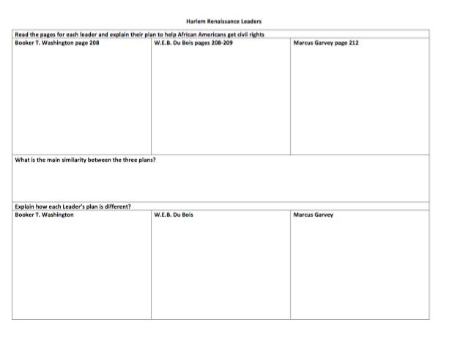
Graphic Organizer - Page 208 - 209
Directions: You will be given one Harlem Renaissance Leader to discuss. Find in just your assigned section of the graphic organizer. We will then share out with the class.

Slide 6
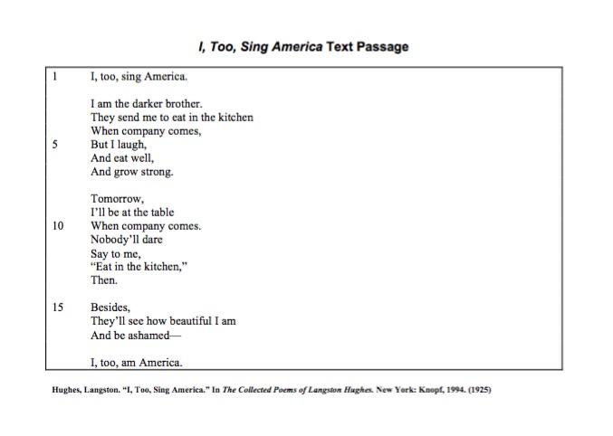
Bellwork

Slide 7
Graphic Organizer - Textbook Pages 209 - 212

Slide 8
Ticket out the Door
Directions: In a written summary explain how the Harlem Renaissance helped shape African Americans culture in the 1920’s. You must provide at least two examples from class using the notes.

