Slide 1
World War I
LEQ: Why was the arrival of U.S. forces so important to the war effort?

Slide 2
LEQ: Why was the arrival of U.S. forces so important to the war effort?
Bellwork:
Directions: On a white board write down two ways Conservation at home helped with war efforts abroad? This is reviewing your home work from last night!

Slide 3
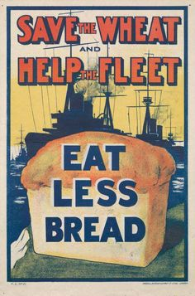
Homework to Review
How could Conservation affect the war effort?

Slide 4
#11 - Selling the War - Whole Group
Selling the War
Once the government had extended its control over the economy, it was faced with two major tasks: raising money and convincing the public to support the war. The United States spent about $35.5 billion on the war effort. The government raised about one-third of this amount through taxes. It raised the rest through public borrowing by selling “Liberty Loan” and “Victory Loan” bonds.
To popularize the war, the government set up the nation’s first propaganda agency, the Committee on Public Information (CPI). Propaganda is a kind of biased communication designed to influence people’s thoughts and actions. The agency created thousands of paintings, posters, cartoons, and sculptures to promote the war.
However, while the campaign promoted patriotism, it also inflamed hatred and violations of the civil liberties of certain ethnic groups and opponents of the war. Attacks on civil liberties erupted as soon as war was declared. The main targets of these attacks were Americans who had emigrated from other nations, especially those from Germany and Austria-Hungary. The most bitter attacks were directed against the nearly 2 million Americans who had been born in Germany, but other foreign-born persons and Americans of German descent suffered as well.
Many Americans with German names lost their jobs. Orchestras refused to play the music of Mozart, Bach, Beethoven, and Brahms. Some towns with German names changed them. Schools stopped teaching the German language, and librarians removed books by German authors from the shelves. People even resorted to violence against German Americans, flogging them or smearing them with tar and feathers. A mob in Collinsville, Illinois, wrapped a German flag around a German-born miner named Robert Prager and lynched him. A jury cleared the mob’s leader.

Slide 5
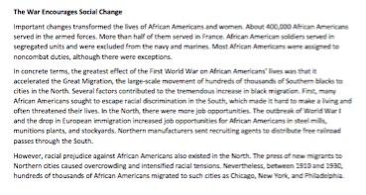
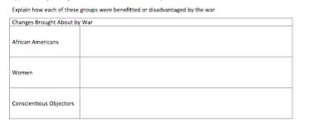
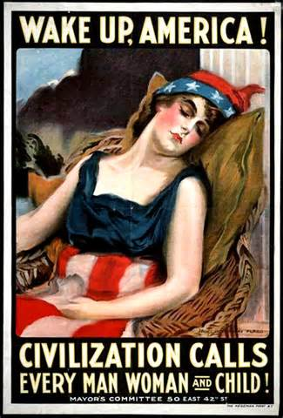
Partner Work
Directions: Read the article “ The War encourages Social Change” and annotate the reading ! Then with your partner complete the graphic organizer. (#12)

Slide 6
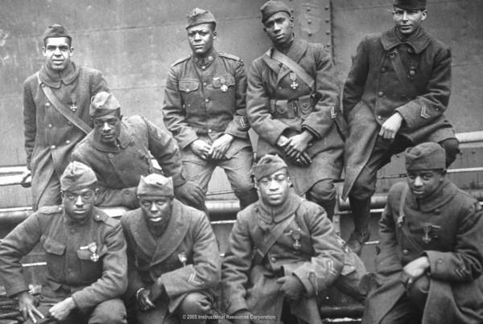
Video -
https://app.discoveryeducation.com/techbook2:concept/view/guidConceptId/B8A0D4BA-B534-4849-AE91-BCA0D26F70B4/guidUnitId/CCF3149C-1413-4866-9D3D-8D84C964177F#/tab=explore-tab&page=9&subTab=explore-main-tab
Question to answer:
How were African Americans viewed during WWI?

Slide 7
Independent Work
#13 - American troops on the Offensive
American Troops Go on the Offensive
When Russia pulled out of the war in 1917, the Germans shifted their armies from the eastern front to the western front in France. By May they were within 50 miles of Paris. The Americans arrived just in time to help stop the German advance at Cantigny in France. Several weeks later, U.S. troops played a major role in throwing back German attacks at Château-Thierry and Belleau Wood. In July and August, they helped win the Second Battle of the Marne. The tide had turned against the Central Powers. In September, U.S. soldiers began to mount offensives against the Germans at Saint-Mihiel and in the Meuse-Argonne area.
On November 3, 1918, Austria Hungary surrendered to the Allies. That same day, German sailors mutinied against government authority. The mutiny spread quickly. Everywhere in Germany, groups of soldiers and workers organized revolutionary councils. On November 9, socialist leaders in the capital, Berlin, established a German republic. The Kaiser gave up the throne.

Slide 8
Summary
What effect did American Forces have on the war?

Slide 9
Homework:
Website: www.mrsnykiel.weebly.com
All documents up to #13 should be complete. Tomorrow we will finish up WWI and review for the Unit Quiz!
Bring back your packet tomorrow!

