Slide 1
The Great Depression
UEQ: How did the New Deal lessen the effects of the Great Depression on the American people and simultaneously forever change the role of government?
DBQ Documents - You should have Documents A-I completed. You have five minutes to look through them and make any corrections.

Slide 2
LEQ: What were the underlying conditions that led to the collapse of the U.S. economy?
Directions: Write down the definition for each vocabulary word!
Bull market -
Speculation -
Margin -
Margin call -
Bank run -
Installment -

Slide 3
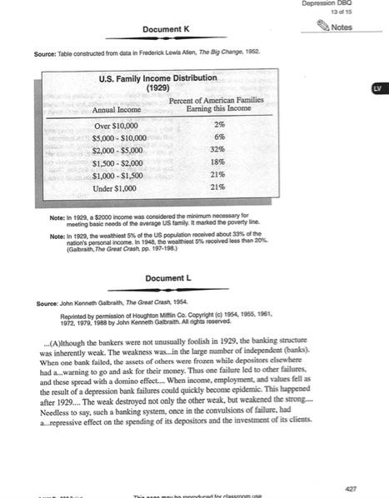
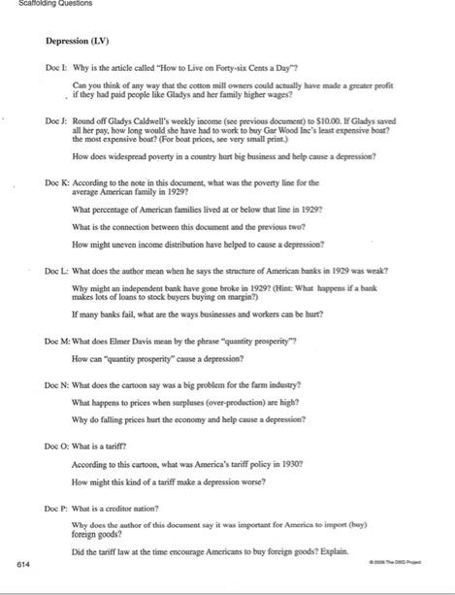
Documents K & l

Slide 4
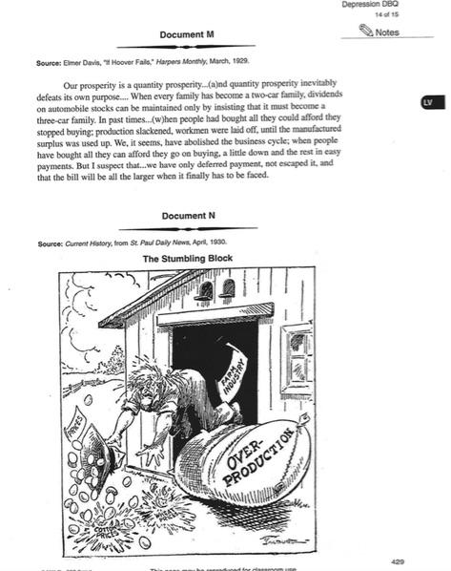
Documents M & N

Slide 5
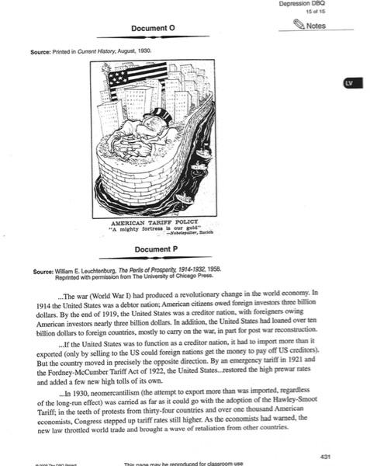
Documents O & P

Slide 6
Homework
Directions:
All documents and questions will be completed and handed in tomorrow for a mastery grade!

