Slide 1
The Roaring Twenties
UEQ: How has the cultural identity of the United States Changed over time?

Slide 2
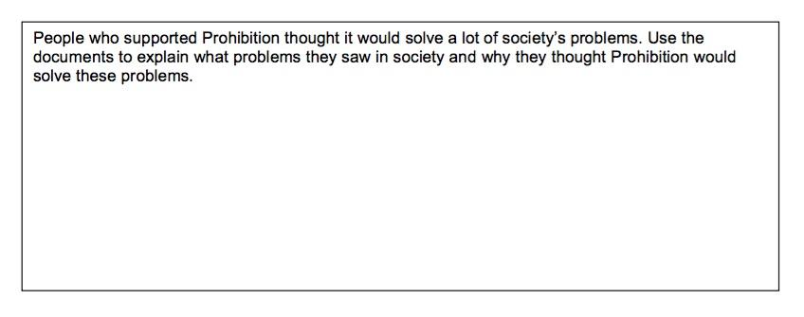
Homework to hand in...
LEQ: Why did people care about the Butler Act?
LEQ: What was the significance of the Scopes Trial?

Slide 3
What is Fundamentalism?

Slide 4
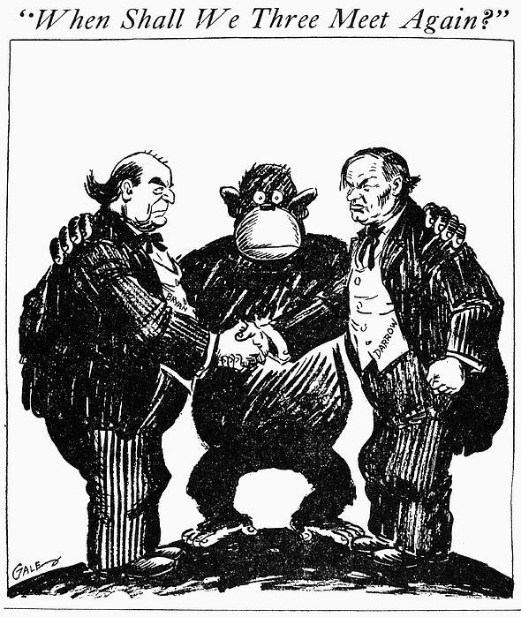
POSES
https://app.discoveryeducation.com/player/view/assetGuid/2673b052-e1e7-4b77-9ff4-33ccbda9faf5

Slide 5
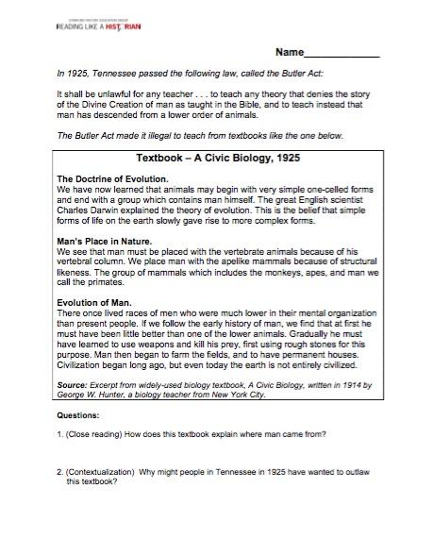
Whole Group

Slide 6
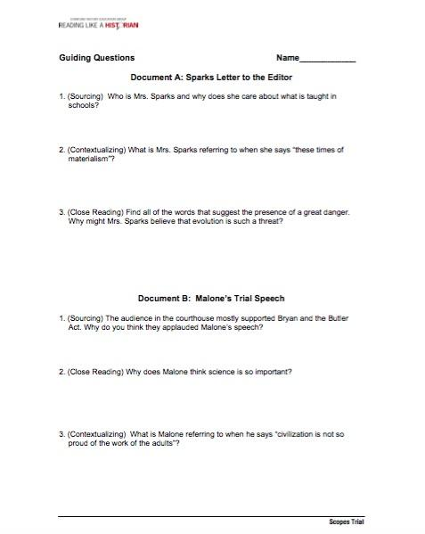
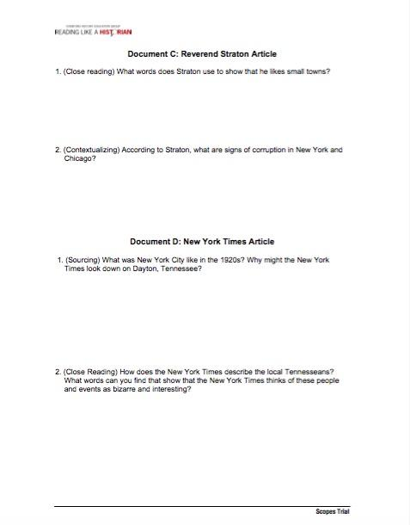
4 Corners - Documents A,B,C, & D

