Slide 1
The Roaring Twenties
UEQ: How has the cultural identity of the United States Changed over time?

Slide 2
LEQ: Why did some Americans fear this new morality?
https://app.discoveryeducation.com/player/view/assetGuid/5f9acac1-4e23-4703-bc77-7c27b7c52c09
Why did some Americans support Temperance?

Slide 3
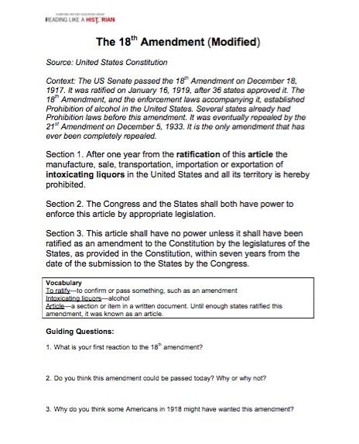
Whole Group

Slide 4
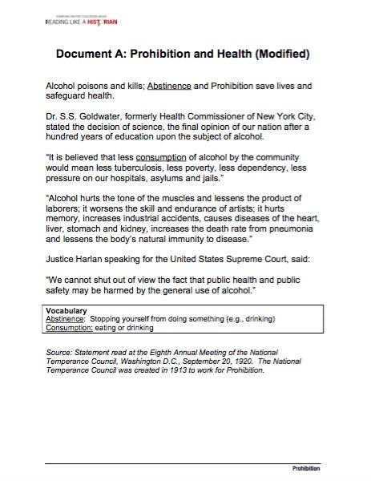
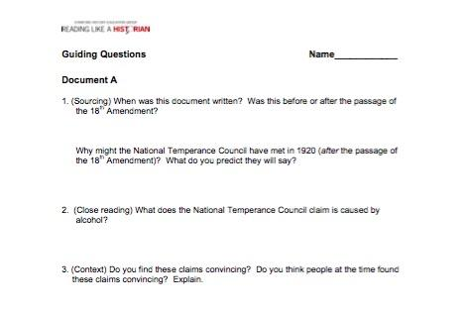
Document A - Partner

Slide 5
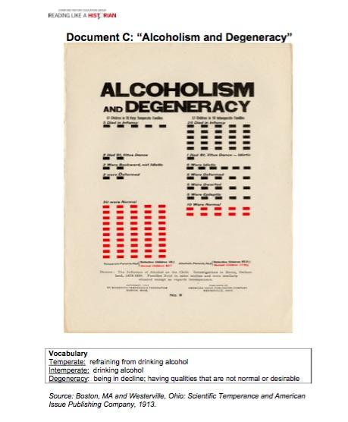
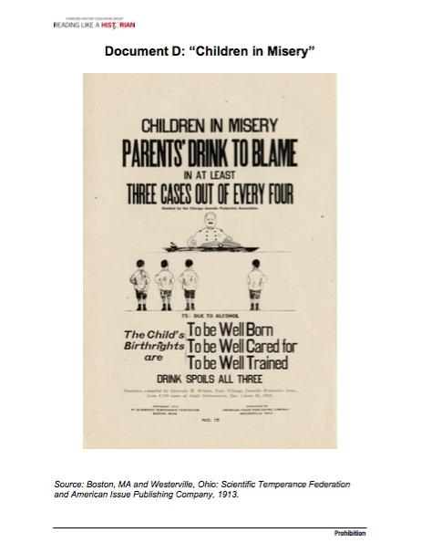
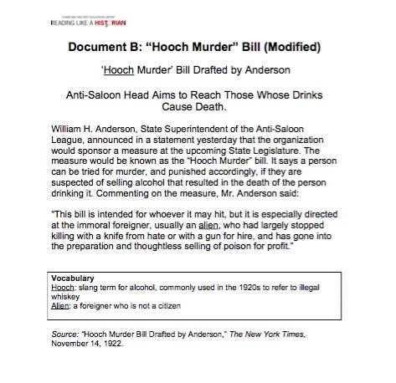
Documents B,C,D

