Slide 1
Civil War Unit #1
Unit Question:
How did the Civil War and failure of reconstruction change the course of the United States?

Slide 2
August 22nd
LEQ: How did the political system attempt to resolve the issues of sectionalism and slavery?
Bellwork:
Write your LEQ and HW in your agenda.
Have your primary source HW out on your desk to be collected.
Go retrieve your journal from your class period bin.
On the next piece of lined paper answer this question in a paragraph.
Prompt: Would you be for or against slavery in the 1860's?
Justify your answer by providing details or examples.
Stand and share!

Slide 3
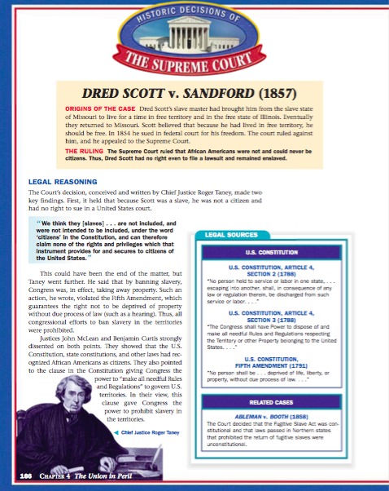
LEQ: How did the political system attempt to resolve the issues of sectionalism and slavery?
America was having the same debate 200 hundred years ago about slavery!
Find this sheet in your folder!

Slide 4
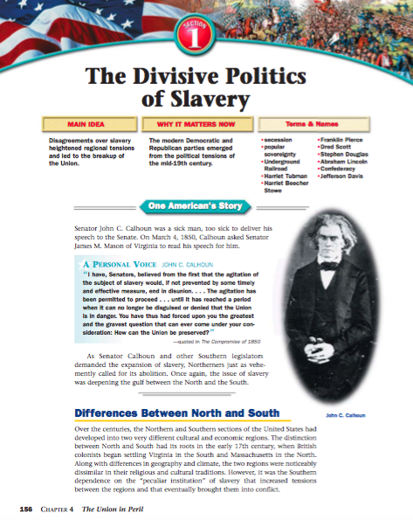
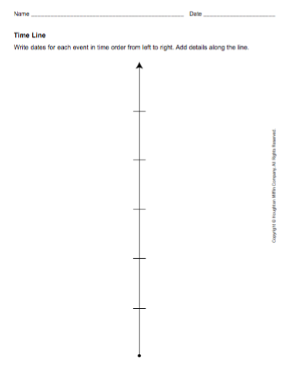
LEQ: How did the political system attempt to resolve the issues of sectionalism and slavery?
Open this reading on Mrs. Nykiel’s website
Find this in your team folder

Slide 5
LEQ: How did the political system attempt to resolve the issues of sectionalism and slavery?
Directions:
Students will work with a partner to create a timeline showing the tension escalating between the North and the South. Students will be provided a graphic organizer and a reading “The Divisive Politics of Slavery” pages 1-7. Student must show from the year 1850 through 1860.
The teacher will model the year 1850 with the Missouri Compromise.

Slide 6
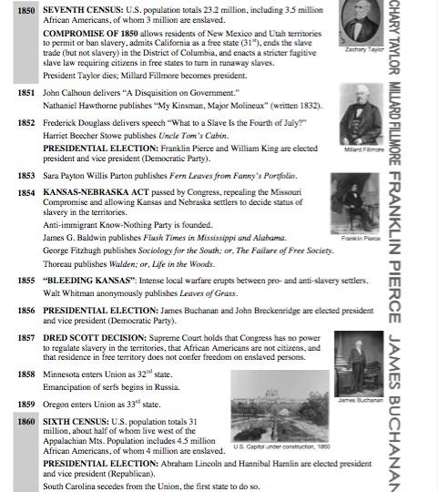

Slide 7
Homework:
Choose only six terms or names to complete the homework on a piece of lined paper.

Slide 8
Honors Homework:
Choose 9 terms or names to complete the homework on a piece of lined paper.

