Slide 1
The Great Depression
UEQ: How did the New Deal lessen the effects of the Great Depression on the American people and simultaneously forever change the role of government?

Slide 2
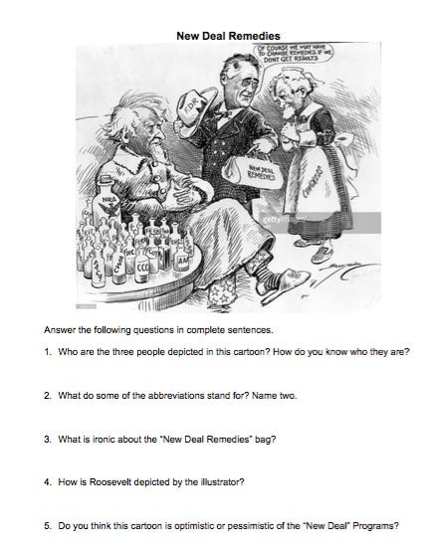
Homework to hand in...
This will be collected for a grade!

Slide 3
LEQ:How did the Wagner Act and Social Security Act affect Americans?
Video: http://historicalthinkingmatters.org/socialsecurity/

Slide 4
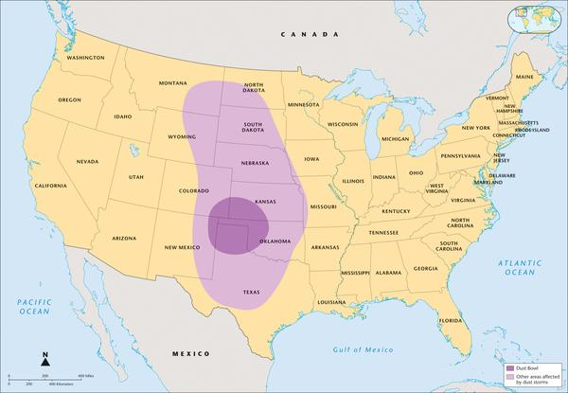
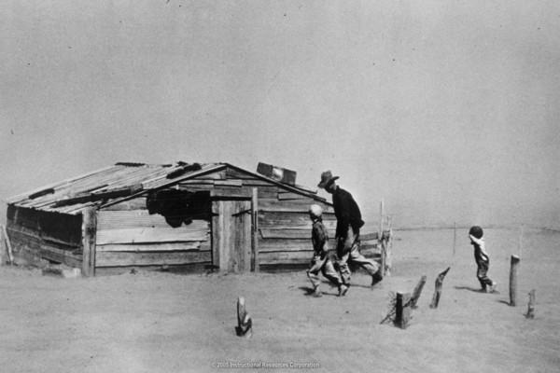
Dust Bowl
The dust storms could not have hit farmers in the Great Plains at a worse time. These people were already dealing with low prices for farm products and the additional hardships of the Depression. The Dust Bowl made conditions worse. The plight of the Okies became the subject of songs and literature and remains a symbol of the Great Depression today. However, the Plains were not the only place where farmers faced difficulties. In the South, many people lost their farms, especially African Americans.

Slide 5
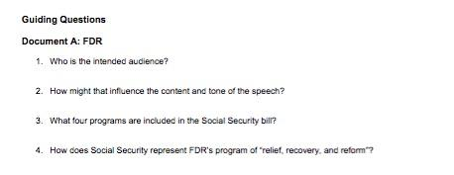
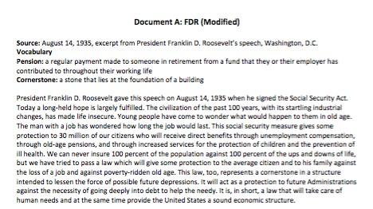
Whole Group - Document A

Slide 6
Teamwork - Document B

Slide 7
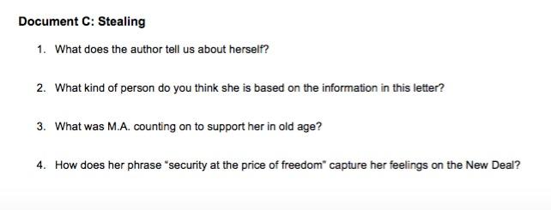
Independent - Doc C

Slide 8
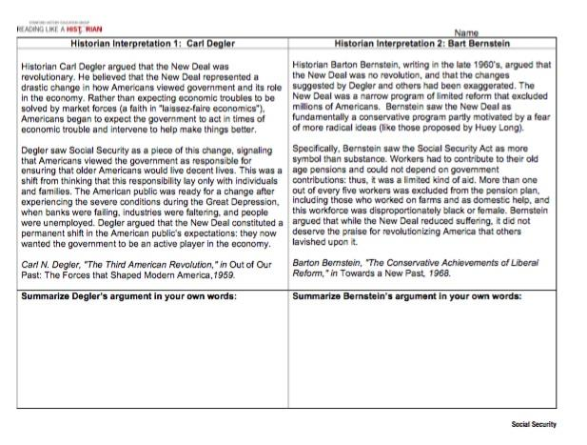
Homework:

