Slide 1
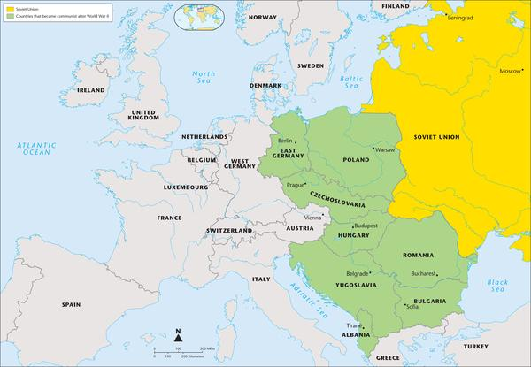
The Cold War 1947 -1991
LEQ: How did tensions grow between the United States and the Soviet Union?

Slide 2
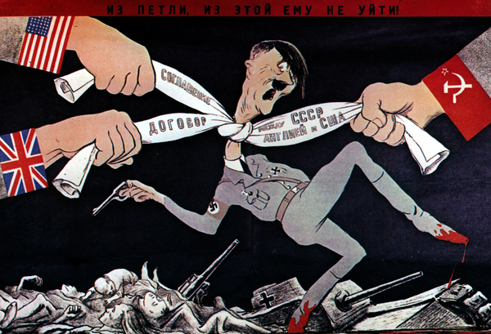
LEQ: How did tensions grow between the United States and the Soviet Union?
Directions: On your worksheet answer the following questions.
1.) In what ways did the Allies work together in World War II?
2.) What disagreements or conflicts did the Allies have with one another?
https://app.discoveryeducation.com/techbook2:concept/view/guidConceptId/185BB9FF-DB19-4A7E-9571-EC0DF3A39B5F/guidUnitId/47FA59F5-F932-4416-8E3F-DF0CFDC70C9A#/tab=engage-tab&page=1&subTab=

Slide 3
Cold War Background
United States and Soviet Union were allies during World War II, but their different economic systems and interests created an intense rivalry. As World War II ended, these two new superpowers began to compete for power and influence in the world.
The Cold War was a decades-long conflict between the United States and the Soviet Union. During the Cold War, both superpowers competed to expand their influence throughout the rest of the world. It was called a “cold” war because the two countries did not fight each other on a battlefield or attack each other with nuclear missiles. They fought in other ways.
For example, both countries spied on each other. They spent massive amounts of money to build their military capabilities. They used threats, offered rewards, and competed economically.

Slide 4
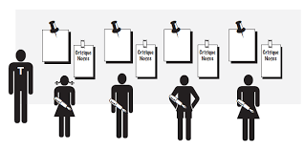
Stations
Directions: Located around the room are seven stations. You will go to each station and complete the guided questions for each station.

Slide 5
Summary
What was the rationale for forming the United Nations? Give two examples from the stations in your writing response.

