Slide 1
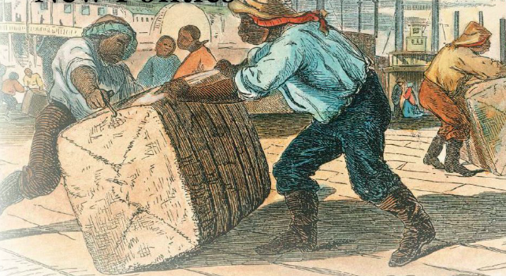
New Industries, New Politics Years: 1815-1829 Chapter 9 LEQ: Explain the role of cotton in transforming the land and lives of people in the United States? LEQ: What technology helped to create a new market economy in the United States?

Slide 2
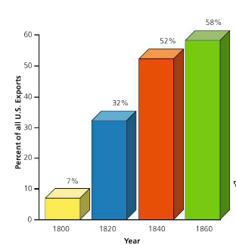
The Cotton Boom
The rapid growth of cotton production changed the lives of Americans physically, commercial, and politically. The value of cotton increases as well as the demand. Therefore, slaves on expanding cotton plantations faced fatiguing labor. This new cotton based economy made slaves much more valuable.
The Cotton Boom started with Europeans preferring cotton to wool or linen. The East India Company could not produce enough cotton to meet European’s growing demand. The “Flying Shuttle” was an invention by John Kay in 1733 that made weaving cloth much faster and allowed a single weaver to handle a loom. The spinning jenny and water frame soon followed making the production of cotton much easier and faster.
The Cotton Gin designed by Eli Whitney in 1793 allowed for the inexpensive processing and cleaning of cotton. It could clean 50 pounds of cotton a day, a slave could clean around one pound a day by hand. This leads him to the idea of interchangeable parts.

Slide 3
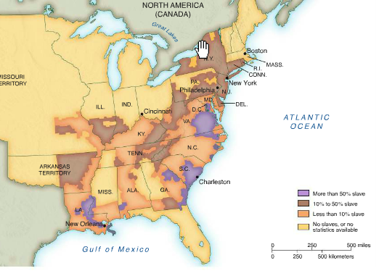
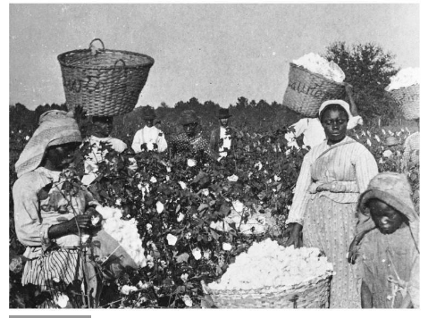
The Land of Cotton
The Black Belt region from Georgia to Louisiana was named for its rich black soil. This soil was perfect from growing cotton. The Federal government began legal sales of the land and sold 2.5 million acres at $2 per acre. This income helped the federal budget, maintained an army to protect the new lands, and built a road to expand father into the region.
This expansion west forced over 1 million black Americans from their homes onto cotton growing lands. Slavery dwindled in the north and more slaves were sold to interior states, losing family and connections to their birthplaces.
Slaves between 14 and 35 where often sold for a higher price and women were often sold so they could bear more children. Salves often rebelled and slave trading became a dangerous business.

Slide 4
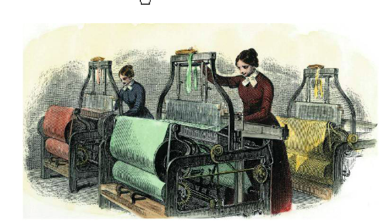
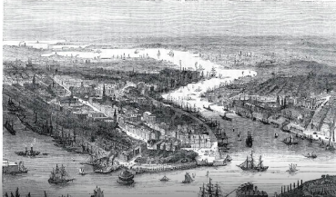
Lowell Mills
American Francis Lowell spent 2 years in British mills memorizing the technology and skills. He brought this to the Massachusetts and created the Lowell Mills. These mills also used the idea of multi-shareholders. Multiple individuals would invest and raise money faster that one individual.
As men headed West there was a surplus of women in New England. The idea of earning their own money appealed to many young women and farm life was tough. The Lowell Mills were clean and included boarding houses with educational and religious activities. The work was long, hard, and the conditions were harsh.
New York City becomes the center of shipment of cotton across the Atlantic. The deep-water harbor benefited ships docking directly in Manhattan and not needing to use smaller boats to transport the goods. Most of the South’s cotton was shipped North to New York and then reshipped. The experienced workers handled hundreds of boats a day.

Slide 5
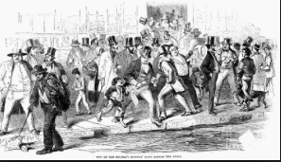
Panic of 1819
In 1819 the massive growth in the United States came to a stop. Europe was growing more food, less imports from the Americas were being brought in, and the value of cotton fell from 32.5 cents a pound to 14 cents a pound.
The Bank of the United States protected itself by limiting credit and calling in loans. State banks followed and farmers and investors could not pay their debts. Small business failed, farms were foreclosed, and thousands lost their jobs. This led to a wide-spread depression and Americans worried about the future of cotton.

Slide 6
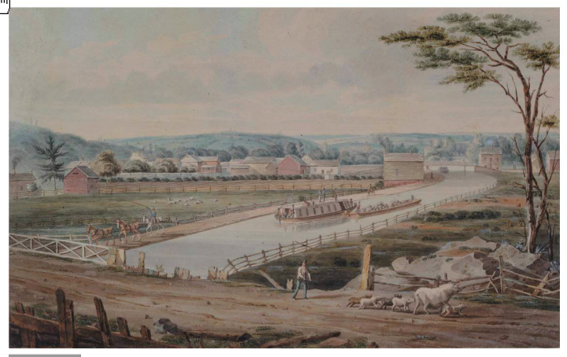
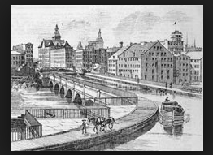
Transportation and Technology
Many New Yorkers wanted an easy way to transport across the state. Governor DeWitt Clinton proposed building a canal using state funds over an old Mohawk Indian trading route. This man made Erie canal, also known as “Clinton’s Ditch”, was completed in 1825 and lined the Hudson River to the Great Lakes. This allowed farmers a new route and created a global economic system of trade.
Steamboats and Railroads increased travel and trade time. Steamboats could travel against the current, unlike before and railroads could move goods to locations not near the waterways.

Slide 8
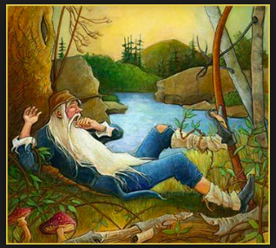
Banks, Corporation, and Finance
By 1815, the US had 200 state-chartered banks. These banks printed bank notes that were backed by the bank’s gold and silver deposits and made loans and collected interest. A corporation had limited liability for individual stock holders and had freedom from having its charter withdrawn or altered by the government.
In 1819 Washington Irving published the story “Rip Van Winkle”. A young man takes a nap and wakes up 20 years later to see everything has changed. No more King, political parties had emerged, and a busy tone was present. This story represented many Americans and how culture had so quickly changed in the early 1800’s.
The Era of Good Feeling from 1817 to 1823 saw the decline of the Federalists and a growth in the Democratic-Republicans to have a spirit of nonpartisan harmony.

Slide 9
McCullough v. Maryland 1819
Congress had chartered the Second Bank of the US at the end of the War of 1812 to stabilize the nation’s finances. The state of Maryland imposed a tax on the bank as a way to drive it out of business, it was not popular with the farmers.
Congress had the right to charter a bank, “Necessary and Proper”, if it thought it was in the national interest, despite the 10th amendment that says states have the power if not specifically stated by the national government.
States could not interfere with the workings of the federal government.

Slide 10
Court Cases
In Gibbons v. Ogden (1824) the court ruled that the state of New York did not have a right to give Ogden, a partner of Robert Fulton, a monopoly to ferry services in NY Harbor. This harbor had inter state commerce, which Congress would control.
Worcester v. Georgia (1832) the court ruled that the state of Georgia could not regulate private dealings by citizens within the territory controlled by the Cherokee tribes, they were subject only to the federal government. “Strengthen government at the expense of the people”
The Tallmadge Amendment in 1819 prohibited the introduction of new slaves into the state of Missouri and gradually free those who were already there. This created a huge crisis in which southern representatives and senators attacked Tallmadge.

Slide 11
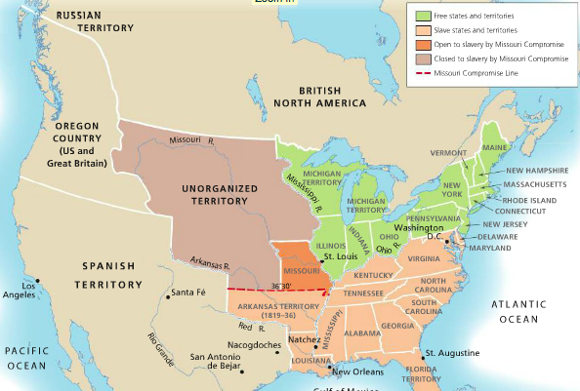
Missouri Compromise
In 1820 Congress compromised and admitted Missouri to the Union as a slave state and Maine as a free state as well as prohibited slavery in the rest of the Louisiana Purchase territory. This eased tensions between the states keeping it equal, but nothing was solved for the future.

Slide 12
Andrew Jackson & the Election of 1828
Andrew Jackson was an unlikely candidate for president, as he had never served in a cabinet or represented the nation abroad. He was the hero of the Battle of New Orleans and in 1820 the military was not a popular institution. He was nominated by the Tennessee legislature to block Crawford. The broad white male population backed up Jackson and they wanted a say in the president more than a voice from a few members of the social elite. Jackson won the popular vote, but did not secure the 131 electoral votes needed.
Adams was chosen by the House or Representative to be the next president. 5 days after the vote Adams appointed Clay, the previous presidential candidate, to be his secretary of state in a corrupt bargain.
Secretary of State Clay creates the American System, where the government pays for improvement on roads and canals to foster the economic growth ad protect domestic manufacturers from foreign competition.

Slide 13
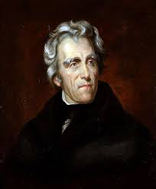
Andrew Jackson & the Election of 1828
Jackson runs for president again in 1828 and the “Jackson Men” also known as the Democratic-Republicans, controlled Congress. The Whig Party was created to advocate for a strong central government in the economy and supported Clay. Jacksonians dropped the “republicans” and the Democratic party is born for the common man and to be left alone by centralized government.
57.5 Percent of all voters actually voted and the popular vote nearly tripled from 1824. Campaigning takes on a new role with election materials like buttons, mugs, and posters. Jackson wins 56 percent of the popular vote and 178 electoral votes.

