Slide 1
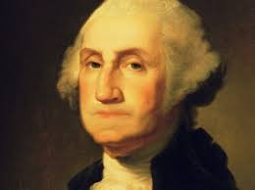
Unit #2 - A New Birth of Freedom
Chapter 7– Day #1
LEQ: What precedents did George Washington establish as the first president on the United States?
Homework:
Chapter 7 Reading Guide – Due Friday

Slide 2
First President of the United States
Directions: Take two minutes and explain to your partner what a precedent is. The class will then discuss how the first several Presidents might serve as a precedent for later Presidents.
George Washington, the commander of the Continental Army during the Revolutionary War, is unanimously elected the first president of the United States by all 69 presidential electors who cast their votes in 1789. John Adams of Massachusetts, who received 34 votes, was elected vice president.

Slide 3
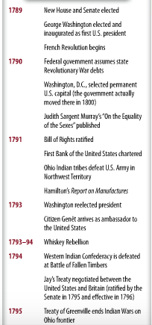

Slide 4
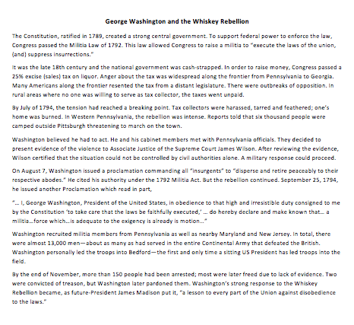

Slide 6
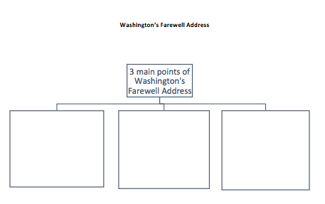
https://www.youtube.com/watch?v=gtlNf3DmbM4

Slide 7
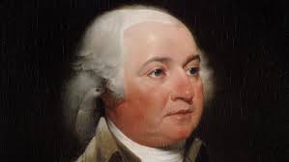
Unit #2 - A New Birth of Freedom
Chapter 7 – Day #2
LEQ: How did the events of John Adams effect the future of the United States?
Homework:
Chapter 7 Reading Guide – Due Friday

Slide 8
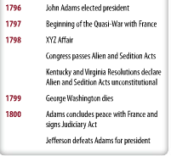

Slide 9
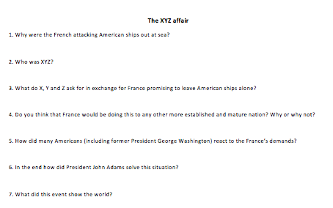
https://www.youtube.com/watch?v=uw0KcA59_8s&t=50s

Slide 10
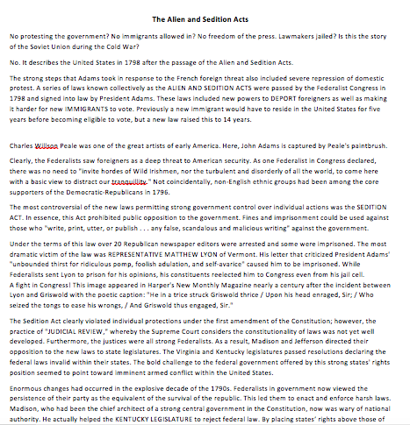

Slide 11
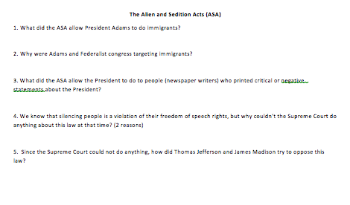

Slide 12
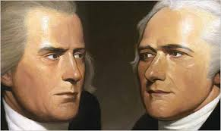
Unit #2 - A New Birth of Freedom
Chapter 7 – Day #3
LEQ: Early Release
What were Jefferson’s and Hamilton’s view on the economic status of the United States?
Homework:
Chapter 7 Reading Guide – Due Friday!
Writing Thesis Statement

Slide 13
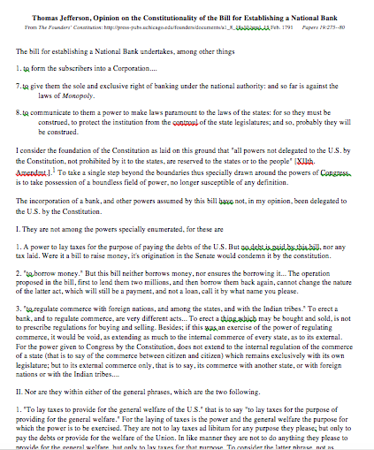

Slide 14
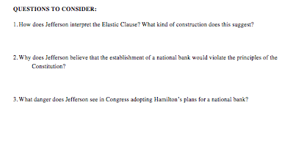

Slide 15
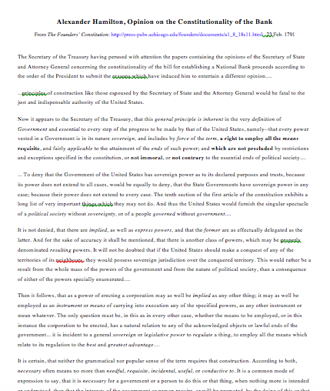

Slide 17
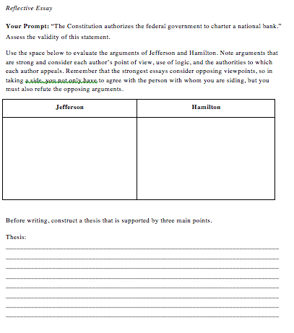

Slide 18
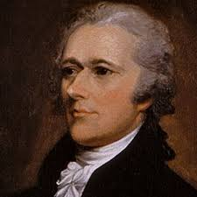
Unit #2 - A New Birth of Freedom
Chapter 7 – Day #4
LEQ: How can I review Chapter 7 content using a class discussion?
Homework:
Chapter 7 Reading Guide – Due tomorrow!

Slide 19
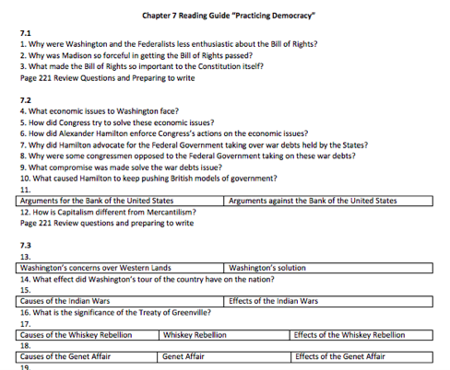

Slide 20
Chapter Verbal Quiz
Directions: Students will take out their Chapter 7 reading guides. The teacher will cold call on students as they go through the review, or use volunteers. If a student answers correctly they receive one point, students need 3 points for the class to receive full 100 % participation. Two points is an 80%, one point is a 70%, and no points is a 50%.
You should be writing down the answers as we go through them! This will be handed in at the end of class! Chapter guides are due every Friday!

Slide 21
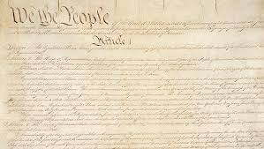
Unit #2 - A New Birth of Freedom
Chapter 7 – Day #5 - Constitution Day
LEQ: How does the US Constitution apply to our lives today?
Homework:
Chapter 7 Reading Guide – Due today
Unit #2 Review Guide Due next Friday

Slide 22
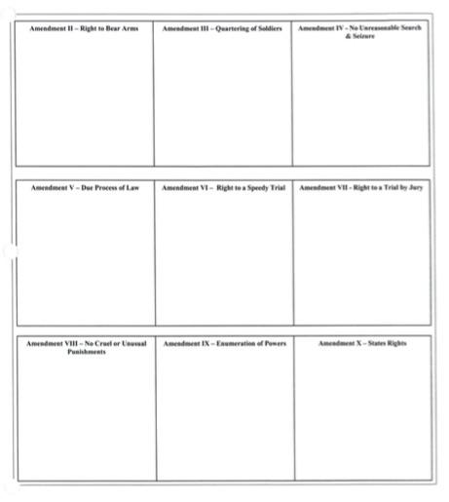
Gallery Walk
Direction: Around the room are the first ten amendments, the Bill of Rights. Visit each one at your own pace. Draw a picture and write down the right provided by the amendment.

Slide 23
How does the Constitution limit the Federal Government?
Directions:
On a whiteboard generate a list of ways the Constitution limits the federal government.
We will then create a master list on the board while discussing each item.

Slide 24
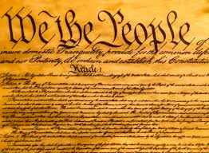
Written Response
Directions: In your journal write a paragraph explaining how the Constitution applies to your life today. Include at least two amendment in your response.

Slide 25
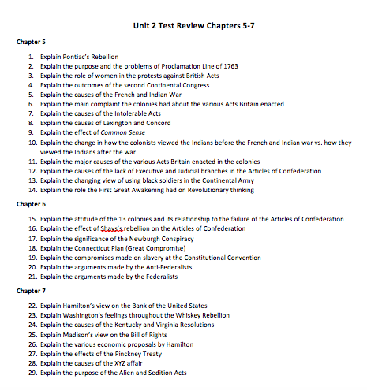
Unit #2 Review Guide

