Slide 1
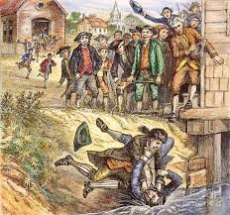
Unit #2 - A New Birth of Freedom
Chapter 6 – Day #1
LEQ: How revolutionary was the Revolutionary War?
DBQ Rubric and background Info
Homework:
Chapter 6 Reading Guide – Due Friday

Slide 2
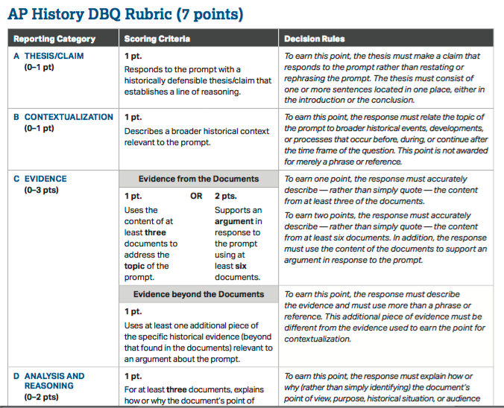

Slide 3
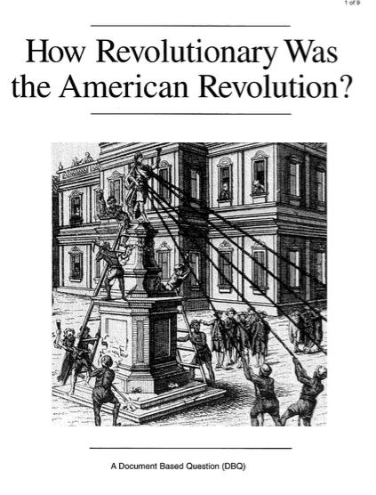

Slide 4
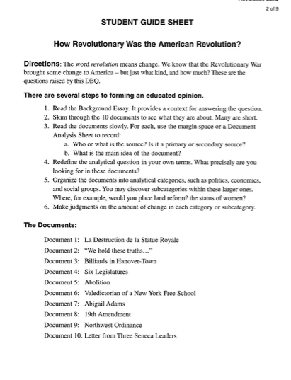

Slide 5
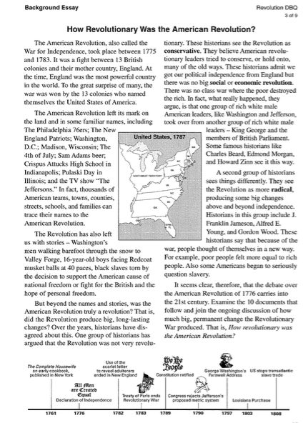

Slide 6
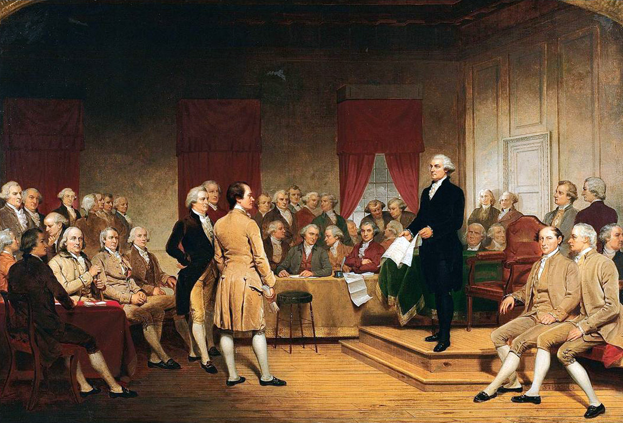
Unit #2 - A New Birth of Freedom
Chapter 6 – Day #2
LEQ: How revolutionary was the Revolutionary War?
Documents and Organization
Homework:
Chapter 6 Reading Guide – Due Friday

Slide 7
How Revolutionary was the Revolutionary War?
Was Revolutionary | Was Not Revolutionary

Slide 8
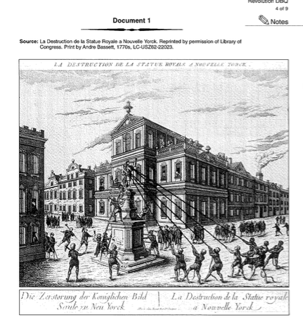

Slide 9
How Revolutionary was the Revolutionary War?
Was Revolutionary | Was Not Revolutionary

Slide 10
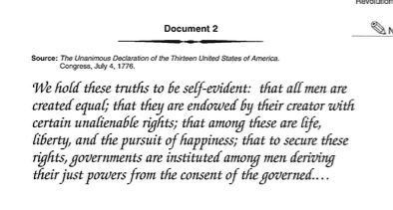

Slide 11
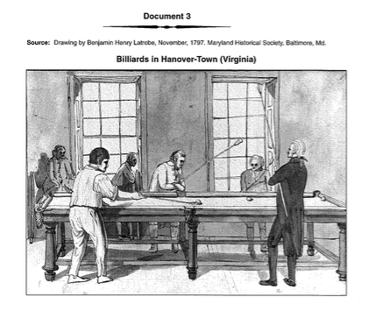

Slide 12
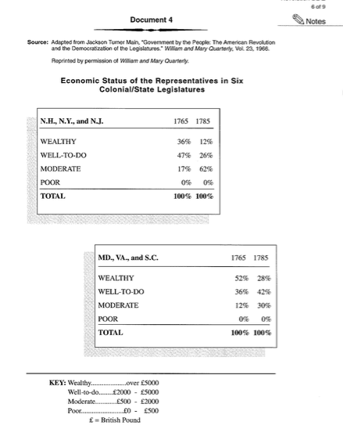

Slide 13
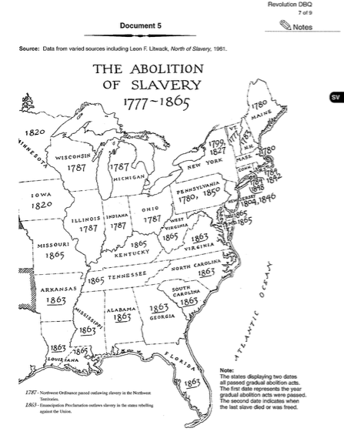

Slide 14
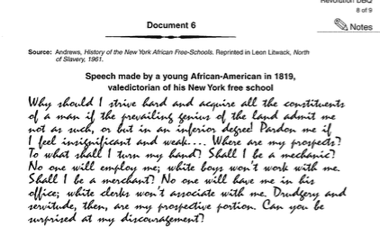

Slide 15
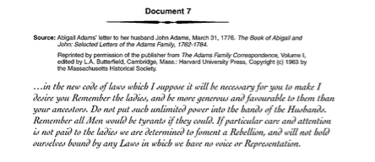

Slide 17
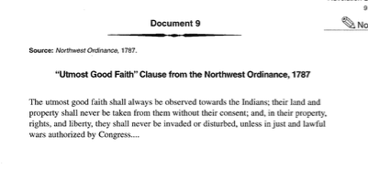

Slide 19
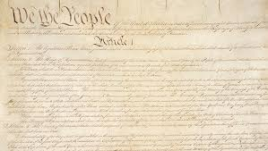
Unit #2 - A New Birth of Freedom
Chapter 6 – Day #3
LEQ: How revolutionary was the Revolutionary War?
Thesis statement & Writing the Essay
Homework:
Chapter 6 Reading Guide – Due Tomorrow!

Slide 20
Brainstorm how to organize / write your essay

Slide 21
Unit #2 - A New Birth of Freedom
Chapter 6 – Day #4
LEQ: How revolutionary was the Revolutionary War?
Homework:
Chapter 7 Reading Guide

Slide 22
Chapter Verbal Quiz
Directions: Students will take out their Chapter 6 reading guides. The teacher will cold call on students as they go through the review, or use volunteers. If a student answers correctly they receive one point, students need 3 points for the class to receive full 100 % participation. Two points is an 80%, one point is a 70%, and no points is a 50%.
You should be writing down the answers as we go through them! This will be handed in at the end of class! Chapter guides are due every Friday!

Slide 23
