Slide 1
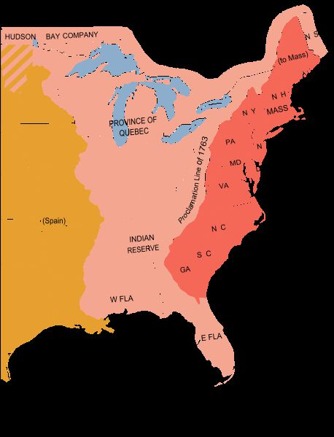
Unit #2 - A New Birth of Freedom
Chapter 5 – Day #1
LEQ: What put Britain and the colonies on a path to Revolution?
Homework:
Chapter 5 Reading Guide – Due Friday

Slide 2
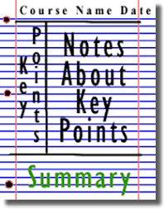
Directions: Students will use Cornell Notes to complete the following note headings; Fort Dusqense, Pontiac’s Rebellion, Proclamation of 1763, and Paxton Boys.

Slide 3
Causes of the French and Indian War
The colonies had been in the middle of a series of wars between the British and French fought with the Indians in the frontier
In 1754 a Young George Washington was sent to attack a French fort along the Ohio River which the French considered trespassing
Washington and some Indian allies easily took the small fort only to have a larger French and Indian force attack back and force them to surrender
These two events led to a World War that would begin the colonies’ desire for independence only 20 years later

Slide 4
The French and Indian War
War had already broken out in much of Europe, and spilled into Asia and Africa before ultimately reaching North America
While most of the fighting happened in the Caribbean, The most significant battles would happen between the colonies of Britain and France
The British were able to gain advantage by turning some Indian tribes by promising the land west of the Appalachian Mountains.
The most significant battle saw the British capture Quebec, ending Frances control of Canada

Slide 5
Effects of the French and Indian War
Everyone involved came out of the war deeply in debt, although little land in Europe changed hands
However, in North America France gave Canada and lands east of the Mississippi River to Britain and lands west to Spain
Without the need for Indian allies, the British colonists began ignoring Indian claims and taking land for their own
An Indian chief named Pontiac led several rebellions and attacked British forts, but the British soldiers were too strong and Pontiac had to initiate peace
To pay off the debt of this expensive war, the British believed the colonists need to pay taxes to cover their share

Slide 6
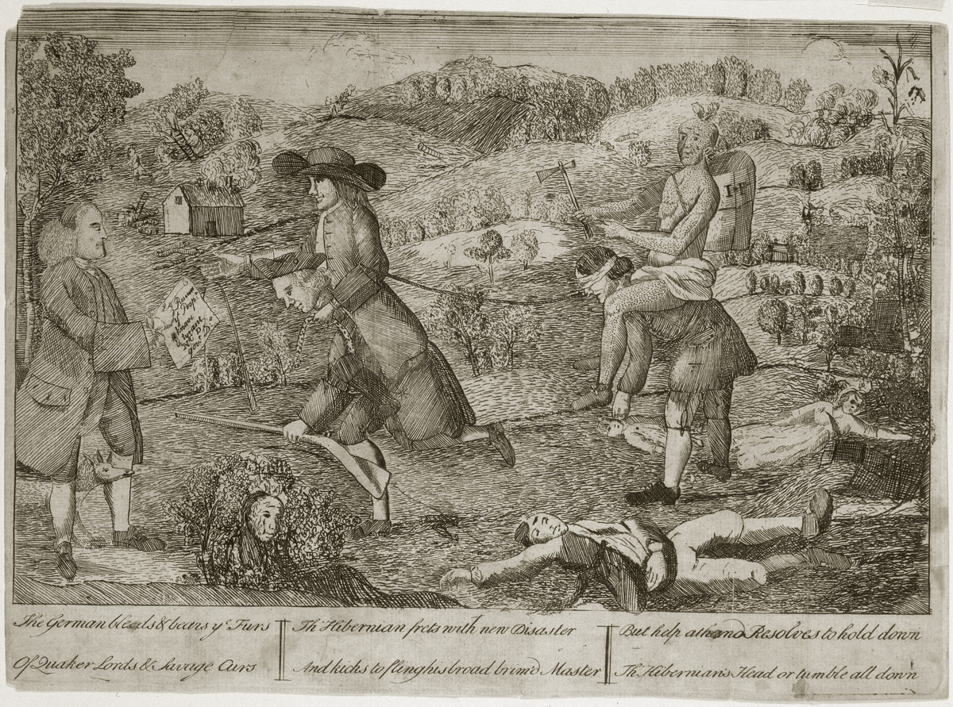
The Proclamation Line of 1763
The new King, George III, wanted to avoid costly conflicts wit the Indians so he issued the Proclamation of 1763
The Proclamation angered many colonists as they were no longer allowed to settle west of the Appalachian Mountains and anyone who already had settled had to leave
Many colonists ignored the order and crossed the Mountains anyway and some , like the Paxton Boys, believed the only way to solve this conflict was to kill the Indians
This led many colonists to view all Indians as one enemy tribe, inspite of historical evidence to the contrary
This political cartoon by James Claypoole shows a Native American and a Quaker riding on the backs of rural residents while children lie dead and farmhouses burn in the background. This image reflected the opinion of people who thought the Philadelphia Quakers allowed rural residents to suffer and remain unprotected from the threat of Native Americans. Benjamin Franklin is in the left side of the image, holding a proclamation against the Paxton Boys.

Slide 7
Summary
How will Britain’s more hands on approach affect their relationship with the colonies moving forward?

Slide 8
Page 135

Slide 9
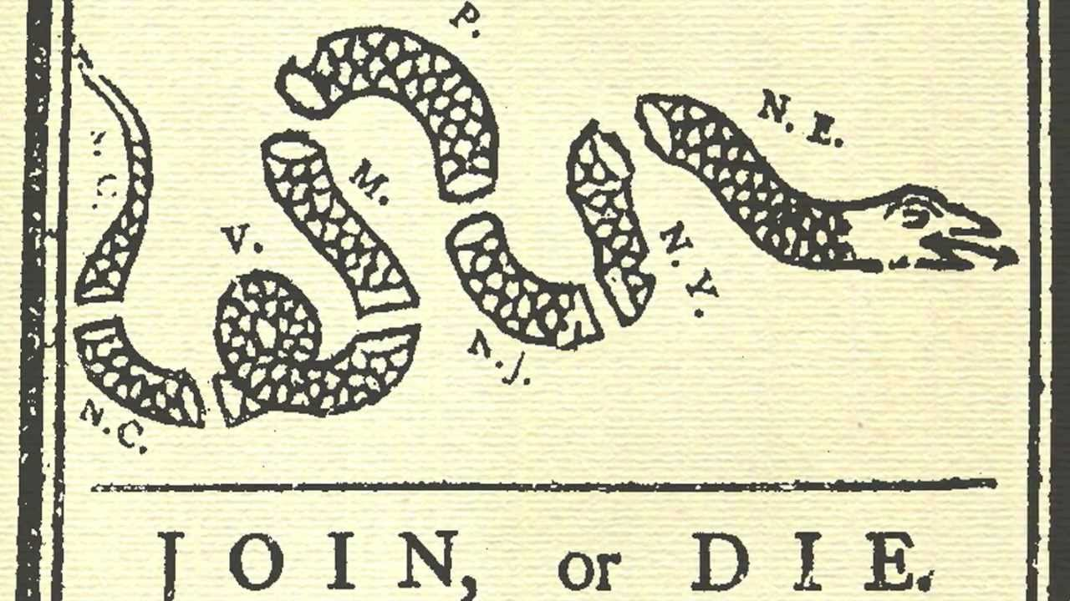
Unit #2 - A New Birth of Freedom
Chapter 5 – Day #2
LEQ: How did support for the patriot cause spread so quickly among many different groups ?
Homework:
Summary - Could the American Revolution have been avoided?
Chapter 5 Reading Guide – Due Friday

Slide 10
Whiteboard Brainstorming
Directions: Using a whiteboard, work with your table to create a list of what the main reasons for issues between the colonists and British were.

Slide 11
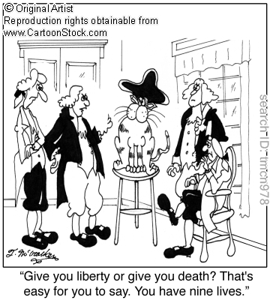
Whole Class Brainstorming
Directions: What the main reasons for issues between the colonists & British?

Slide 12
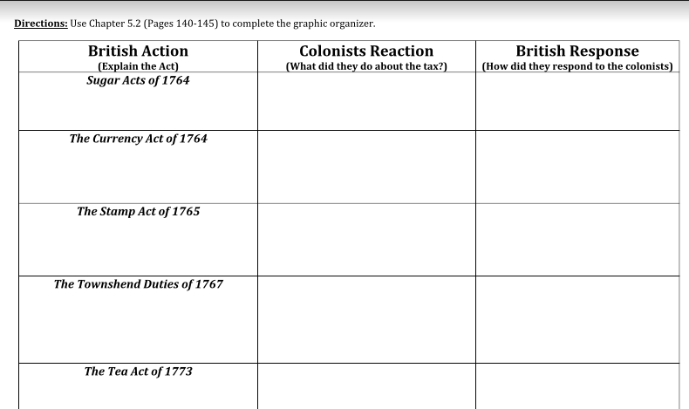
Directions: Students will then read through 5.2 with their table partner. Students will find evidence to fill in the table. Use quotes and the page number!

Slide 13
Written Summary
Directions: Using several sentences and two pieces of evidence from the text answer the following question.
Could the American Revolution have been avoided?

Slide 14
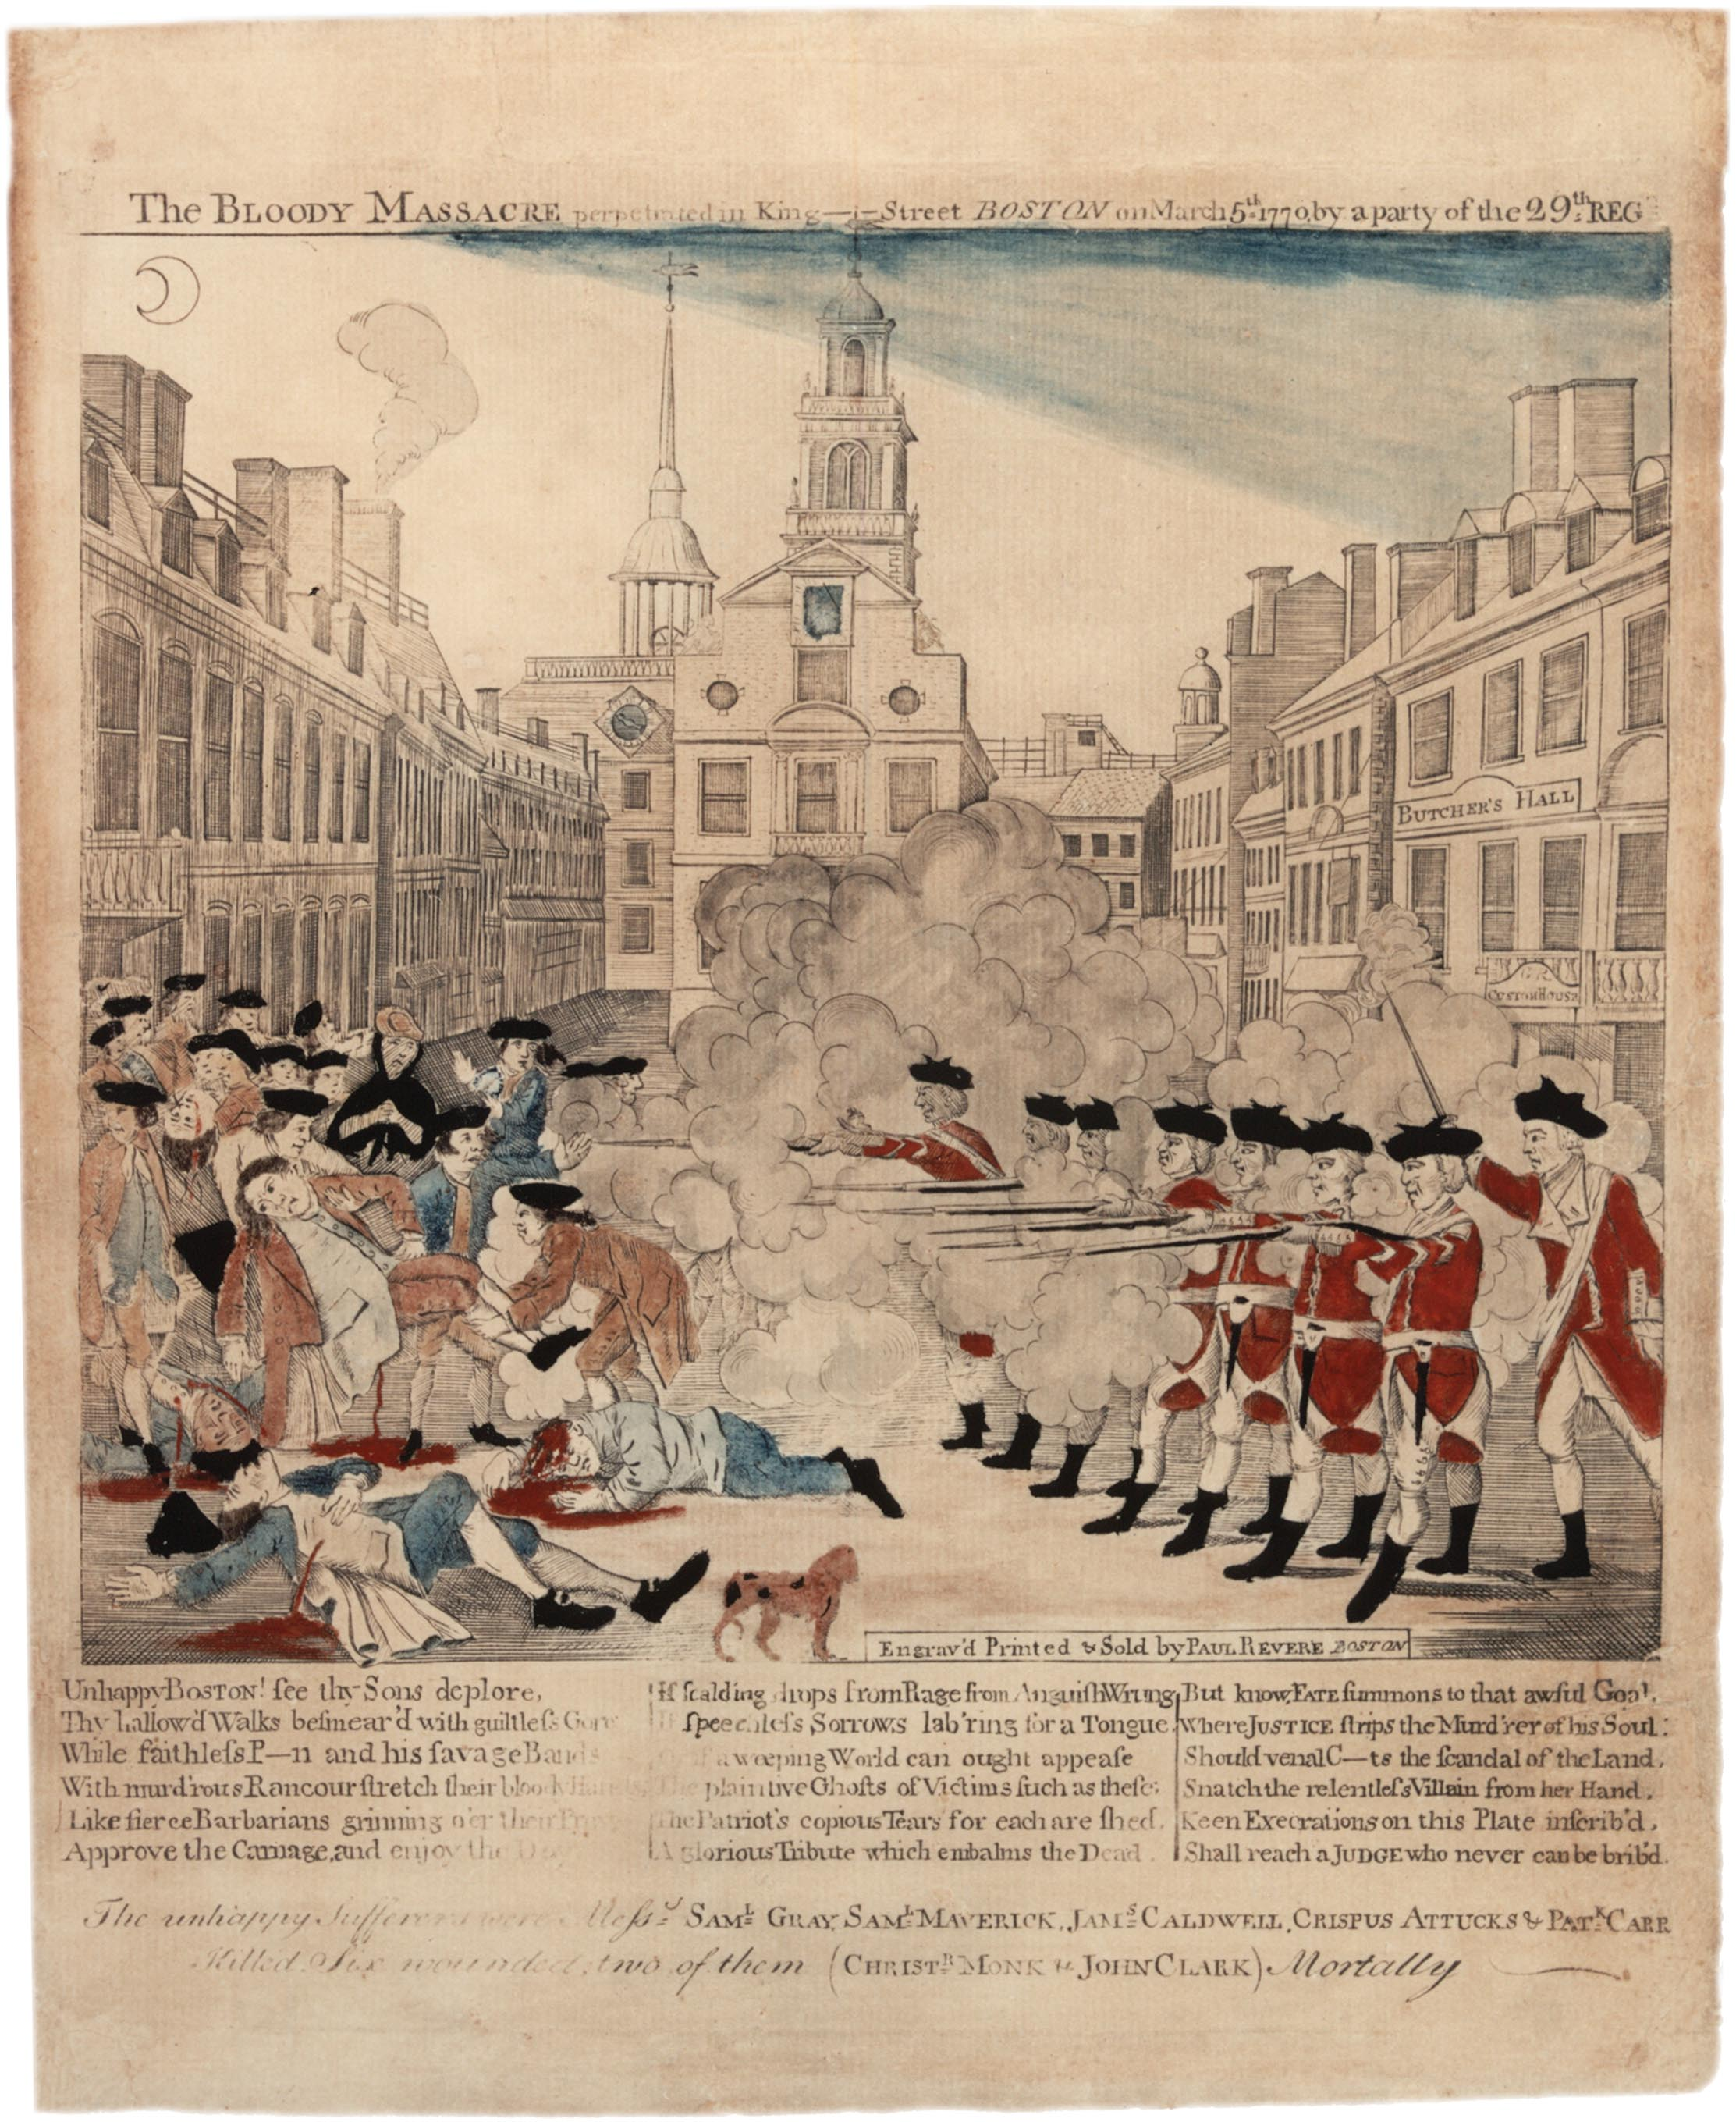
Unit #2 - A New Birth of Freedom
Chapter 5 – Day #3
LEQ: How did support for the patriot cause spread so quickly among many different groups ?
Homework:
Ticket out the Door
Chapter 5 Reading Guide – Due Friday

Slide 15
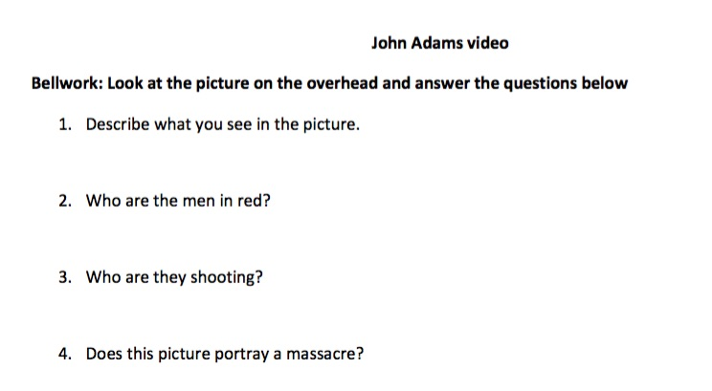

Slide 17
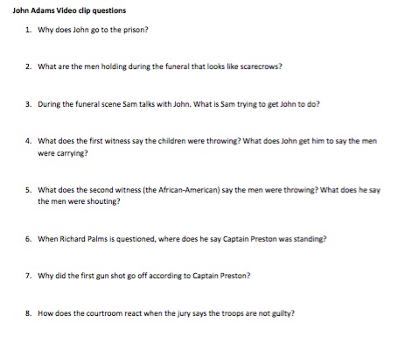

Slide 18
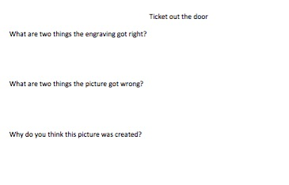

Slide 19
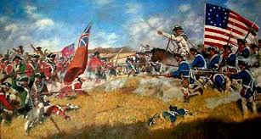
Unit #2 - A New Birth of Freedom
Chapter 5 – Day #4
LEQ: How did military strategy support the patriot cause that led to an American victory in the war for independence?
Homework:
Battle Graphic Organizers
Chapter 5 Reading Guide – Due Tomorrow at the end of class!

Slide 20
Bell work
Directions: Write out the complete question and your answer in your notebook or lined paper. We will discuss as a class the correct response.

Slide 21
Jigsaw
Directions: Students will be counted off by fives. The numbers will then go to their assigned corner and work with their new group to complete their graphic organizer. Students will have 15 minutes to work with their group. Then students will need to come back to share out with the class.
#1 – Lexington and Concord
#2 – Bunker Hill
#3 – Long Island / Mahattan
#4 – Saratoga
#5 - Yorktown

Slide 22
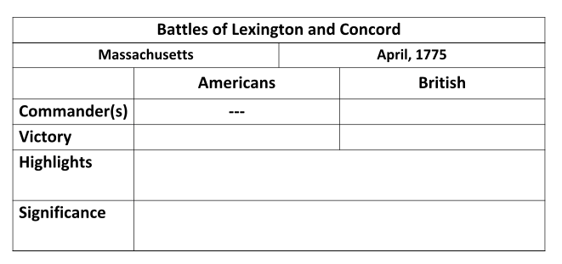
#1

Slide 23
#2

Slide 24
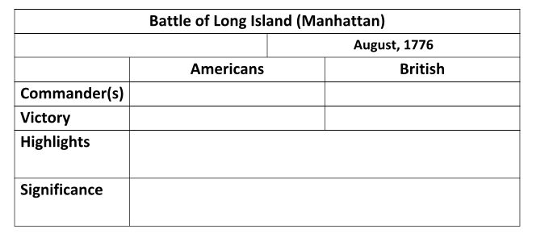
#3

Slide 25
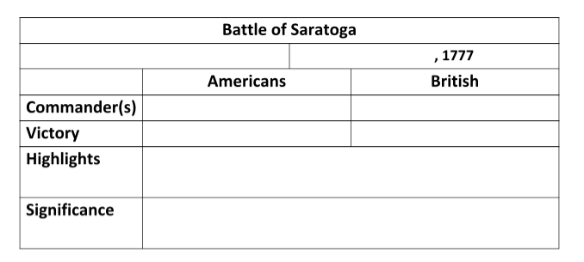
#4

Slide 26
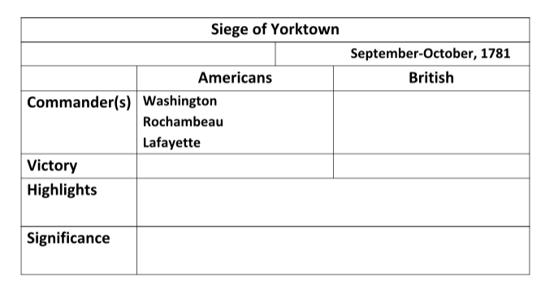
#5

Slide 27
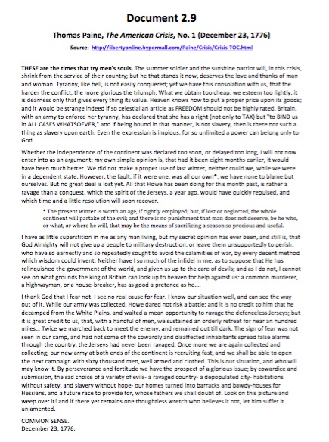
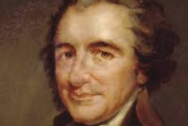
Directions:
Read through the primary source “The American Crisis” by Thomas Paine. Complete a SOAPStone for the document.

Slide 28
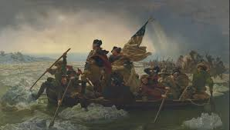
Unit #2 - A New Birth of Freedom
Chapter 5 – Day #5
LEQ: How did Britain’s victory over France in the war of 1754-1763 increase the grievances of many colonists?
Homework: Chapter 6 Study Guide

Slide 29
Chapter Verbal Quiz
Directions: Students will take out their Chapter 5 reading guides. The teacher will cold call on students as they go through the review, or use volunteers. If a student answers correctly they receive one point, students need 3 points for the class to receive full 100 % participation. Two points is an 80%, one point is a 70%, and no points is a 50%.
You should be writing down the answers as we go through them! This will be handed in at the end of class! Chapter guides are due every Friday!

Slide 30
