Slide 1
Chapter 11 Manifest Destiny 1830-1855
The Mexican War and the Pacific Expansion

Slide 2
LEQ: What were the arguments for and against Manifest Destiny ? (11.1)
HW: Chapter 11 reading guide due Next week Wednesday

Slide 3
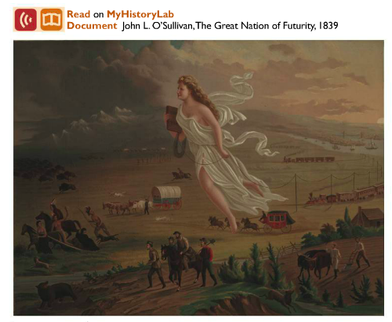
P
O
S
E
S

Slide 4
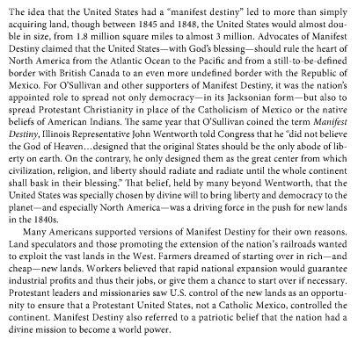
Background Info Page 321-322
As we read the background info highlight the reasons for Manifest Destiny and the reasons against Manifest Destiny.
Green = For Manifest Destiny
Red = Against Manifest Destiny

Slide 5
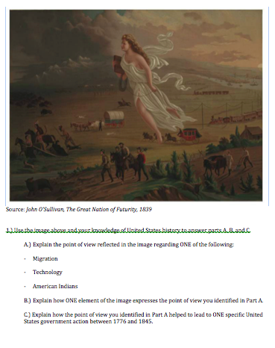
Short Answer Writing

Slide 6
LEQ: Was the United States justified in going to war with Mexico?
HW: Chapter 11 reading guide due Next week Wednesday

Slide 7
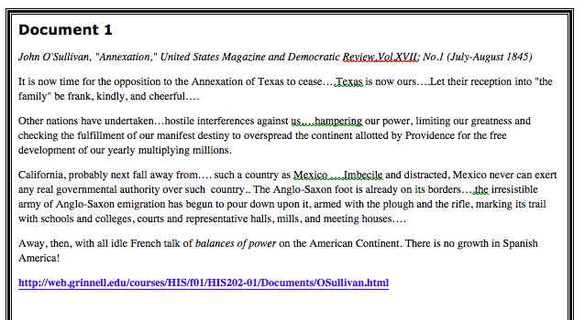
DBQ Documents - SOAPStone

Slide 8
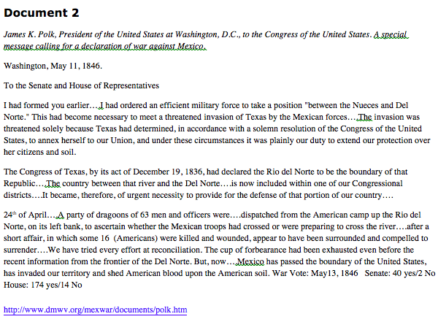

Slide 11
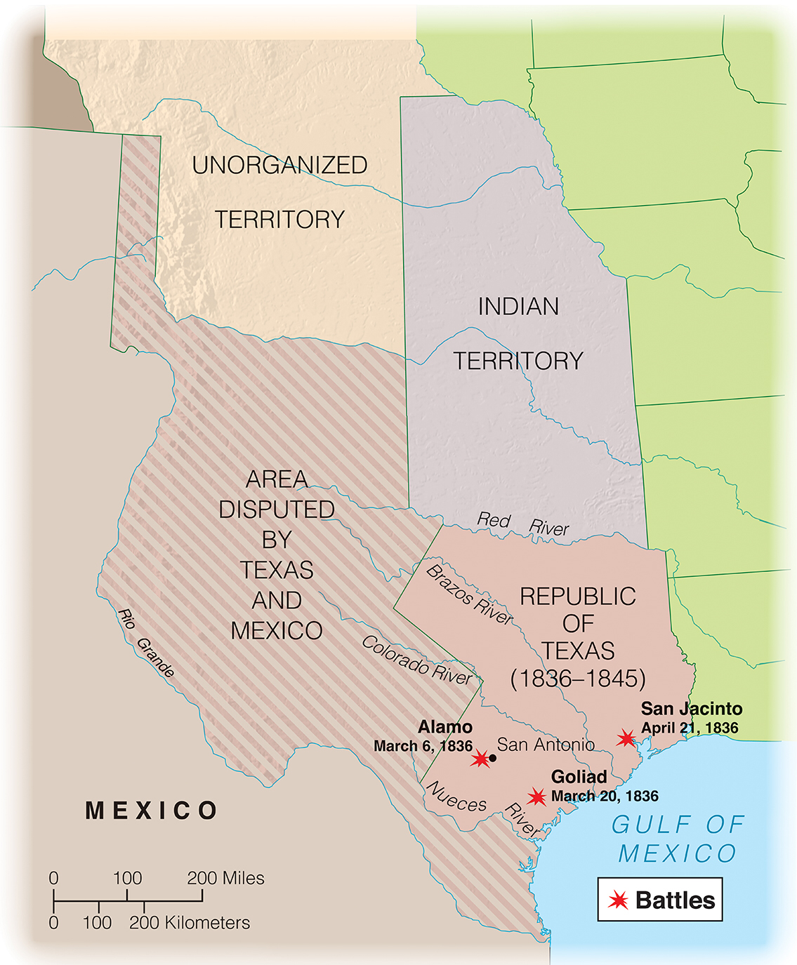
Chapter 11(11.2 and 11.3) The Mexican War
LEQ: What were the cause and effects of the us war with mexico?
HW: Chapter 11 reading guide due tomorrow!

Slide 13
Causes of the war
President Polk wanted not only Texas, but California and New Mexico as well either through purchase or war if necessary
Despite Mexico's warning that annexation means war, the U.S. Annexed Texas, however both sides disagreed on what constituted the boundary
President Polk ordered General Zachary Taylor to the edge of the Rio Grande
Mexican troops crossed the Rio Grande and attacked what they saw as an invading U.S. Force while the U.S. saw this as an act of war on Mexico’s part
President Polk went to congress asking for a declaration of war since, "Mexico has invaded our territory and shed American blood on American soil."

Slide 14
Opposition to the war
Whigs were against the war for a variety of reasons.
Many were against the war because they saw it as an effort to expand slavery
Others felt Polk manufactured the war in an effort to take even more land out west
Henry David Thoreau believed the war was immoral and felt his tax dollars shouldn't go towards something he disagreed with morally
This led others to view civil disobedience as a viable form of protest for generations to come

Slide 15
The War
The war lasted 2 years and was dominated by the U.S.
General Taylor was so successful, Polk began to worry he would become a political threat
Polk halted Taylors advance and sent in General Scott to finish the rest of the war
The war cost the U.S. 12,000 soldiers' lives and $100 million dollars
Mexico lost more lives, including civilians, and their economy was devastated

Slide 16
The Rest of North Mexico
New Mexico was taken over without firing a single shot
California had already seen a U.S. Invasion drum up support for rebellion against Mexico
During the Mexican War, Polk sent General Kearny to secure California and assisting the rebels
After arresting the Mexican governor of California, the rebels declared California independent, known as the Bear Flag Revolt
Later, the U.S. navy would land in California and claim it as conquest of the Mexican War

Slide 17
Peace and Borders
The Treaty of Guadalupe Hidalgo officially brought the war to and end and settled the main boundary disputes
The Texas border would be at the Rio Grande and the U.S.
The U.S. Would also take what would become the Southwest United States from northern Mexico
Later the U.S. Would buy a small sliver of land called the Gadsden Purchase to create a southern railway route around the Rocky Mountains

Slide 18
The Gold Rush
The discovery of gold led people from across the United States and the world flood into California hoping to strike it rich
So much gold was discovered it completely changed the value of the U.S. Economy as well as drastically increased the amount of gold in circulation worldwide
Gold camps were very harsh with widespread violence, especially towards immigrants
Women were generally left out of the gold rush, either being tricked, pushed out, or not making the trek at all

Slide 19
Whaling in the Pacific
Whaling was a tough job but a good source of money that added substantially to the American economy
Whale oil was the best fuel for lamps, the oil that that ran the first industrial revolution, and whale bones were used in corsets and hoop dresses
The sea was one of the few places where diversity was not shunned, although women were generally not allowed.
Whaling vessels led to further exploration of the open ocean and led to more trading routes around the globe

Slide 20
Diplomacy across the Pacific
President Polk had long wanted to gain the California ports which would allow the U.S. to expand into the Pacific and open up trade with Asia
The first stop was Hawaii where missionaries and merchants flooded in, but also brought diseases that killed the native population
While Britain tried opening China to trade, the U.S. concentrated on Japan, both of which had cut themselves off from the rest of the world
The U.S. Signed the Kanagawa Treaty with Japan which opened two ports to the U.S. and would later make inroads into China as well

Slide 21
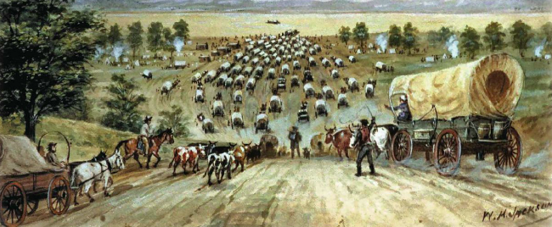
LEQ: How can I apply my knowledge of chapter 11 in a verbal discussion?
HW: Unit #3 Study Guide – tEST ON moNDAY!

Slide 22
Chapter Verbal Quiz
Directions: Students will take out their Chapter 11 reading guides. The teacher will cold call on students as they go through the review, or use volunteers. If a student answers correctly they receive one point, students need 3 points for the class to receive full 100 % participation. Two points is an 80%, one point is a 70%, and no points is a 50%.
You should be writing down the answers as we go through them!

