Slide 1
AP United States History
Mrs. Nykiel
1.) Find the seat with your name on it!!
2.) Attendance by name!
3.) Homework Chapter 1-4
Unit #1
Day #6

Slide 2
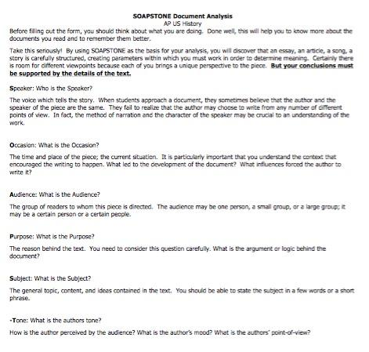
SOAPStone

Slide 3
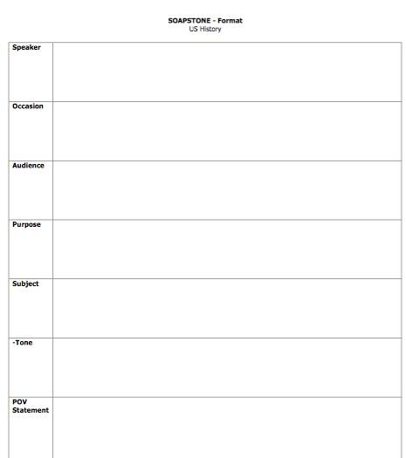
SOAPStone
What can you conclude about indentured servitude and slavery from these docs?

Slide 4
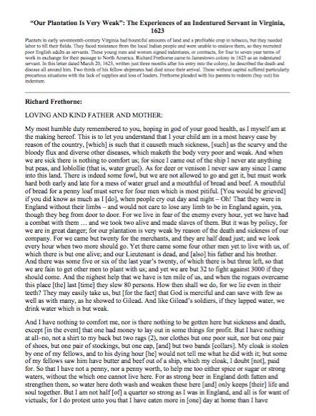
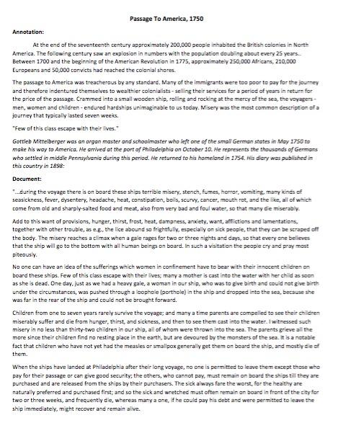
What can you conclude about indentured servitude and slavery from these docs?

Slide 5
Homework
Still working on Chapter reading guides if they are not complete!
Writing: Using your notes now What can you conclude about indentured servitude and slavery from these docs?
(2 pieces of evidence cited correctly)
Check out Website for resources!
www.Mrsnykiel.weebly.com

