Slide 1
Jefferson, Religion, and The Purchase
Notes on 8.1, 8.2, and 8.3

Slide 2
Jefferson and the Republican Ideal
For the first time, the U.S. Presidency changed parties in a peaceful manner and brought in a bigger push for individual liberties
From his first day, Jefferson pushed national unity, a limited government, and more social equality (at least for white males).
The new Republicanism pushed independence, personal freedom, and equality over the pomp and ceremony of the previous administrations
Jefferson did show many contradictions between his personal and presidential life however.

Slide 3
Jefferson the Political Leader
Jefferson began by cutting the size of the government and his concern for a standing army saw him cut the size of the army and navy.
Jefferson kept the tariff on foreign goods but removed all other taxes, which led diplomats to often feel the United States was overly simple
As Adams was leaving office, he appointed many new judges and expanded the federal courts, something Jefferson was completely against.
In his attempt to reduce these federal (and federalist) judges, Jefferson sparked one of the most important supreme court cases.
This is a fake quote!!!

Slide 4
Marbury vs. Madison
Jefferson had decided to repeal the Judiciary Act of 1801 and refuse the judgeships of many of Adams’ appointees, including William Marbury
The case went to the Supreme Court, where Congress and Jefferson dared the court to declare Jefferson’s acts unconstitutional which would cause them to take power away from the courts
Chief Justice Marshall, however, got the right case to give both Jefferson what he wanted while increasing the courts power
His ruling allowed Jefferson to deny the judgeships, but by declaring an earlier congressional act unconstitutional, he asserted the power of Judicial Review

Slide 5
Rural America and the Agrarian Ideal
About 90% of the population lived on a farm of some kind, which helped create political consensus with Jefferson’s ideal nation
More and more people were moving west with little attachment to their property other than what money it could make them
Voting increased to around 80% of white males and an increase in the idea that everyone (white males) was equal regardless of education or wealth
Violence was a huge problem, and often involved alcohol. Politics, race, honor, or family were often reasons to use violence or demand a duel.

Slide 6
Jefferson the Individual
Jefferson’s private life conflicted greatly with his presidential life.
As President he pushed republican ideals of equality, simplicity, and rusticity, but privately he lived a very aristocratic and lavish life.
To make matters worse for Jefferson, a story was published that he had been having an affair with Sally Hemings, one of his slaves.
While Jefferson never admitted to it and it never cost him his office, later DNA testing strongly suggests that Hemings did give birth to 6 children fathered by Jefferson

Slide 7
Separation of Church and State
In a letter to a Connecticut Baptist association, Thomas Jefferson advocated for a wall of separation between Church and State
Most of the country agreed with Jefferson that their beliefs were their own and should not be held against them by the government.
Jefferson was trying to convince 4 New England states to stop forcing a tax on their citizens that benefited only the one church the state advocated for
Over time and as more Democratic Republicans won elections in these states, state sponsored churches were ended

Slide 8
New Religious Expressions
The push for individual freedoms had a profound effect on religious organizations and ideas
This new Religious Fervor became know as the Second Great Awakening and saw a massive increase in church participation and population
Religious revivals in the countryside became incredibly popular. They would sometimes last days and have preaching go from sunup to sundown
“Many things transpired there, which were so much like miracles, that if they were not, they had the same effect as miracles on infidels and unbelievers”
Barton W. Stone, pastor

Slide 9
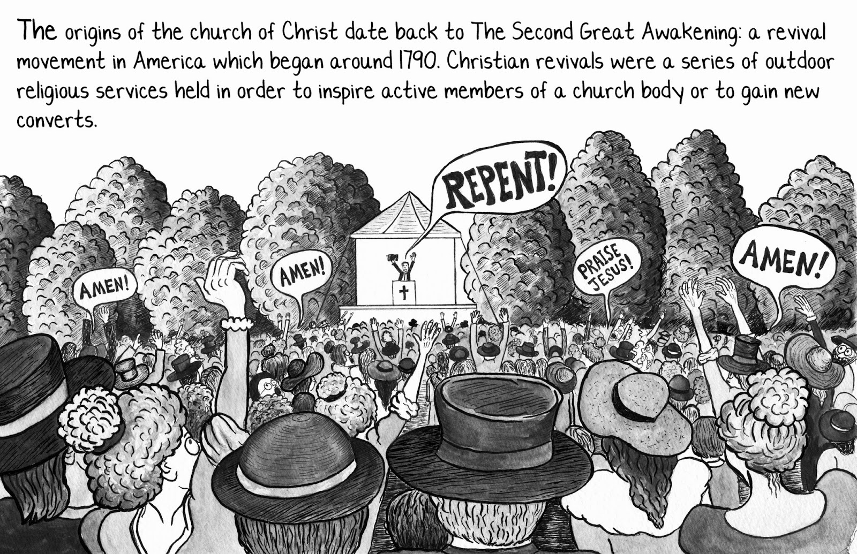
Methodists, Baptists, and other Protestants
The Methodists and Baptists grew the most during this time, which made these two the largest denominations in the United States
Methodism started with John Wesley, whose push for individual freedom appealed to Jeffersonians, and his use of emotion contrasted with other colder denominations
Baptists had been around almost as long as the puritans, however this new group of Baptists were also more emotional than their older counterparts
Methodism was tightly organized with one main head of the church, whereas Baptists were more decentralized, allowing the church to have total control.

Slide 10
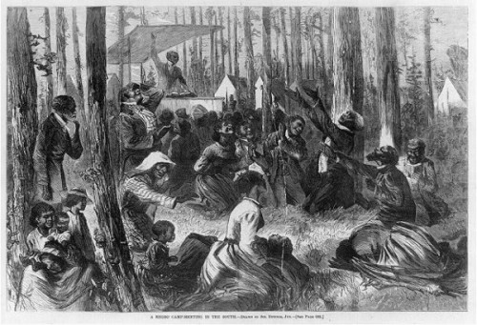
Faith in the Slave quarters, Catholic Churches, and Jewish Synagogues
Religion in slave quarters was an important tool to push community, togetherness, but also ideas of freedom, in spite of slave owners using religion to push obedience
Leaders of slave revolts often sighted the Bible as their inspiration, causing many slave owners to denounce unsupervised meetings amongst slaves
In the North, free black churches began to pop up due to white churches not being very welcoming. These churches would thrive in the north while the south would limit the creation of black churches
Initially Catholics and Jews were limited and restricted in where they could worship, however under Jefferson the push for religious freedom allowed these two groups to grow in strength.

Slide 11
Causes of the Louisiana Purchase
France had negotiated a secret treaty with Spain that gave France the entire Louisiana Territory, including control of the Mississippi River and the port of New Orleans
Jefferson was very concerned as this would potentially interfere with western farmers and trade and give control of American commerce to a European power
Jefferson offered to buy the city of New Orleans from France, which would give the U.S. control of the Mississippi River
France, however, had lost the island of Haiti in a slave revolt so they no longer needed the large Louisiana Territory, thus they offered to sell it to the United States for $15 million dollars

Slide 12
The Lewis and Clark Expedition
Jefferson authorized a scientific expedition led by Lewis and Clark to study the plants, animals, land, and people in the Louisiana Territory
The Lewis and Clark expedition relied on French trappers and Native tribes, the most important of which were Toussaint Charbonneau and Sacagawea
The expedition eventually went past the boundaries of the Louisiana Territory and into Oregon country, where the group almost starved to death before being helped by the Nez Perce
The expedition was a huge success and would inspire more explorers, like Zebulon Pike, which would unfortunately have a negative effect of the Natives that helped make this possible

